Slide 1
Deep Learning for Natural Language Processing DLNLP 16: Neural Architectures for NLP Applications
Mihai Surdeanu and Marco A. Valenzuela-Escárcega

Slide 2
Review
Do you know what an LSTM is? And acceptor, transducer, encoder-decoder using RNNs?
Do you know the transformer architecture?

Slide 3
Overview
Text classification
Part-of-speech tagging
Named entity recognition
Dependency parsing
Relation extraction
Question answering
Machine translation
Search

Slide 4
Text classification

Slide 5
Applications
Probably the most common NLP application (before language models took off)
What applications of text classification can you think of?

Slide 6
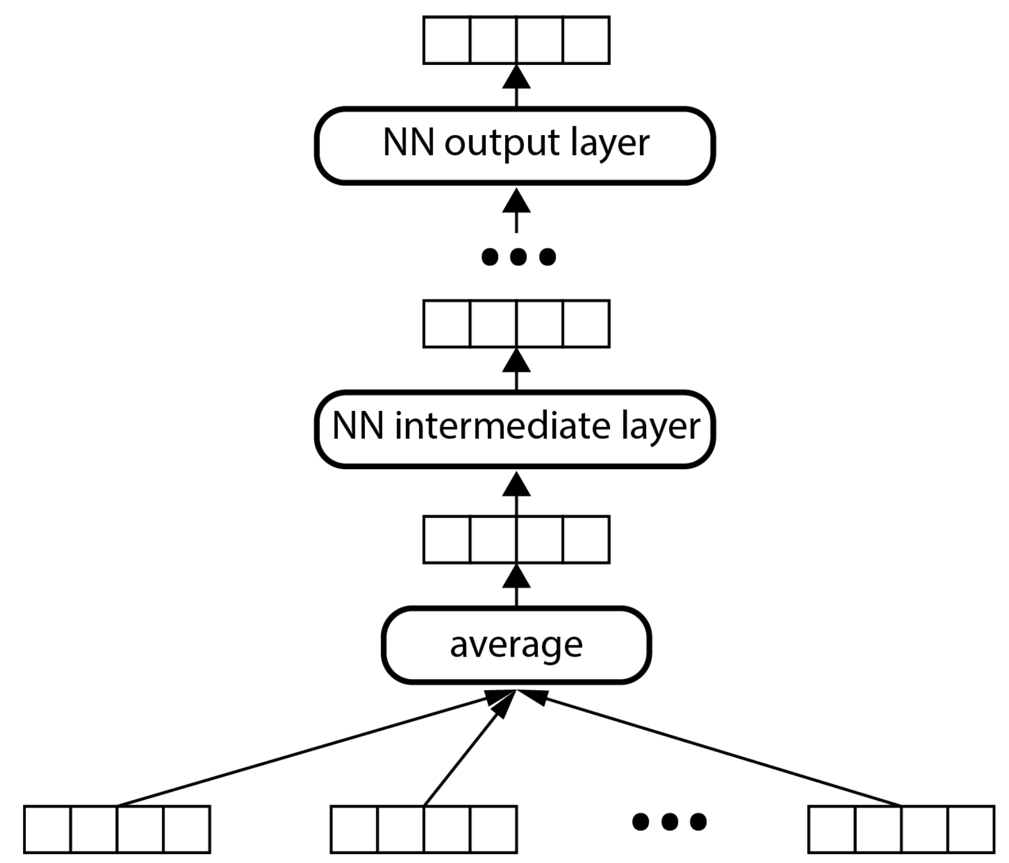
Deep averaging networks (DAN)
Bag of words
Static embeddings
(Iyyer et al., 2015)

Slide 7
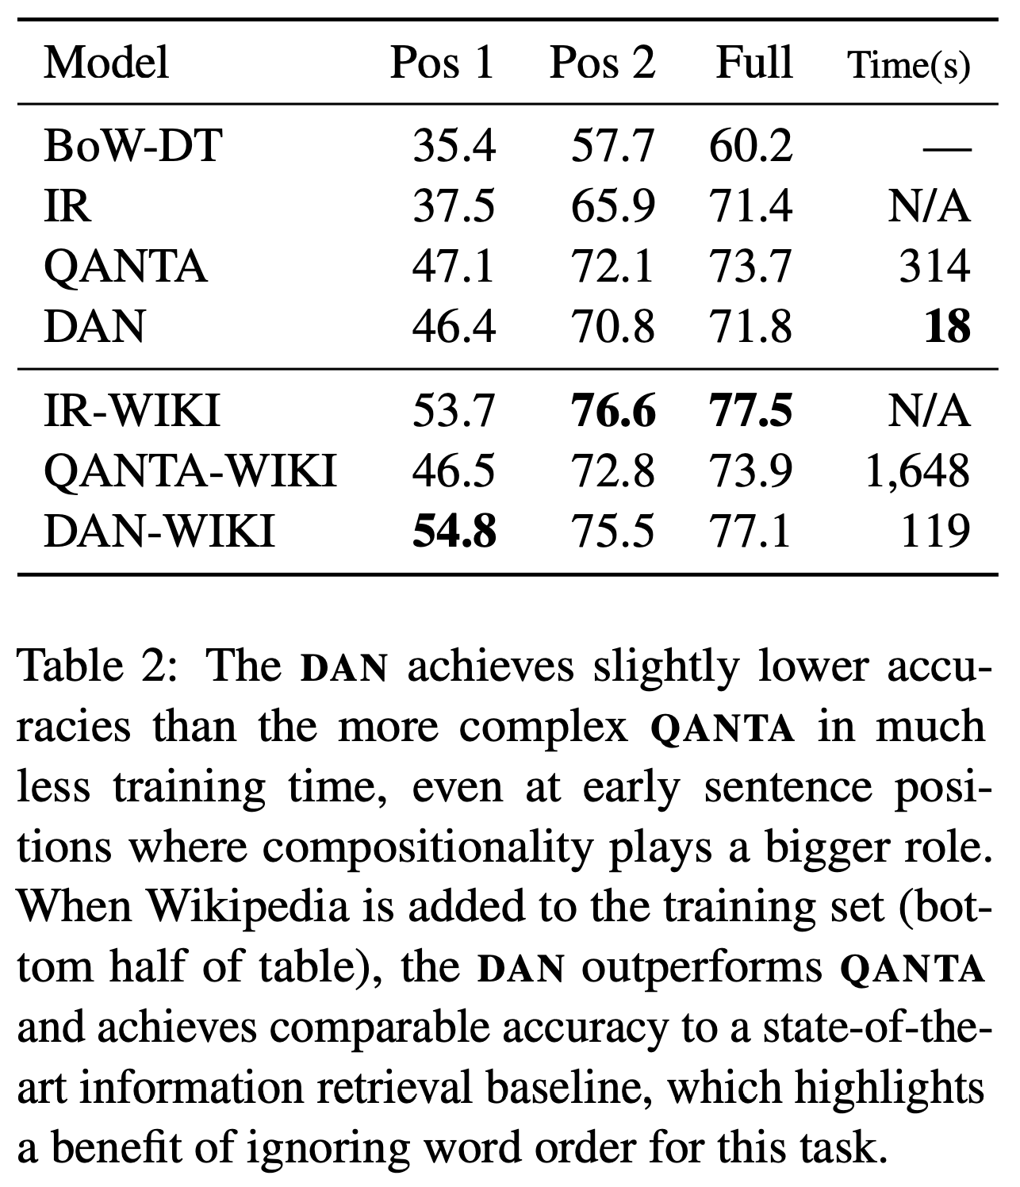
DAN does not outperform traditional information retrieval for search

Slide 8
Improvements
How would you fix the DAN limitations for search?
What about classification?

Slide 9
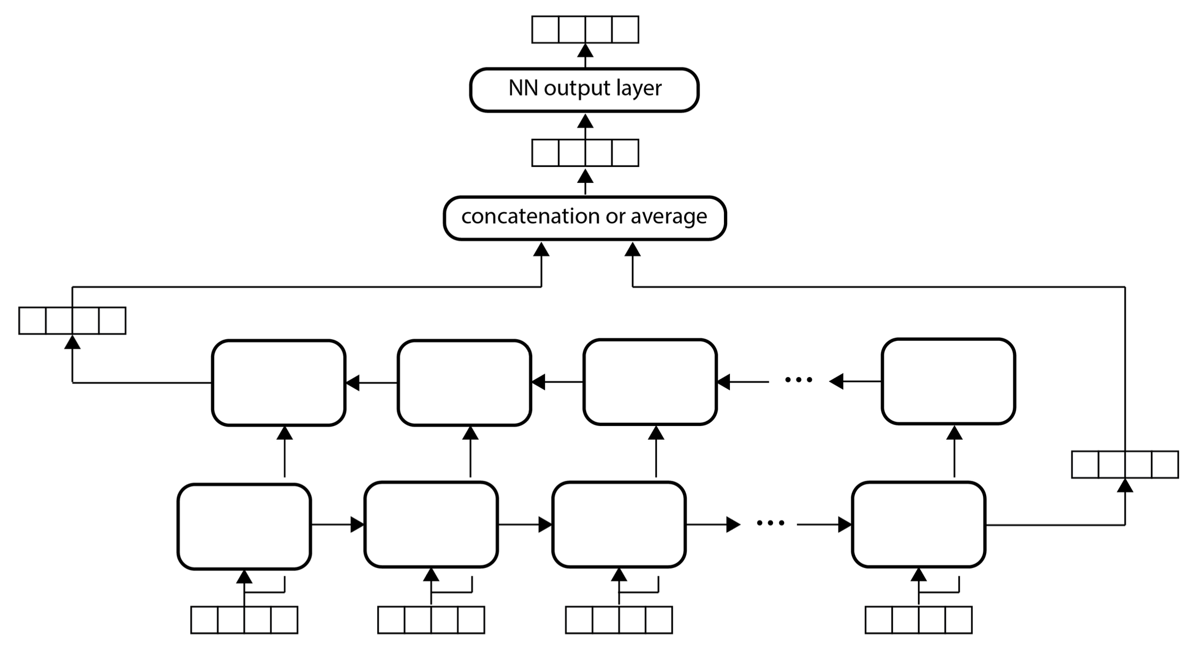
Acceptor biRNN

Slide 10
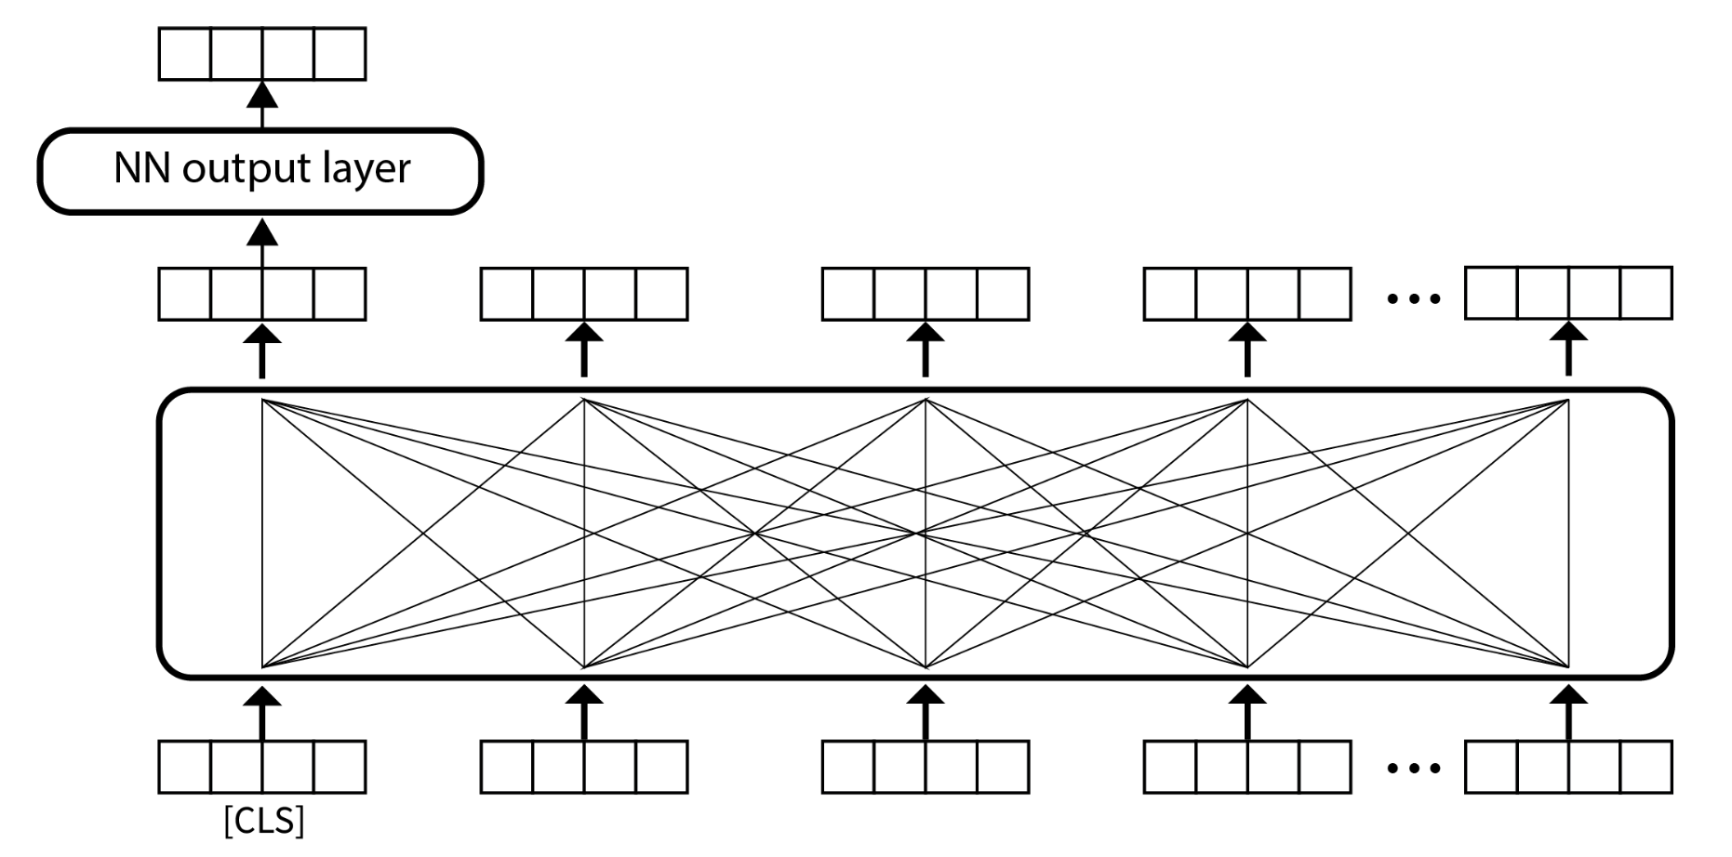
Transformer network (encoder) for text classification

Slide 11
Part-0f-speech tagging

Slide 12
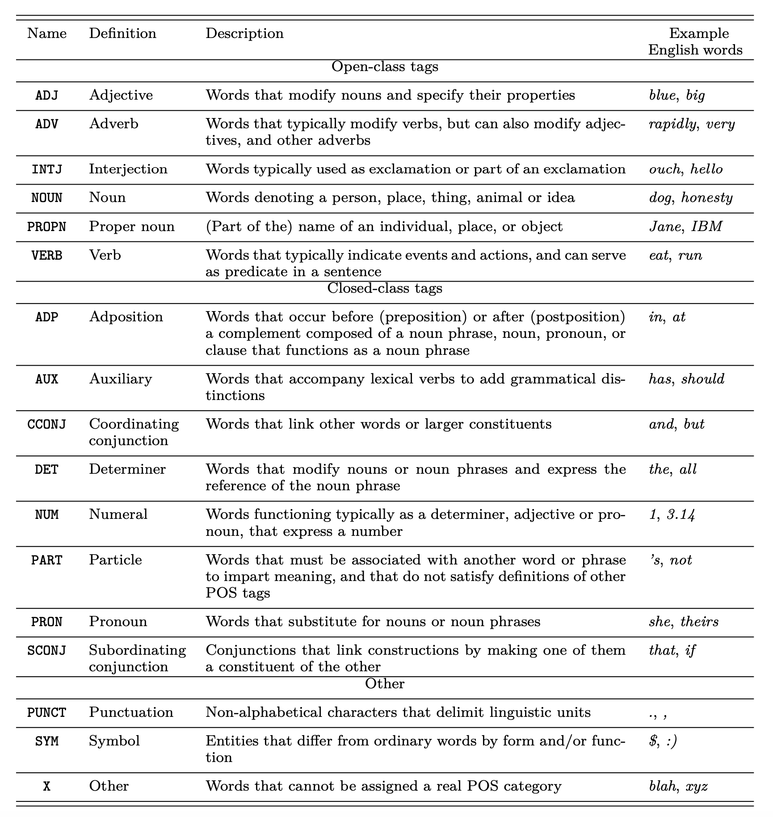
Universal part-of-speech (POS) tags

Slide 13
Where are POS tags useful?

Slide 14
POS tagging datasets
Brown corpus – 87 tags
Penn Treebank corpus – 36 tags + 12 other tags, for punctuation and currency symbols
Universal POS tags – 17 coarser tags that are applicable across languages

Slide 15
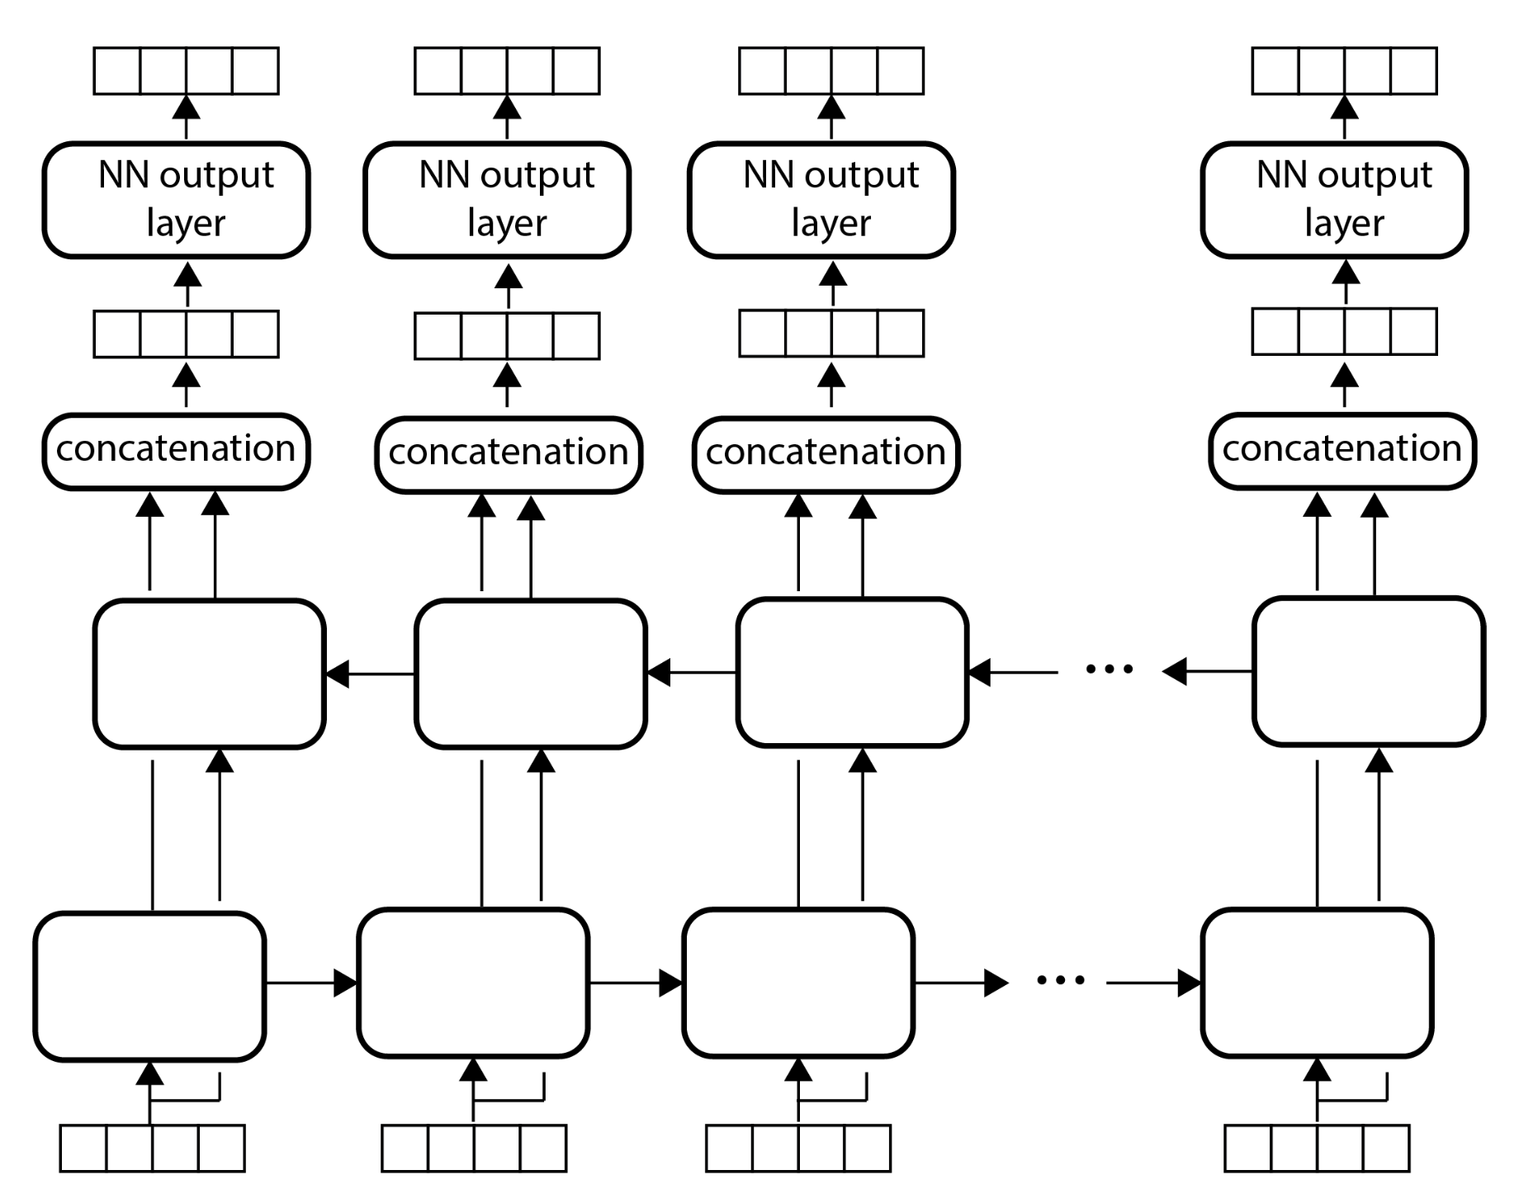
Transducer biRNN for POS tagging
Average cross entropy loss for all words in the sentence
Should we add a CRF layer on top?

Slide 16
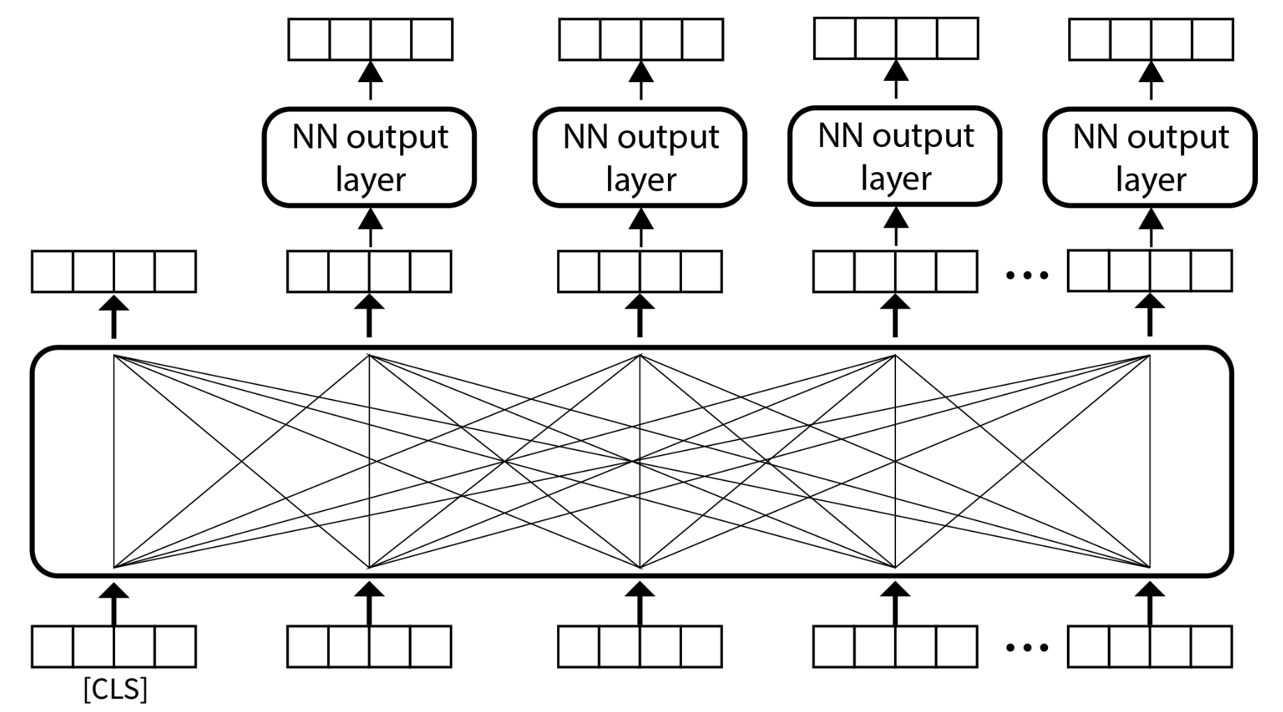
Transducer transformer for POS tagging
Subword embeddings…

Slide 17
Named entity recognition

Slide 18
Example
Ion Jinga moves to New York to start his U.N. position
PERSON
LOCATION
ORGANIZATION
What type is Washington in this sentence?
George Washington is revered not only by Washington oﬀicials, but also by most of the population in Washington D.C.

Slide 19
Where are named entities useful?

Slide 20
Named entity (NE) labels
CoNLL 2003 uses 4 labels: person, location, organization, miscellaneous (nationalities, works of art, fictitious characters)
Stanford CoreNLP adds numeric entities: dates, times of day, percentages, and monetary values
FIGER uses a taxonomy of 112 fine-grained types
Locations split into cities, counties, countries, etc.

Slide 21
NER vs. POS tagging
Both use similar transducer architectures, but
Named entities are multi-word phrases, which introduce a couple of differences
CRF layer more common
Different annotation schema (next slide)

Slide 22
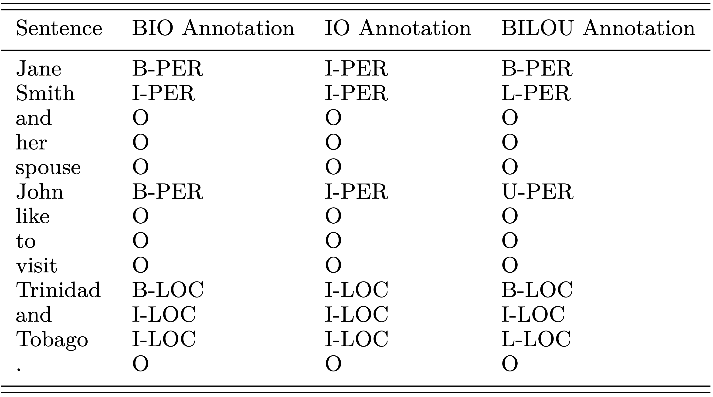
NER annotation schemas

Slide 23
Dependency parsing

Slide 24
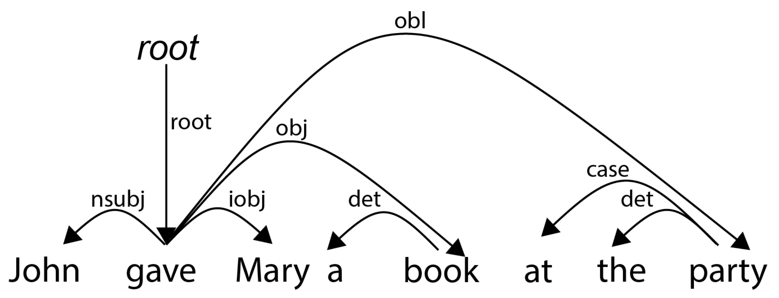
Example of universal dependencies

Slide 25
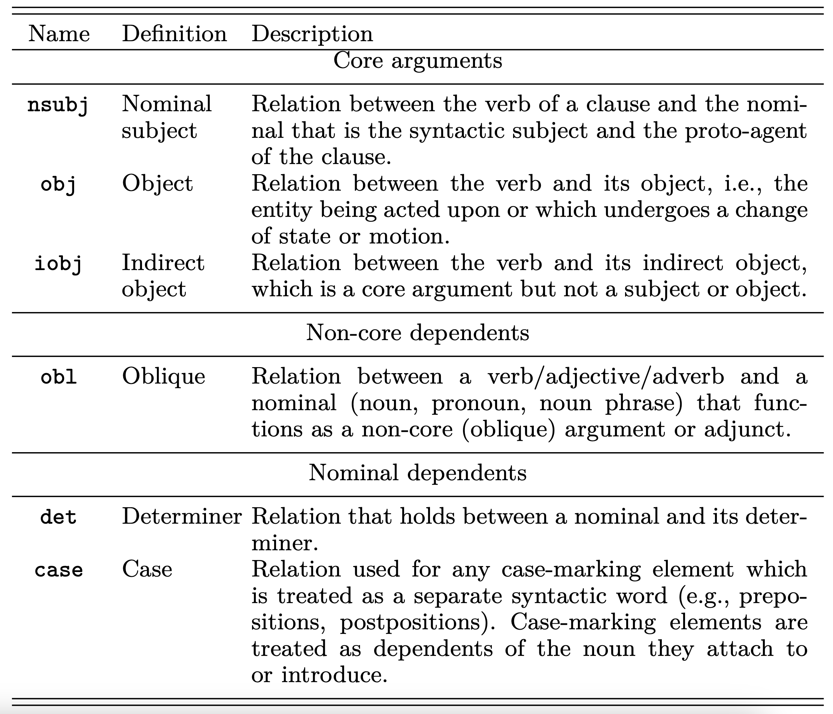
Some universal dependency types

Slide 26
Where are syntactic dependencies useful?

Slide 27
Properties of syntactic dependencies
Binary relations between a dominant word (commonly called head) and another word that immediately depends on it (known as modifier). To capture the fact that one word dominates the other, these relations are directed from the head to the modifier.
These relations are labeled with the syntactic function they capture. For example, the relation between gave and book is labeled obj to indicate that the noun serves as the object of the verb.
Most datasets annotate the syntactic structures of sentences as dependency trees. This means that each word has exactly one head.

Slide 28
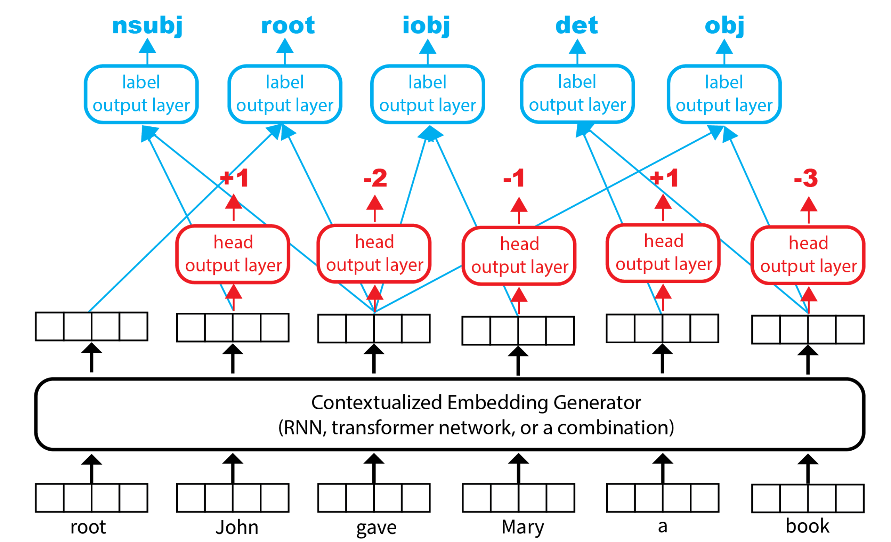
Dependency parsing as sequence modeling
concat, sum,or maxout
[-50, +50] covers 99.9% of dependencies
Virtual token

Slide 29
Problems
May predict heads outside of sentence boundaries
May predict cycles
Why are cycles bad?
To fix: extract the maximum spanning tree from the graph containing the top k head candidates for each word

Slide 30
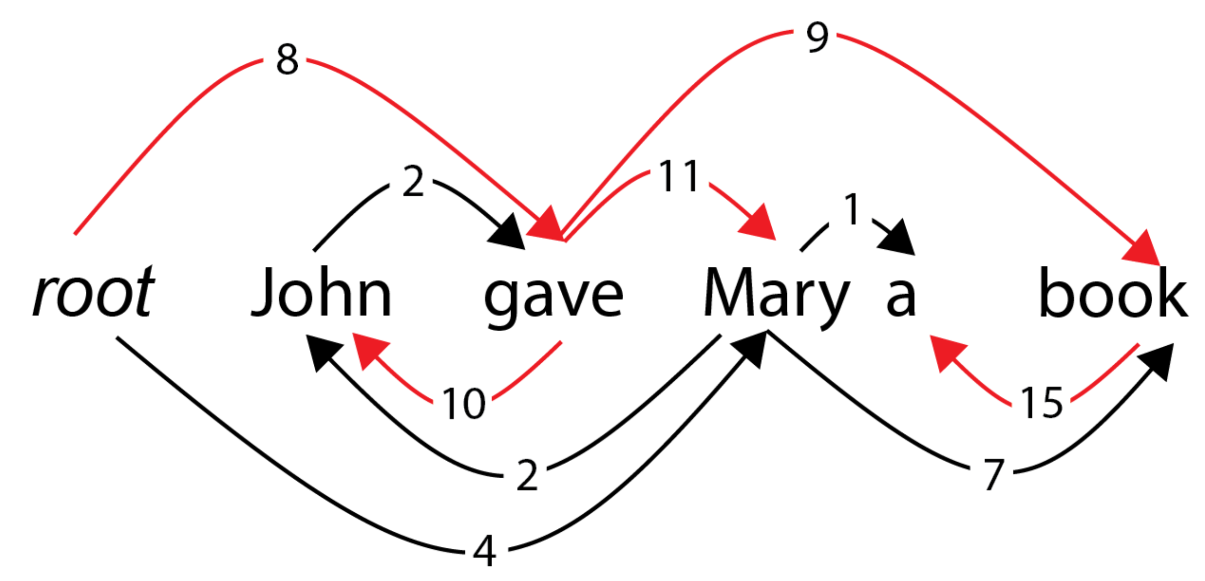
Maximum spanning tree example

Slide 31
Relation extraction

Slide 32
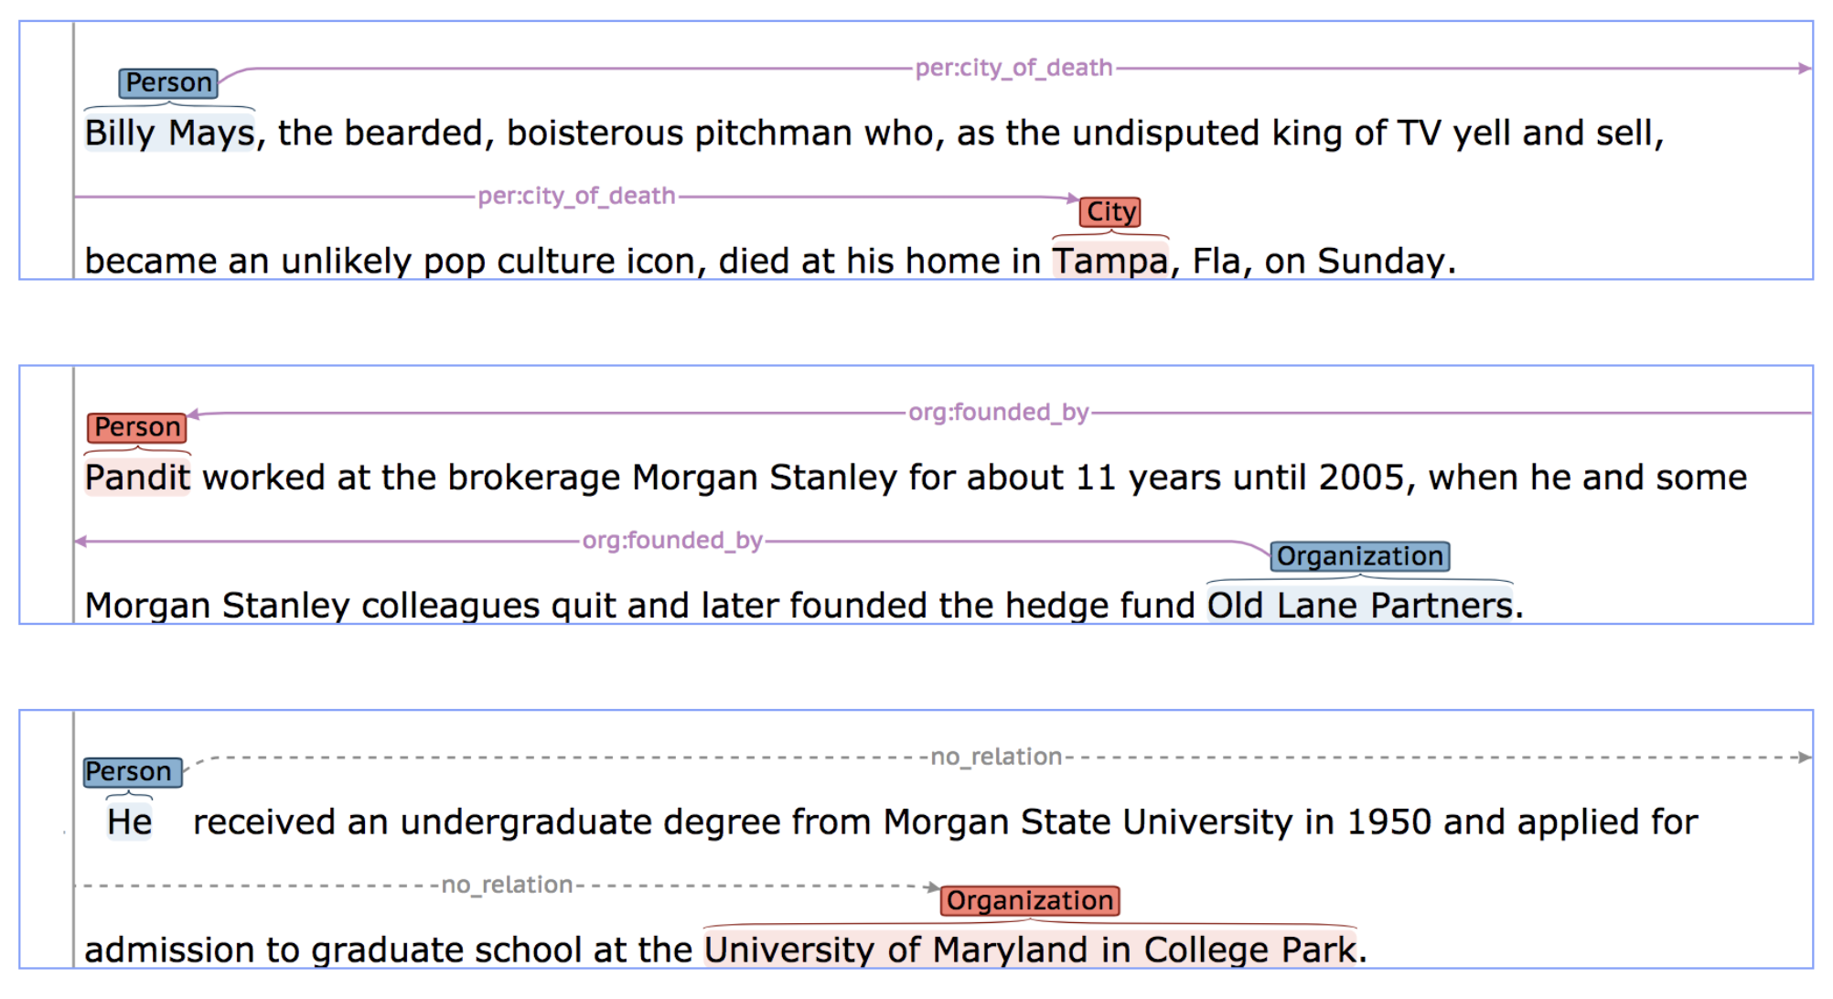
Example
“TACRED is a large-scale relation extraction dataset with 106,264 examples built over newswire and web text [...]. Examples in TACRED cover 41 relation types [...] (e.g., per:schools_attended and org:members) or are labeled as no_relation if no defined relation is held.”

Slide 33
Where are relations useful?

Slide 34
Baseline architecture
We could reuse the transformer-based text classification to classify the relation that holds between two named entities in a sentence
What problems do you see with this?

Slide 35
Problems
Potential overfitting on the participating named entities, e.g.: IF England THEN per:country_of_birth
The [CLS] representation cannot distinguish between multiple relations that occur in the same sentence, e.g.: John, who was born in England, married Mary.

Slide 36
Fix for problem 1: entity masking
Instead of
Bill Gates founded Microsoft
Use
PERSON_SUBJECT founded ORGANIZATION_OBJECT

Slide 37
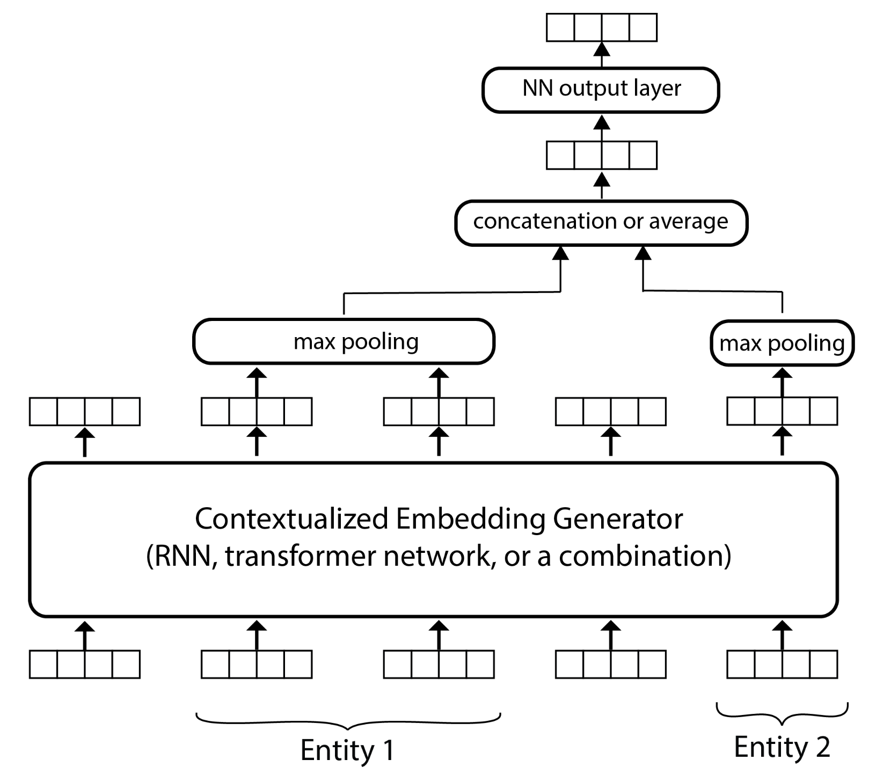
Fix for problem 2: mention pooling

Slide 38
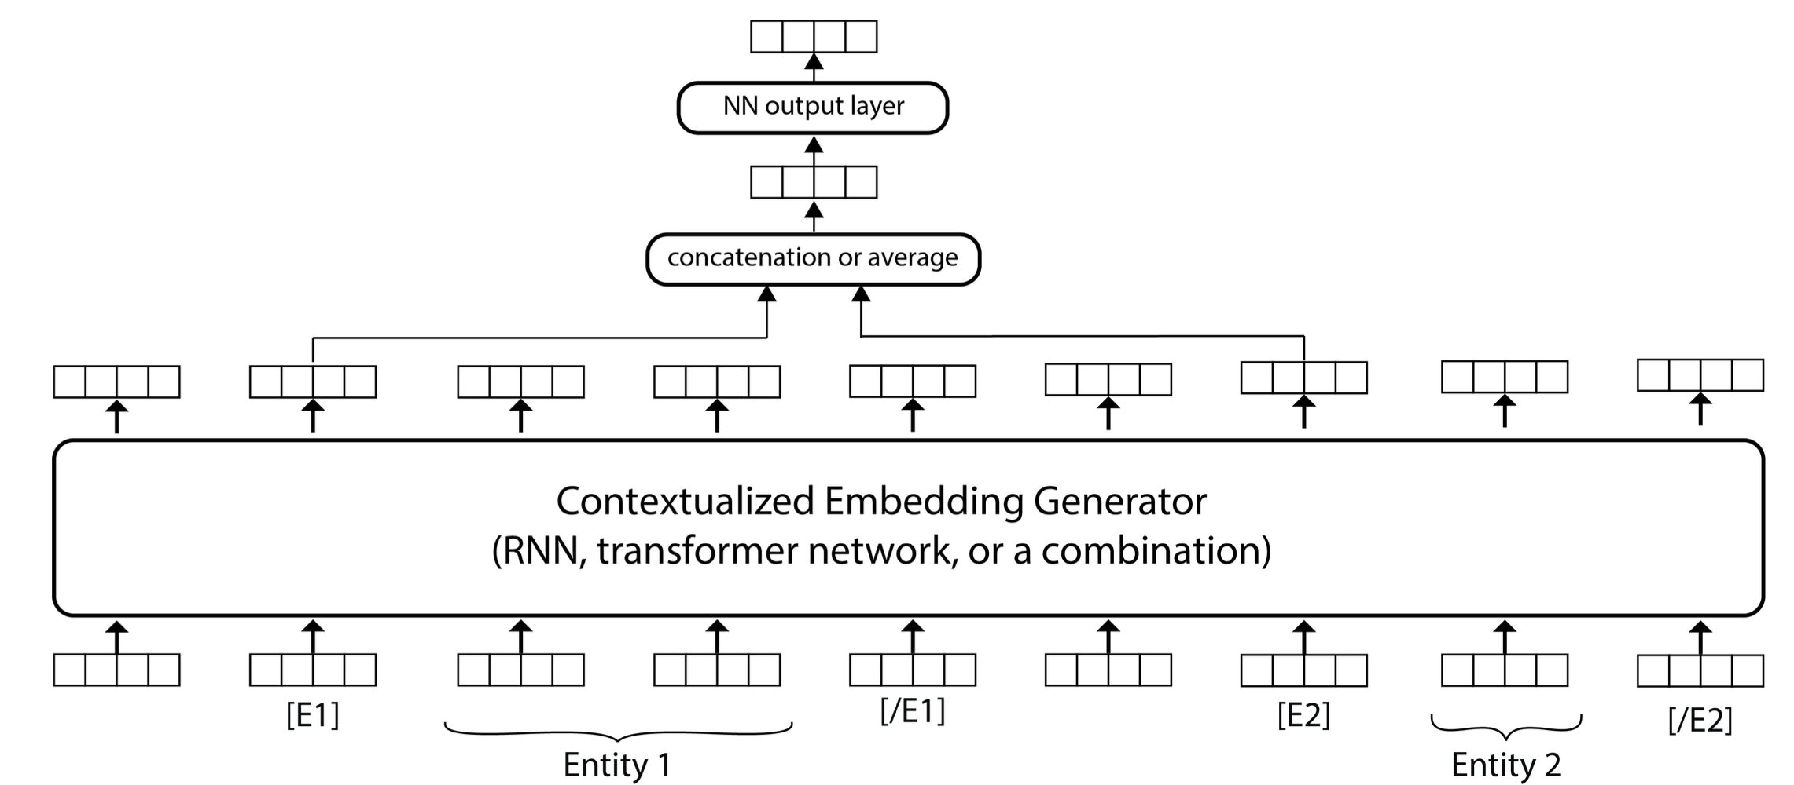
Fix for problem 2: entity markers

Slide 39
Question answering

Slide 40
Definition
Question answering (QA): answering natural language questions with short, exact answers.
Two common types of QA:
Extractive QA, also known as reading comprehension
Multiple-choice QA

Slide 41
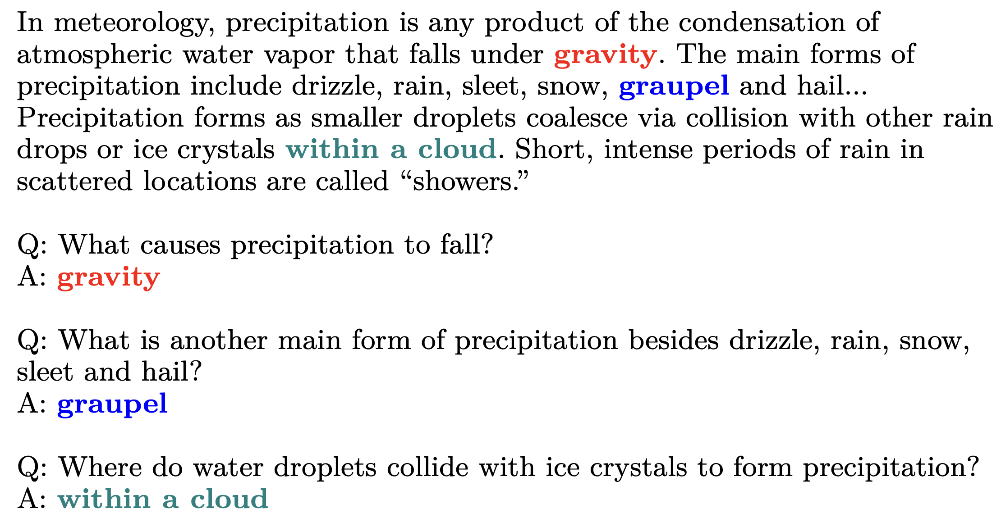
Example of extractive QA (SQuAD)

Slide 42
Example of extractive QA (SQuAD)

Slide 43
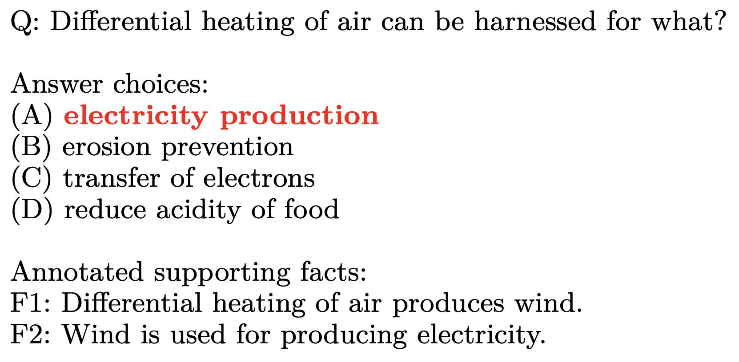
Example of multiple-choice QA (QASC)

Slide 44
Where is QA useful?

Slide 45
Architecture for extractive QA
Answer start
Answer end

Slide 46
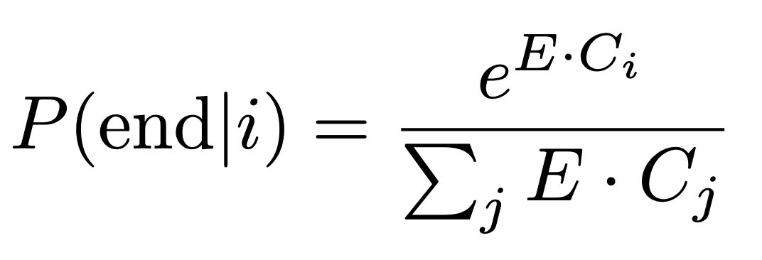
Architecture for extractive QA
Contextualized embedding of token i
S and E are vectors trained with the rest of the network

Slide 47
Architecture for extractive QA
At inference it is sufficient to find i and j that maximize this
where i < j

Slide 48
Architecture for extractive QA
How are questions without an answer handled?
Can you think of variations of this architecture for extractive QA? Hint: how would you use the question more explicitly?

Slide 49
Architecture for multiple-choice QA
Step 1: find the facts that (may) support each candidate answer from a large knowledge base
How would you do it?

Slide 50
Architecture for multiple-choice QA
Binary classifier: correct vs. incorrect answer
[CLS] <QA text> [SEP] <fact text>

Slide 51
Machine translation

Slide 52
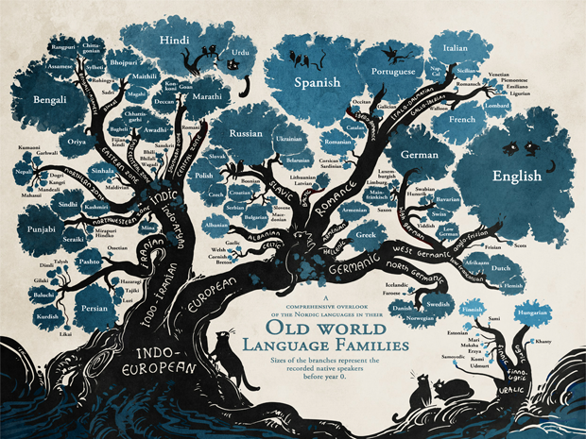
Motivation

Slide 53
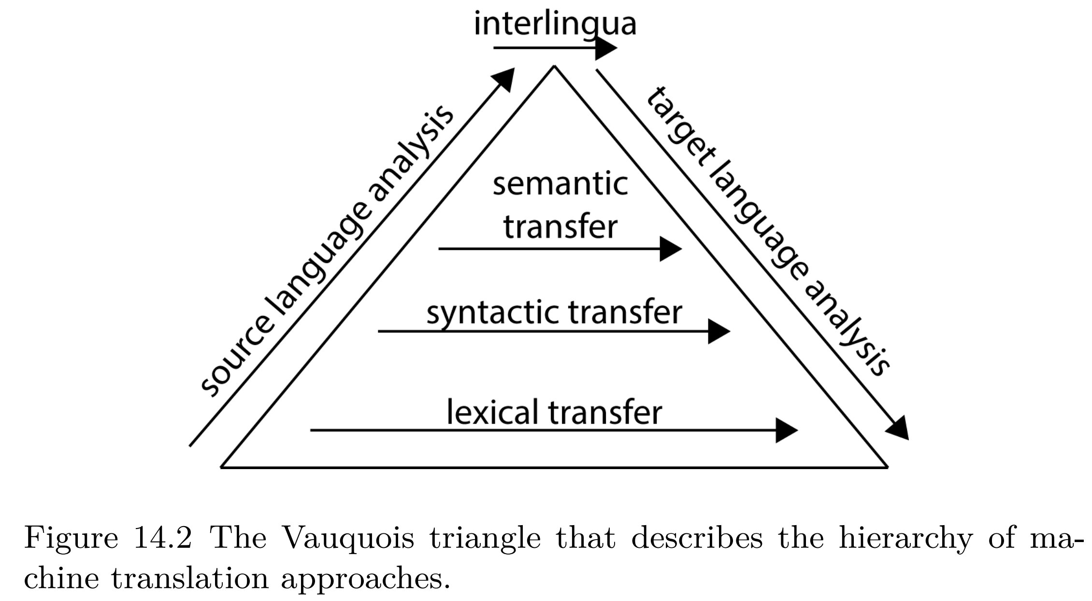
Vauquois triangle for machine translation

Slide 54
Visualizing all attention weights in an encoder-decoder MT system

Slide 55
Example encoder-decoder architecture: Text-to-text Transfer Transformer (T5)

Slide 56
T5 pretraining (before the other 18 tasks)

Slide 57
T5 transformer
Almost identical to the original architecture, except
It replaces the absolute position embedding with an encoding of the relative position between every two tokens
How would you do this?

Slide 58
Takeaway
Text classification
Part-of-speech tagging
Named entity recognition
Dependency parsing
Relation extraction
Question answering
Machine translation
Search

