Slide 1


Deep Learning for Natural Language Processing
DLNLP 12: Contextualized Embeddings and Transformer Networks
(just the encoder for now)
Mihai Surdeanu and Marco A. Valenzuela-Escárcega

Slide 2
Motivation
Embeddings produced by word2vec are the same for all words regardless of their sense (because word2vec aggregates all contexts during training)
  Bank of the river
  Bank of America
We want contextualized embeddings!
  RNNs do this but transformers are better ☺

Slide 3
Overview
Architecture of a transformer layer
Sub-word tokenization
Training a transformer network
How to use word representations in your project

Slide 4
architecture

Slide 5
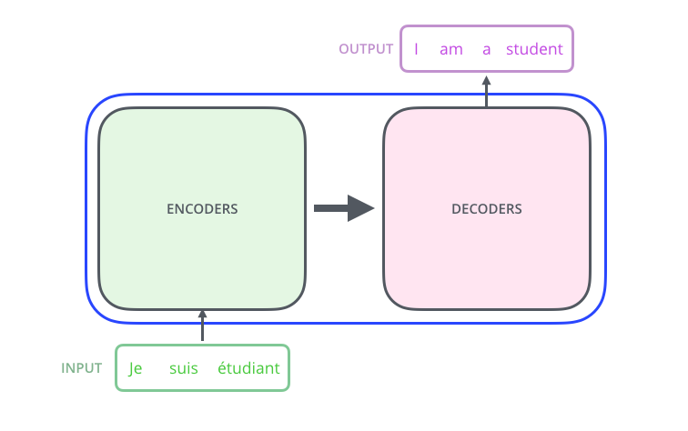
This lecture

Slide 6
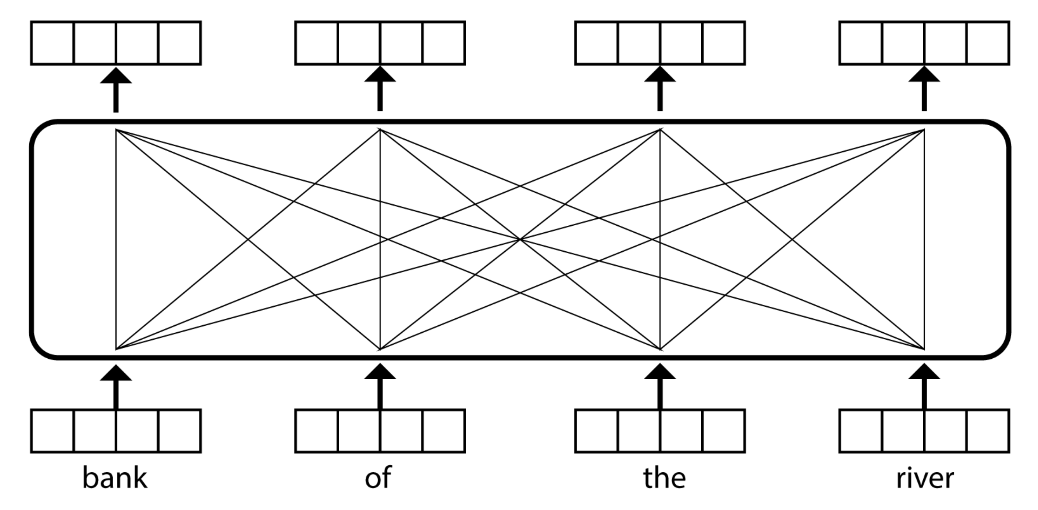
Intuition (1 layer)
Each output embedding is a weighted average of the input embeddings. The weights are learned.

Slide 7
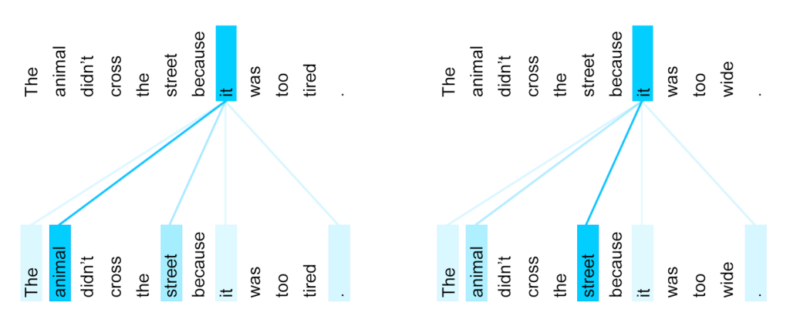
Intuition: the encoding of each word depends on its surrounding words

Slide 8
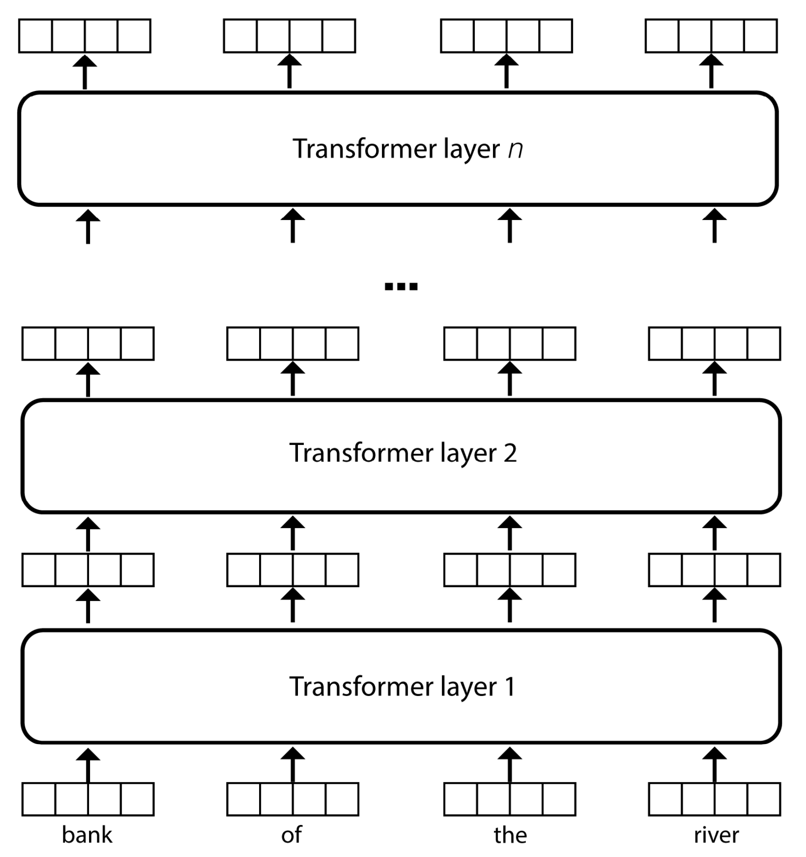
Intuition (all layers)
Multiple layers stacked on top of each other

Slide 9
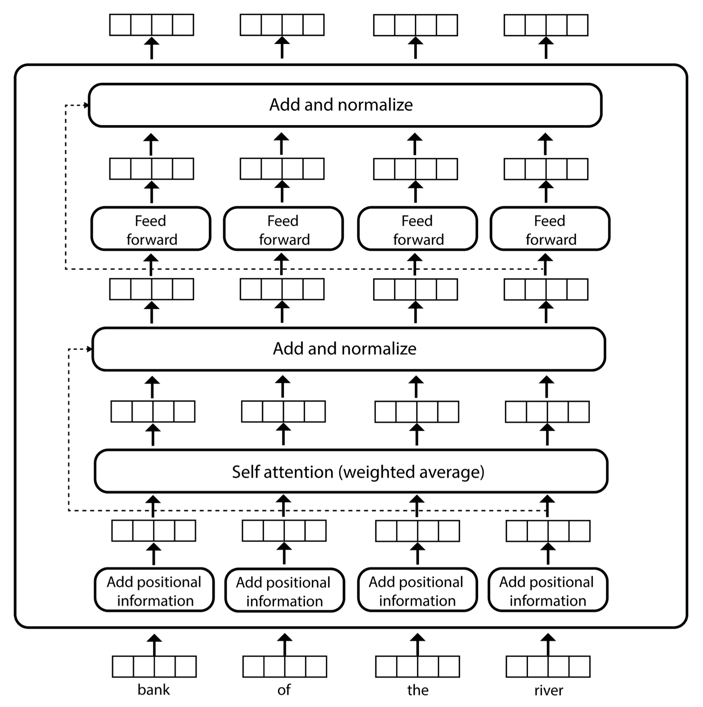
Layer architecture

Slide 10
Layer architecture

Slide 11
Positional embeddings
Prevent this architecture from being a bag of words!

Slide 12
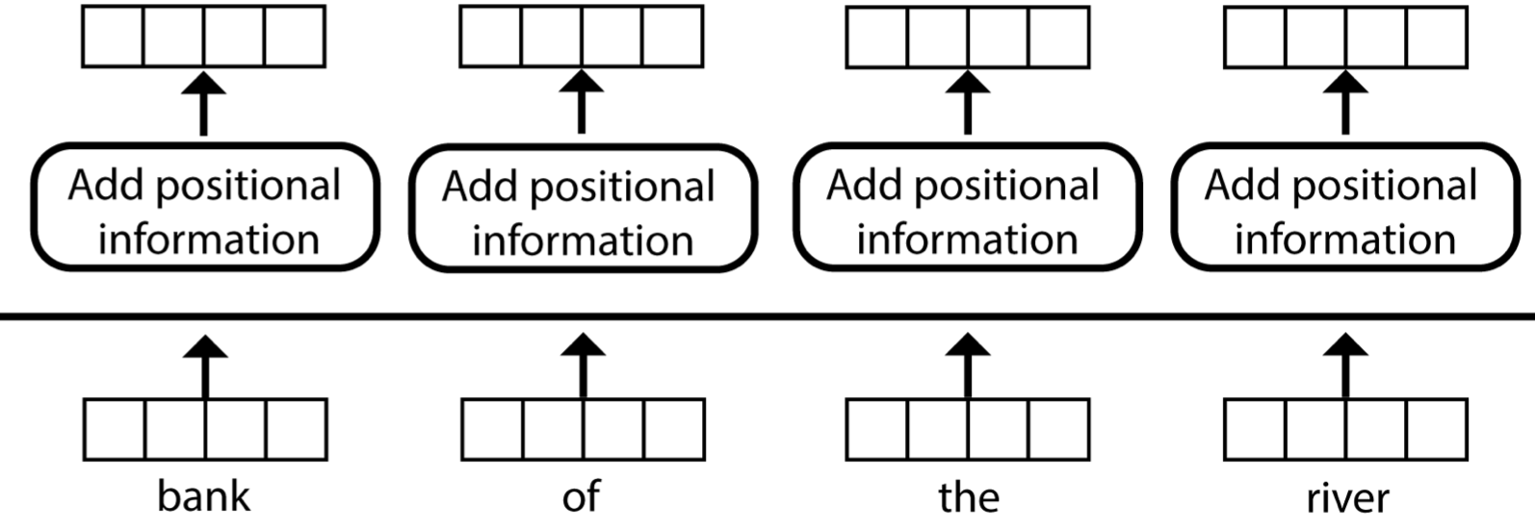
Positional embeddings
x_{i} = [w_{i} + p_{i}], where p_{i} = f(i) encodes position information for token i
W_{i}: static word embeddings

Slide 13
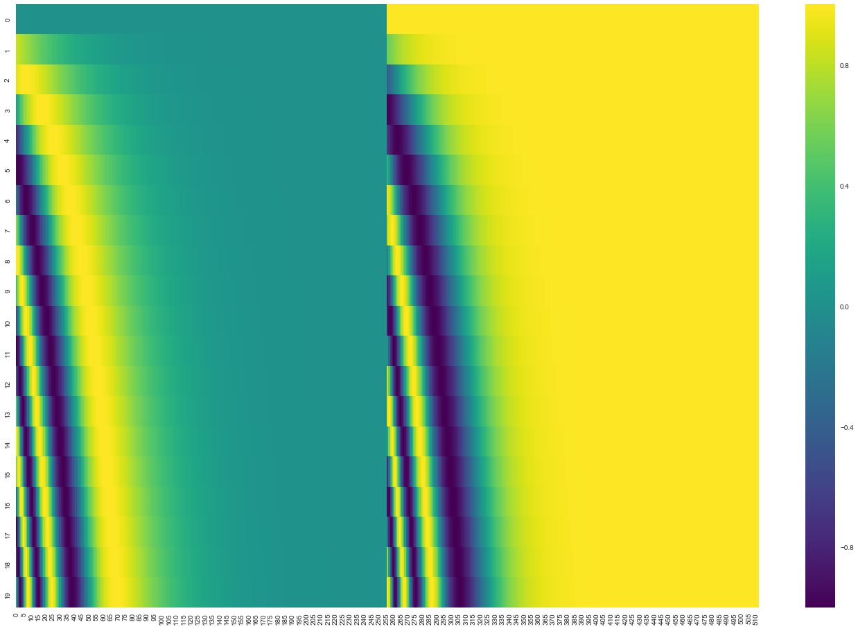
A real example of positional encoding for 20 words (rows) with an embedding size of 512 (columns). You can see that it appears split in half down the center. That's because the values of the left half are generated by one function (which uses sine), and the right half is generated by another function (which uses cosine). They're then concatenated to form each of the positional encoding vectors.

Slide 14
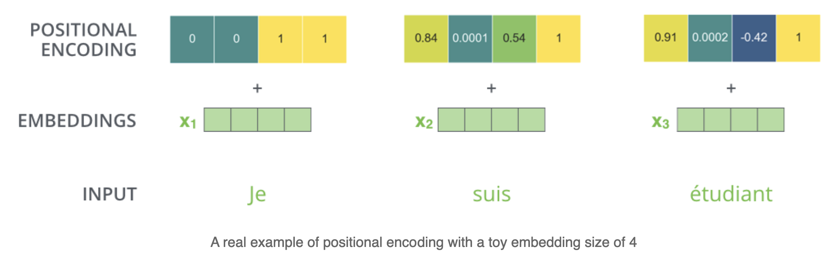
Example of positional embeddings
What’s the problem with this approach?
From https://jalammar.github.io/illustrated-transformer/

Slide 15
Layer architecture

Slide 16
Self attention
Computes the actual weighted average of the z embeddings
These weights are computed using three vectors for each word i
  Query vector (q_{i})
  Key vector (k_{i})
  Value vector (v_{i})

Slide 17
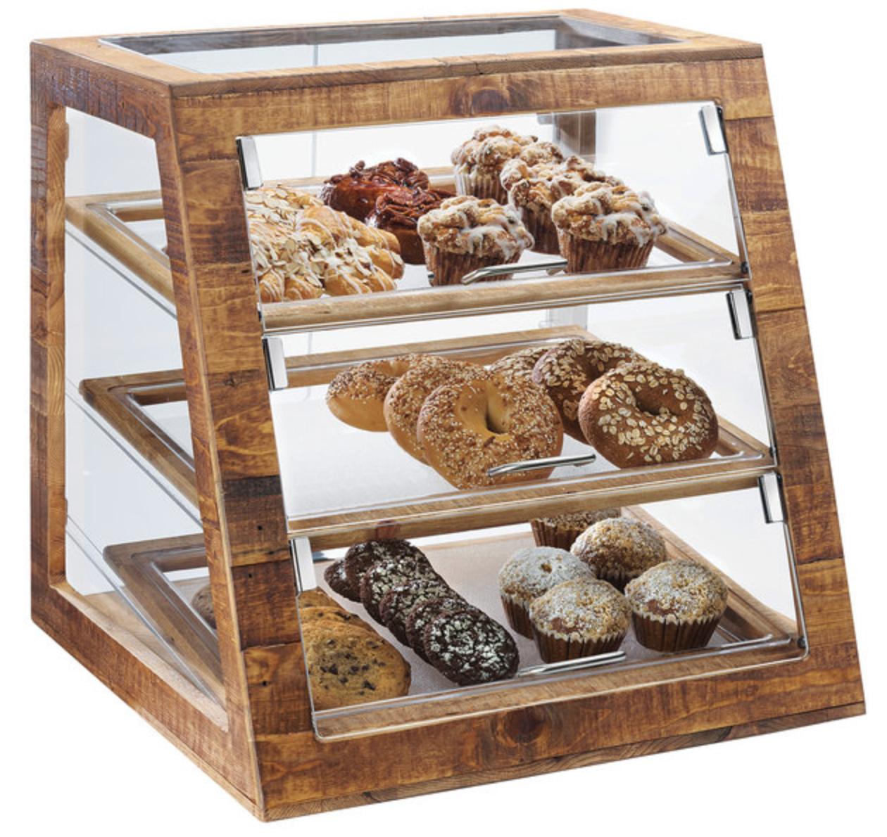
Real-world analogy
You are at a bakery and would like to buy a bagel
  Query (“bagel”)
  Name of a bakery product = key
  Cost of each product = value
Our goal in this shopping experience is to pay more attention to the prices (or values) of the products (keys) that are closest to our interest (query).

Slide 18
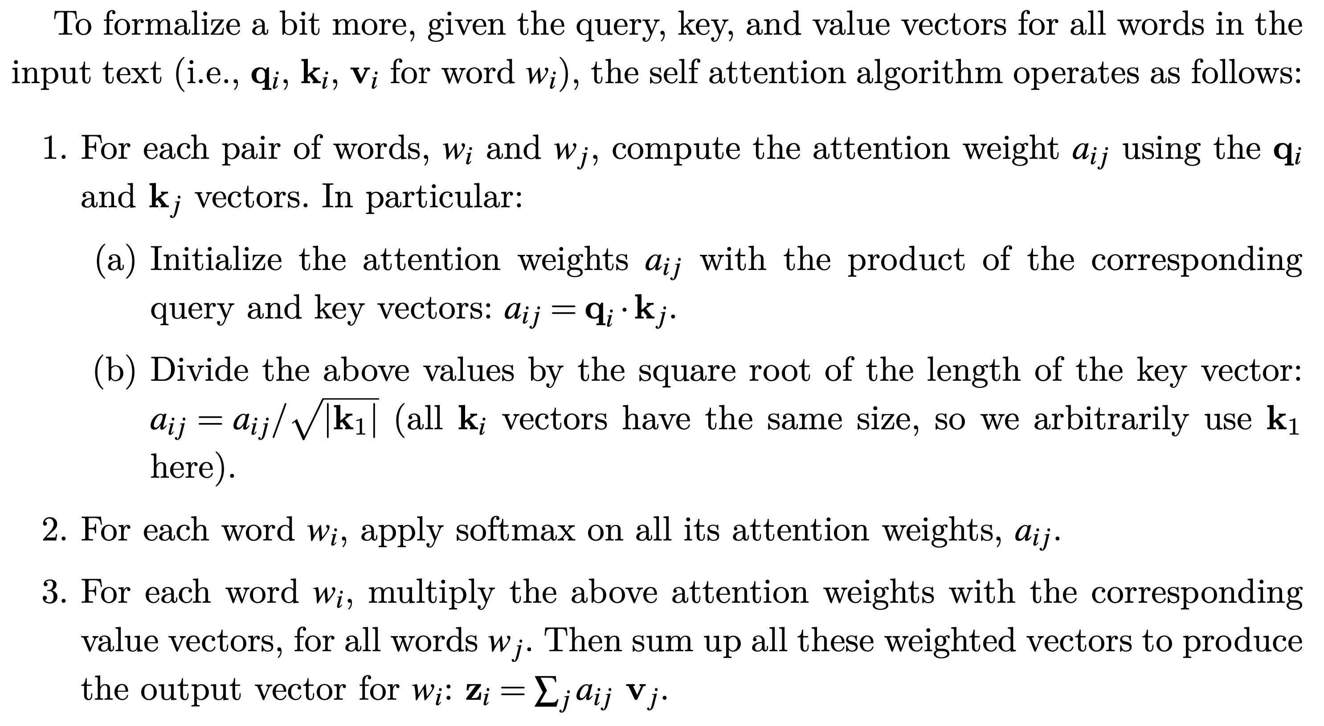
Self-attention algorithm

Slide 19
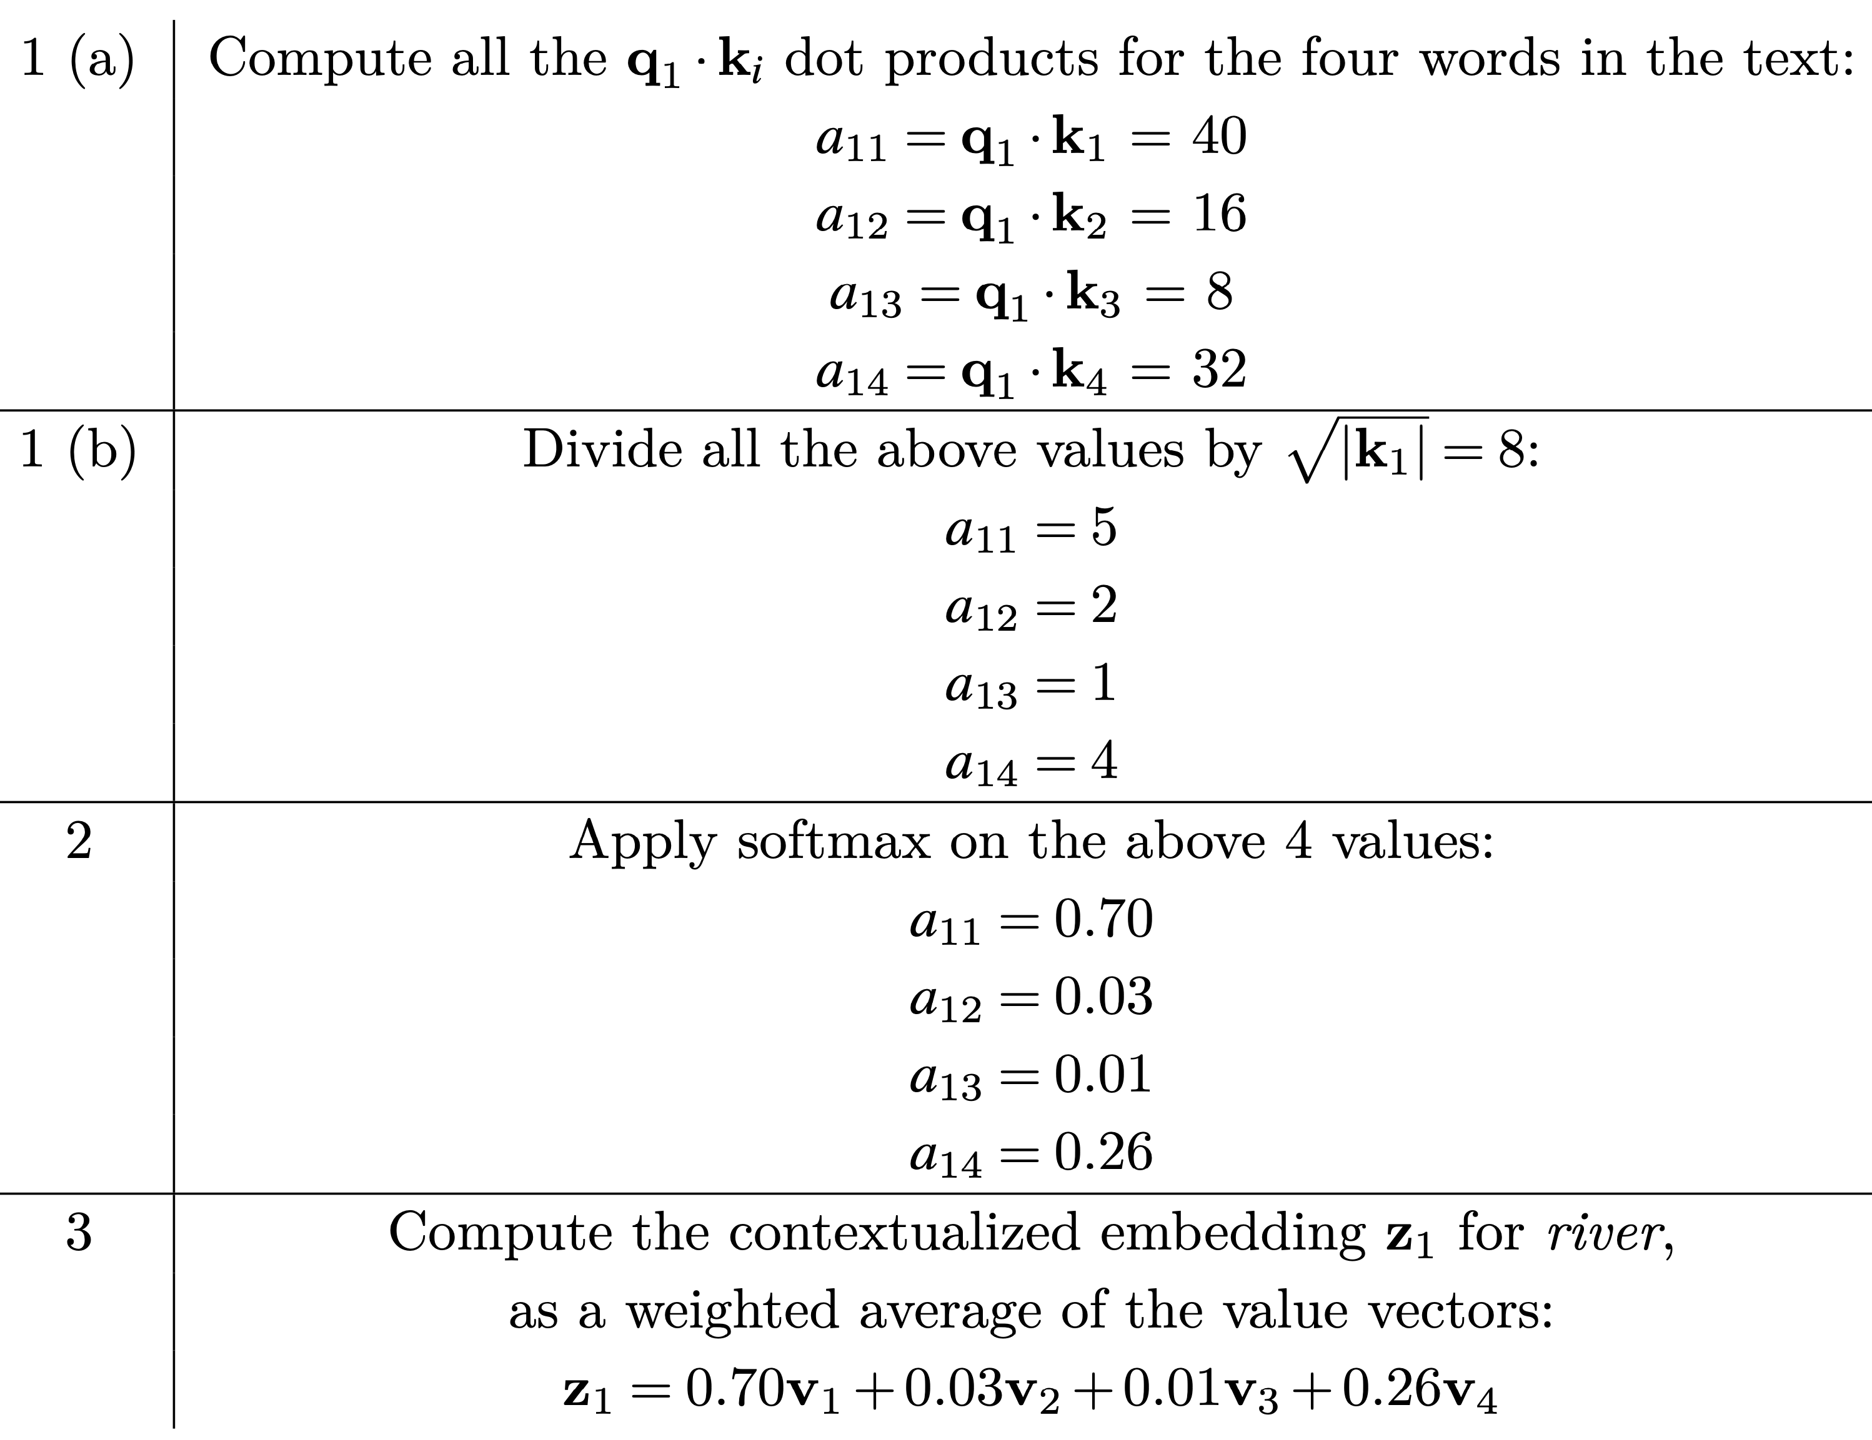
Walkthrough example for
“bank” in “bank of the river”
How would you make this better (hint: think about those absolute position embeddings)?

Slide 20
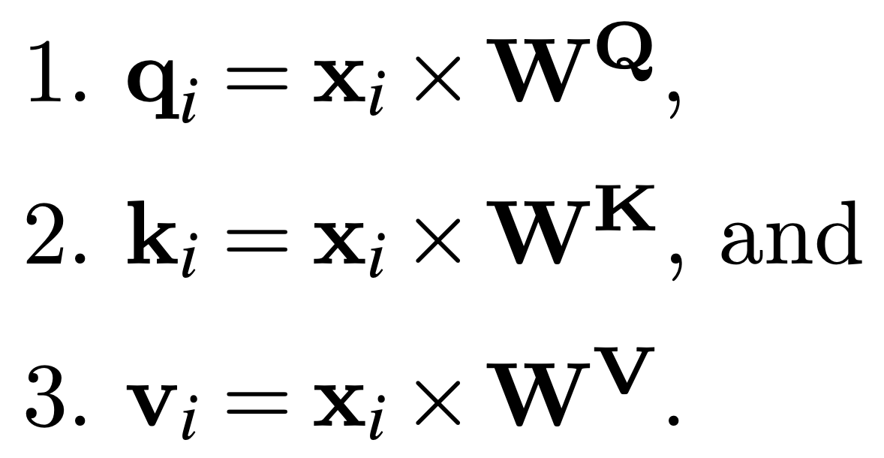
Self-attention parameters (1 head)
Typically, the size of x is 512, and the size of q, k, and v is 64.

Slide 21
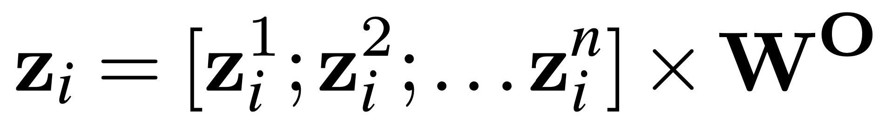
Multiple heads for self-attention
8 layers yield more 1M parameters…
This and the approximate bag of words representation explain the good performance for many NLP tasks!

Slide 22
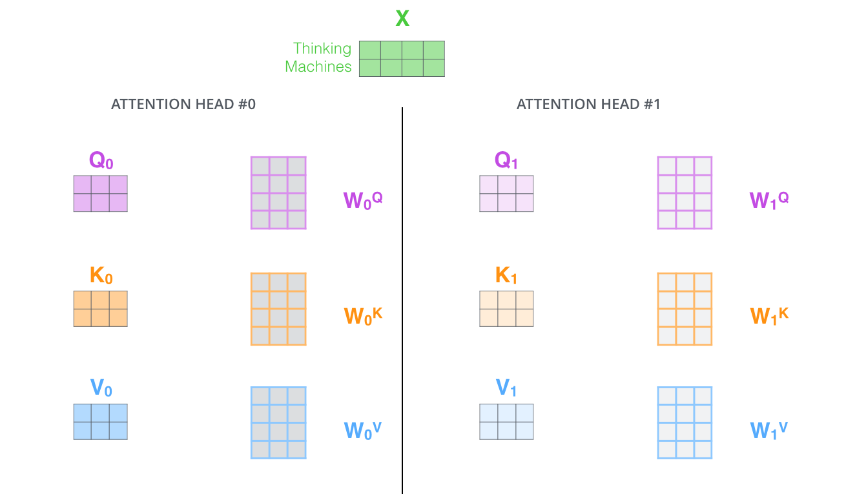

Slide 23
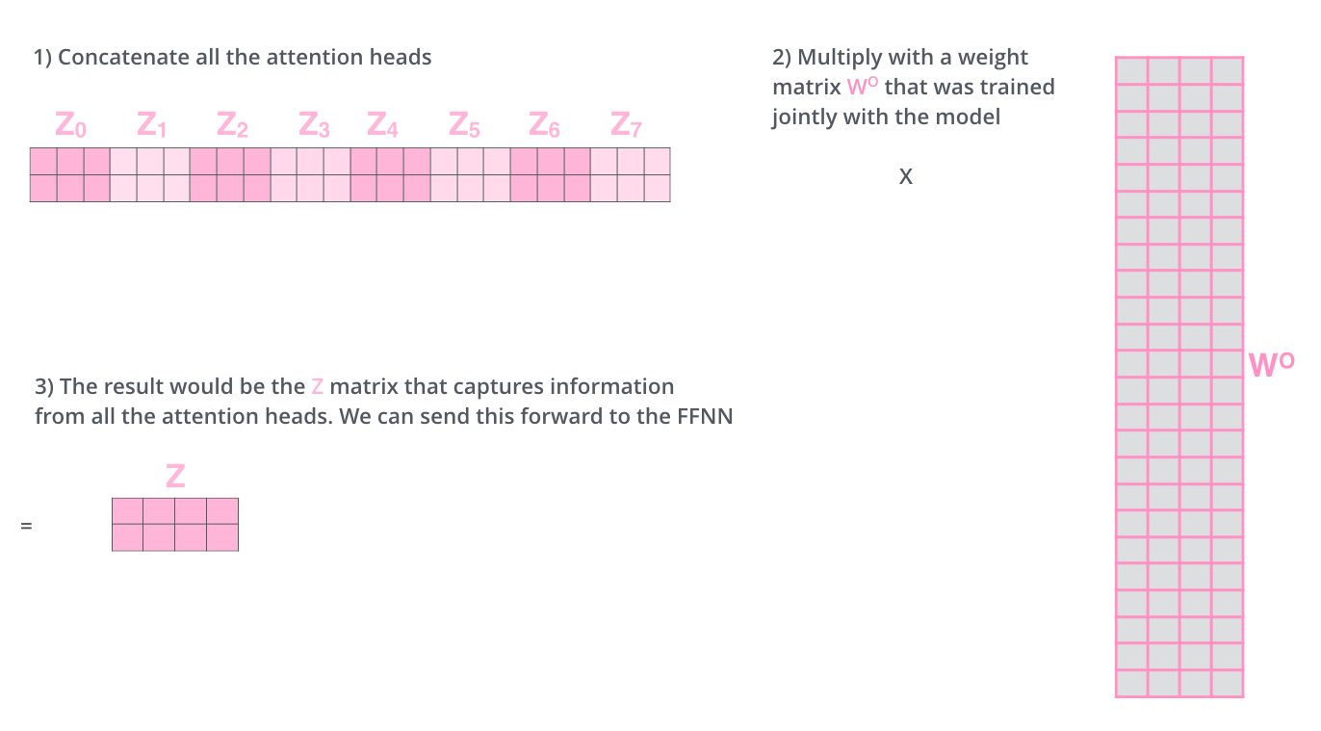

Slide 24
Layer architecture

Slide 25
Add & normalize
Adds the input and output vectors of the previous component, e.g., x_{i} + z_{i}.
  There is value in static word embeddings!
Then normalizes the resulting vector using layer normalization (see previous lecture).
  To avoid jumping around due to dimensions that are too large.

Slide 26
Sub-word tokenization

Slide 27
Transformer tokenization
Transformers do not operate over words (as word2vec) but over subword units
  Less sparse
  Better handling of unknown words
  Can control the size of the vocabulary
Subword units learned from a large text collection using the byte pair encoding (BPE) algorithm (or other similar algorithms)

Slide 28
BPE algorithm
Starts with a vocabulary of single characters, plus a special token that indicates the end of a word, </w>.
Iteratively counts the frequency of symbol pairs in a large text corpus, and replaces the most frequent pair with the concatenation of the two symbols, which is also added to the symbol dictionary.
  Merging not allowed across word boundaries
Stop when the desired dictionary size is reached
  Typical size = 50,000

Slide 29
BPE example

Slide 30
Training

Slide 31
Two training steps
Pre-training
  Trained using language modeling cost functions
Fine-tuning (optional)
  Supervised adaptation to a specific task

Slide 32
Pre-training: masked language model

Slide 33
Pre-training: masked language model
[MASK]
Mask about 15% of the tokens

Slide 34
Pre-training: masked language model
Train a classifier that predicts this token, i.e.:
Positive example: “bank”
Negative examples: other randomly selected tokens
[MASK]
Mask about 15% of the tokens

Slide 35
Pre-training: next sentence prediction
Binary classifier that predicts if a sentence follows another
  Positive example: actual next sentence
  Negative examples: other randomly selected sentences
How to encode an entire sentence?

Slide 36
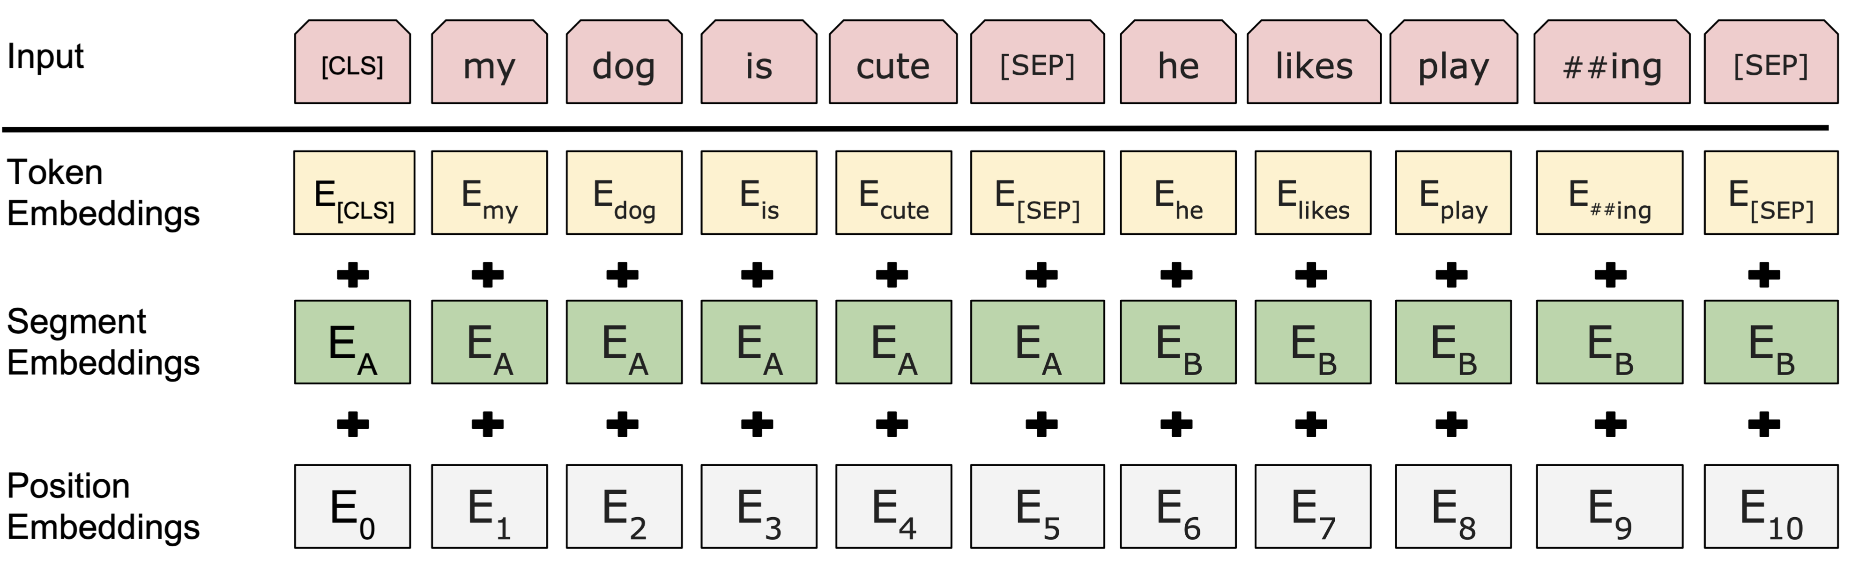
Next sentence prediction example

Slide 37
Next sentence prediction example
Special token that encodes the entire text

Slide 38
Next sentence prediction example
Special token that encodes the entire text
Special separator token

Slide 39
Next sentence prediction example
The binary classifier is trained on top of the contextualized embedding for [CLS]

Slide 40
Fine-tuning
Continues training the transformer network after pre-training, by adapting it for the task at hand.

Slide 41
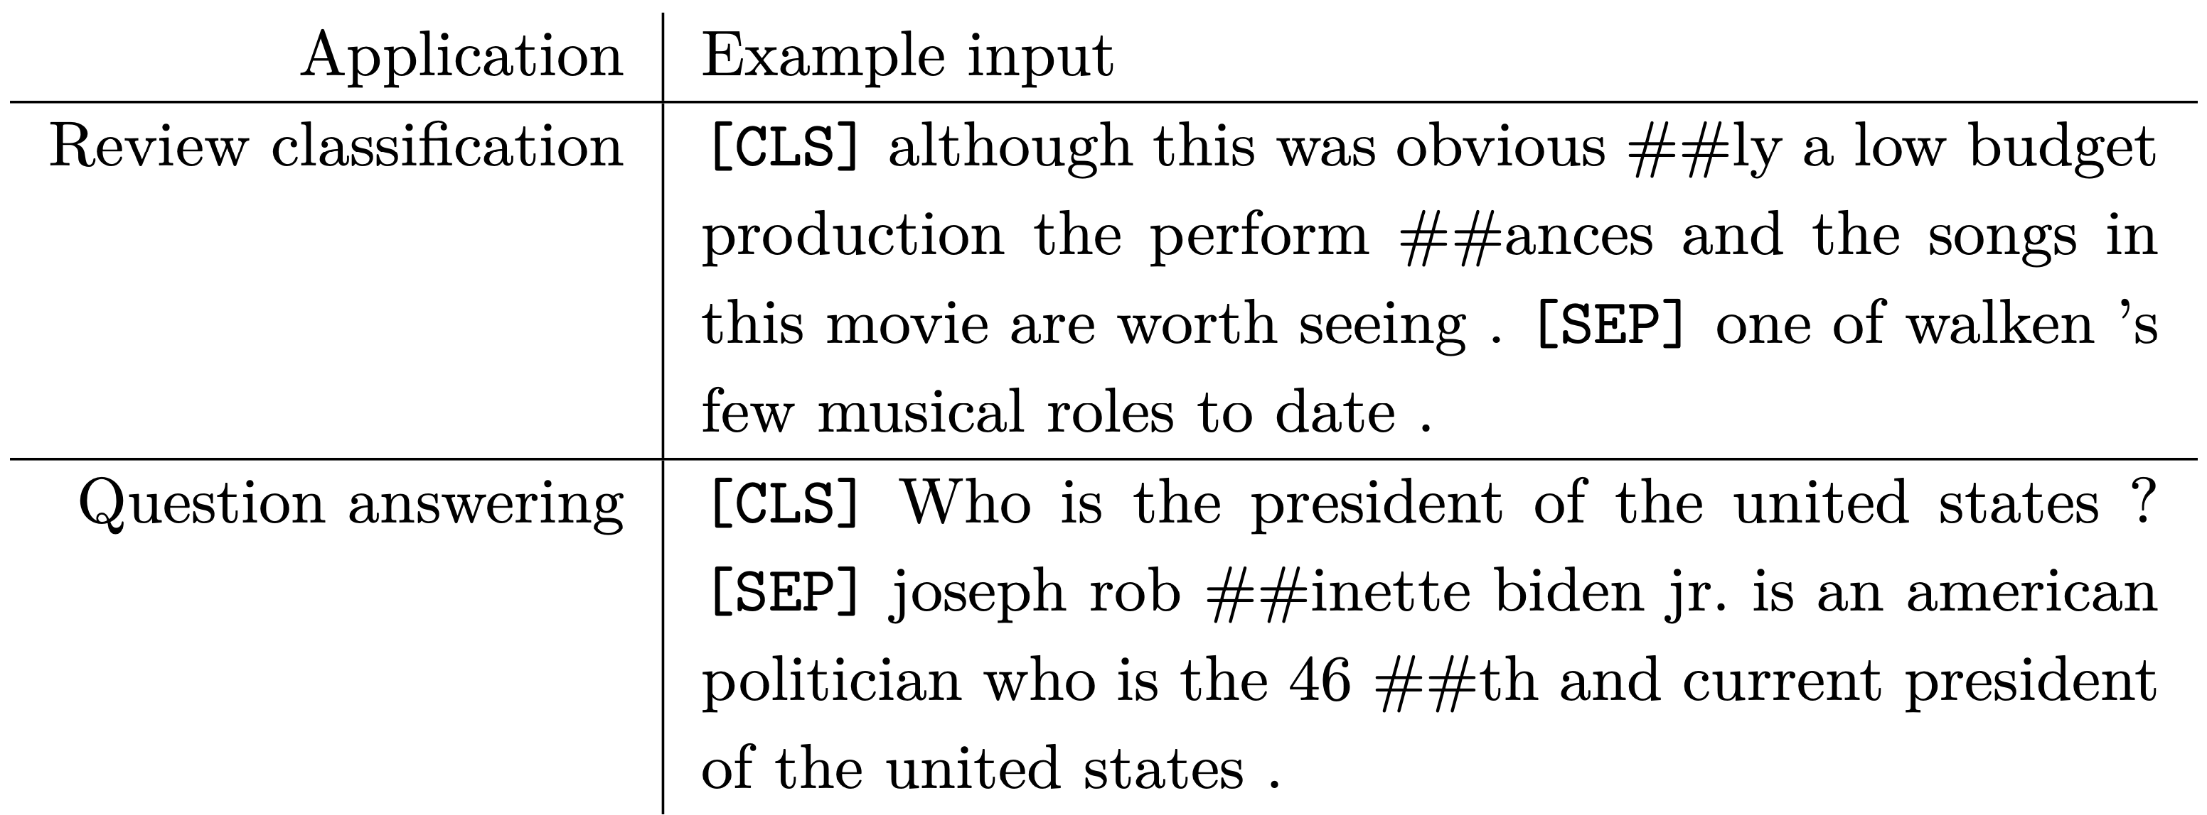
Fine-tuning: application examples

Slide 42
Move tasks to pre-training
Recently, more and more NLP tasks have been plugged into the pre-training stage
What tasks would you use?

Slide 43
How to use word representations in your project

Slide 44
Word2vec static embeddings
Average all word embeddings for a given text
  How would you make this better?
Then:
  For search: index these document embeddings in your annoy index
  For classification: add some feed-forward layer on top of this averaged embedding then train the usual way
    Note that the word2vec embeddings are not adjusted during training
See: https://clulab.org/gentlenlp/chapter9.html

Slide 45
Transformer contextualized embeddings
Run the forward pass of the transformer encoder (what we covered today)
Use the representation of the [CLS] embedding as the representation of the entire text
Then:
  For search: index these document embeddings in your annoy index
  For classification: add some feed-forward layer on top of this averaged embedding then train the usual way
    You may choose to backpropagate through the encoder architecture or not

Slide 46
Take away
Architecture of a transformer layer
Sub-word tokenization
Training a transformer network
How to use word representations in your project

