Slide 1
What does the language of food say about us?
Hoang Van, Ahmad Musa, Hang Chen, Mihai Surdeanu, and Stephen Kobourov
LOUHI 2019

Slide 2
Motivation
30.3M diabetes cases in the US in 2015, of whom 7.2M were undiagnosed
Diabetes caused over 79K US deaths in 2015
Diabetes caused $245B in economic costs in 2012

Slide 3
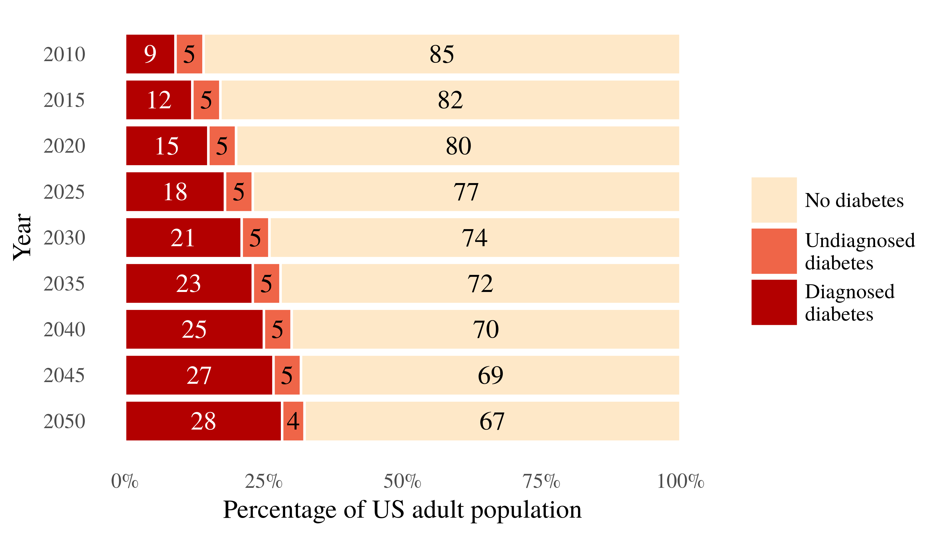
Projected US diabetes prevalence
Boyle et al. (2010)

Slide 4
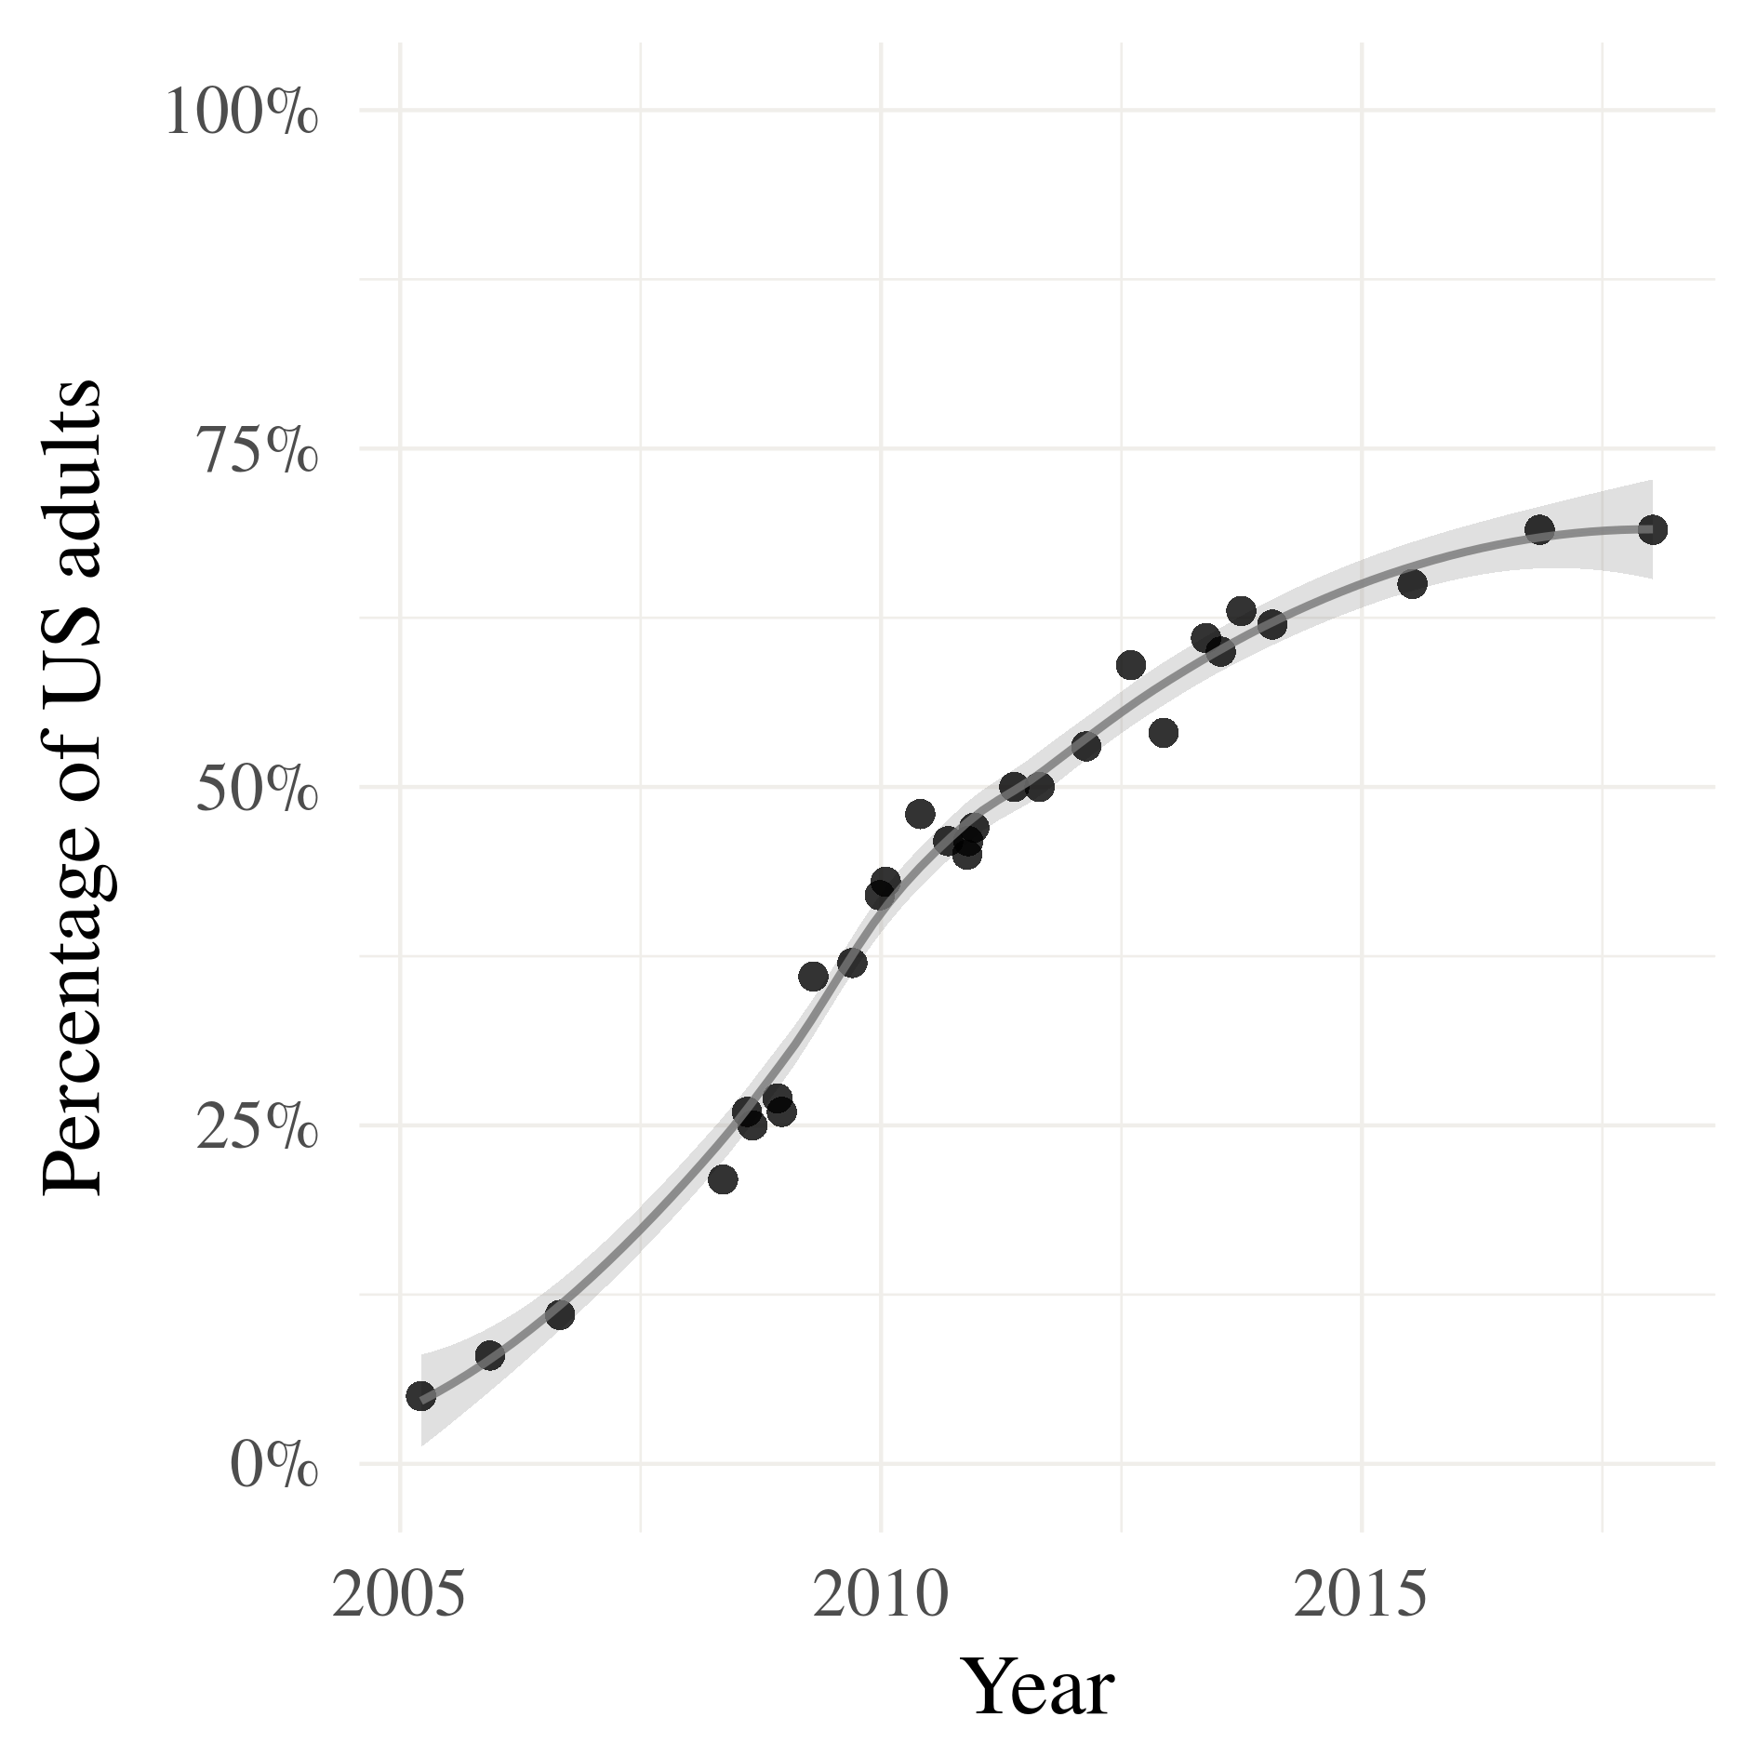
Motivation
Twitter sees 6,000 new tweets per second, from a representative sample of the US population (Mislove et al., 2011)
Our previous work has shown that the language of food is predictive of health risks for communities (Fried et al., 2014) and individuals (Bell et al., 2018)
US adults using social media
Pew Research Center (2018)

Slide 5
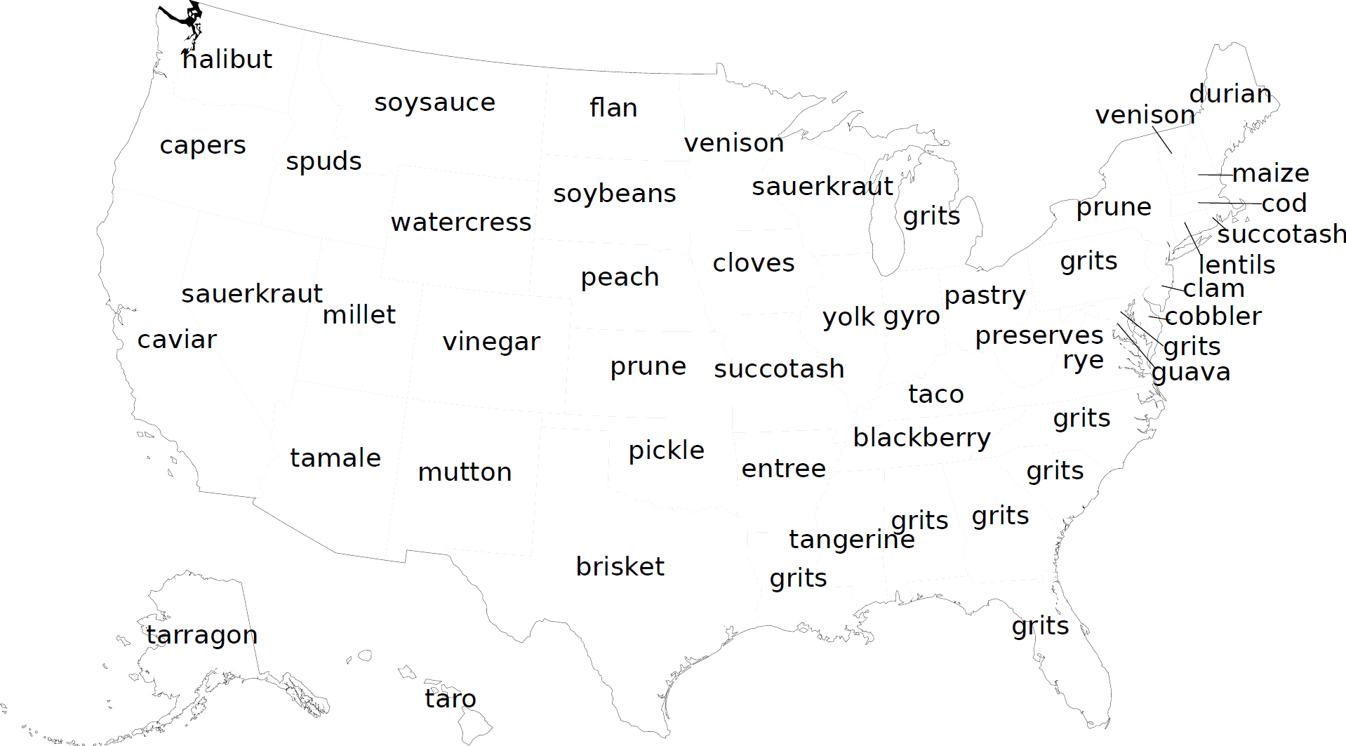
Where we started (Fried et al., 2014)
Collected 3.5M tweets (560K localized to US) between 10/2013 and 3/2014

Slide 6
State-level prediction of risk (Fried et al., 2014)

Slide 7
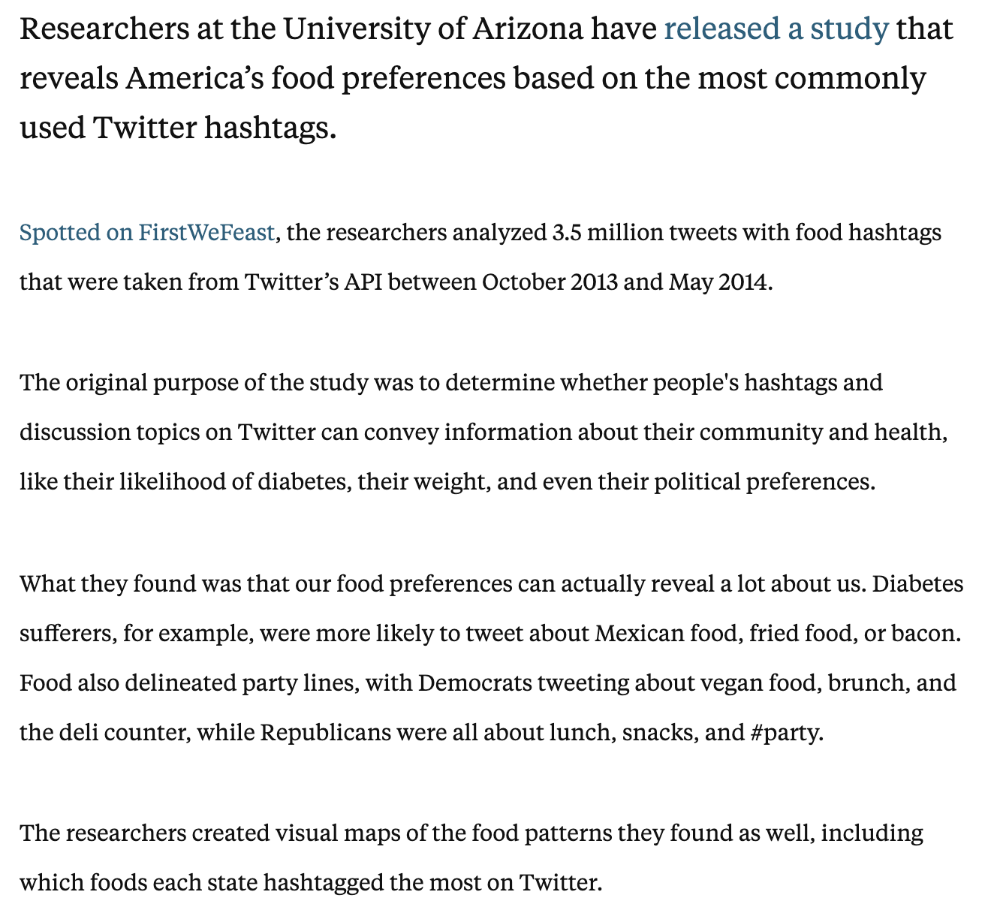
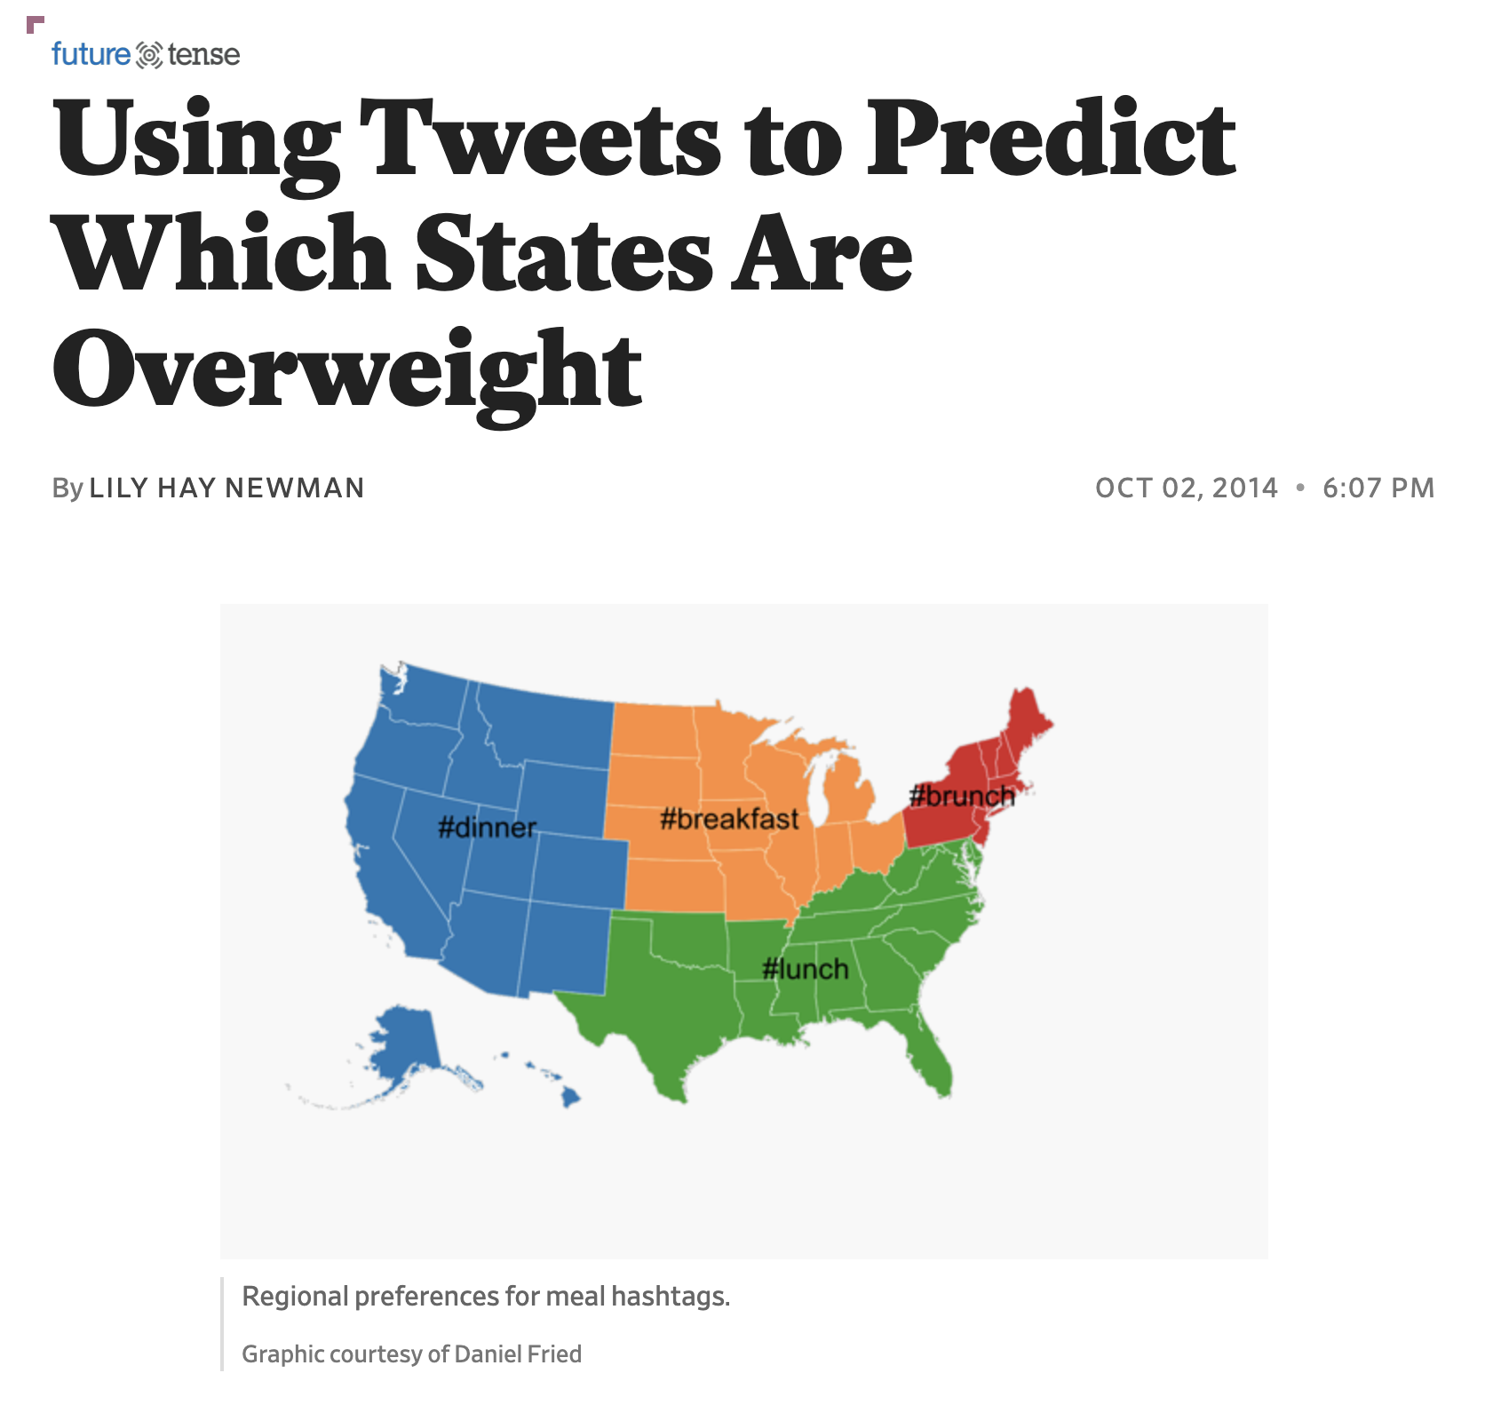
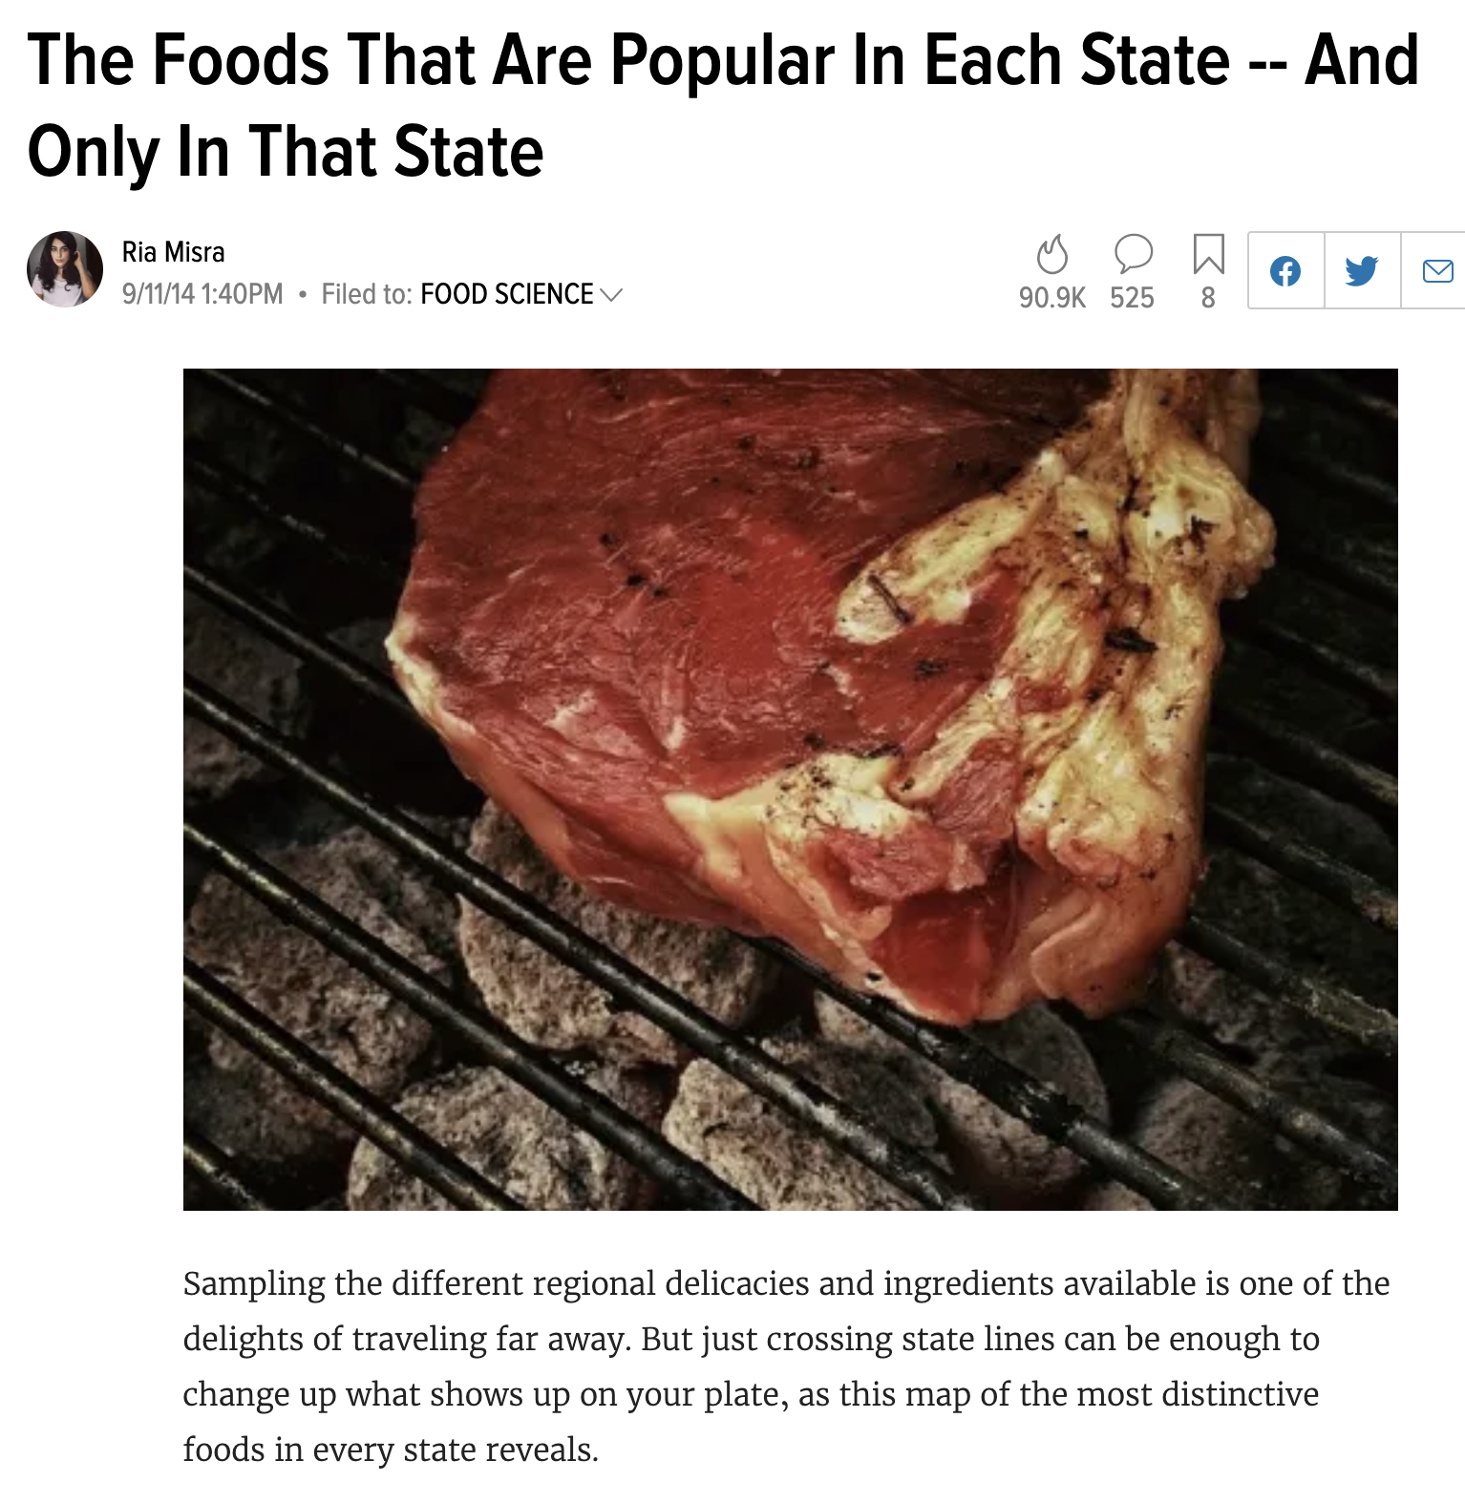
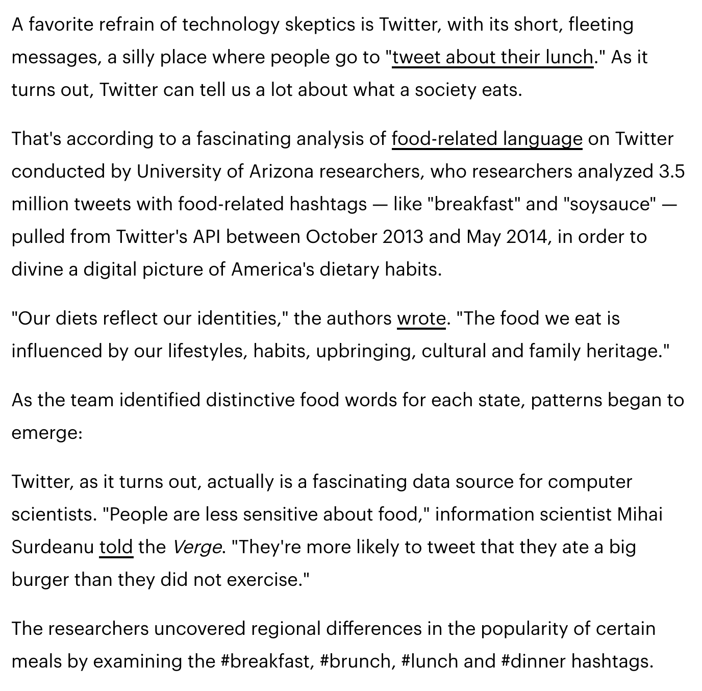
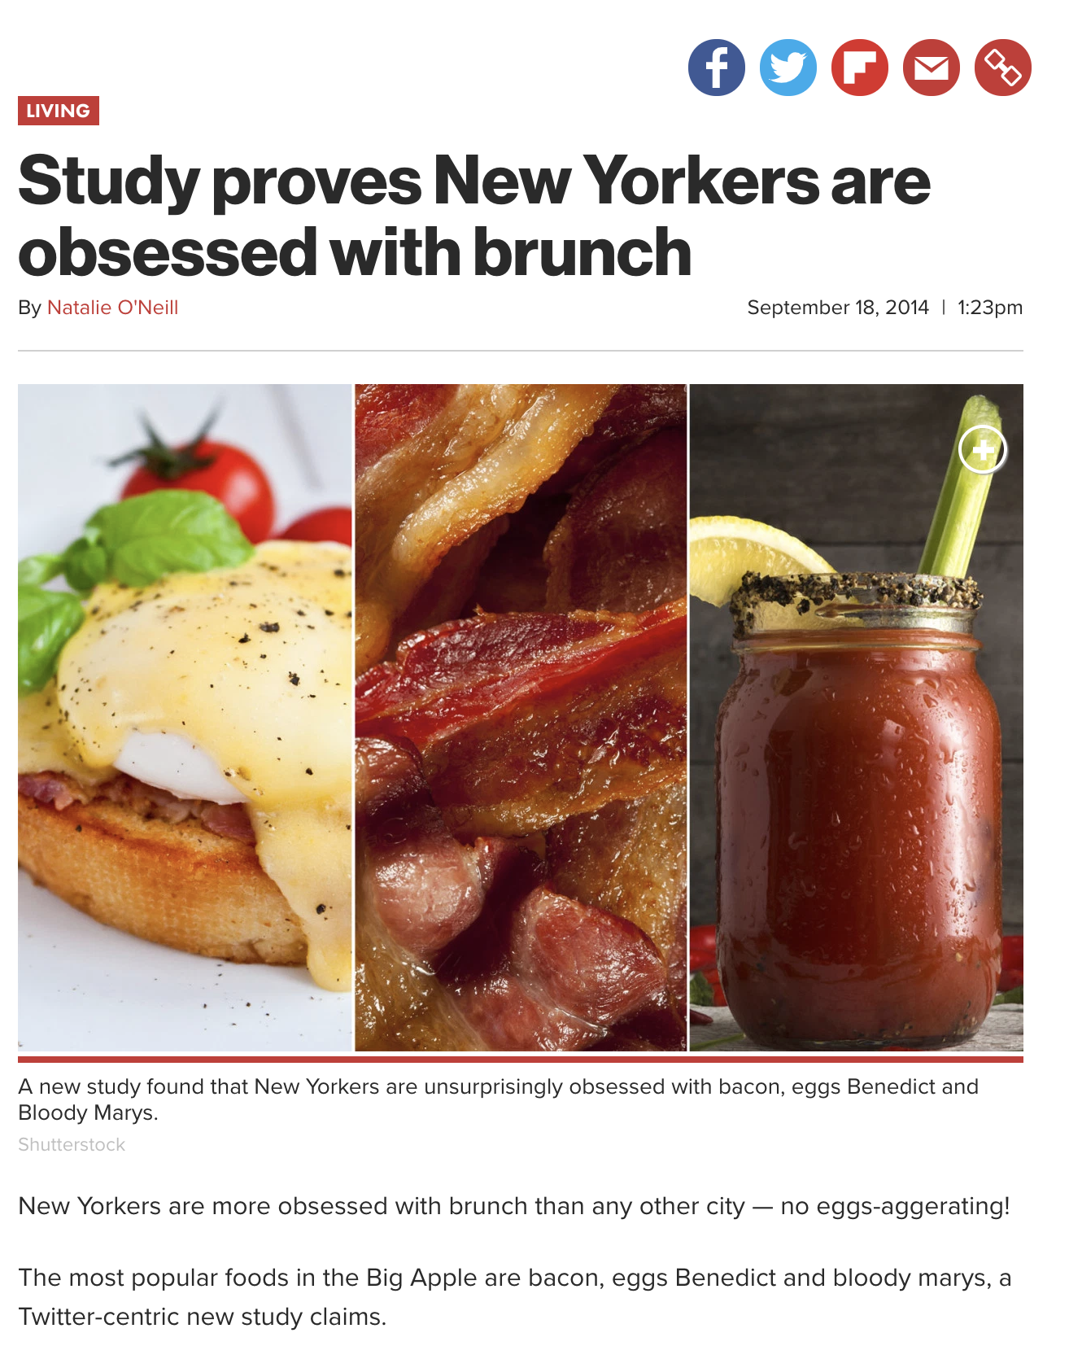
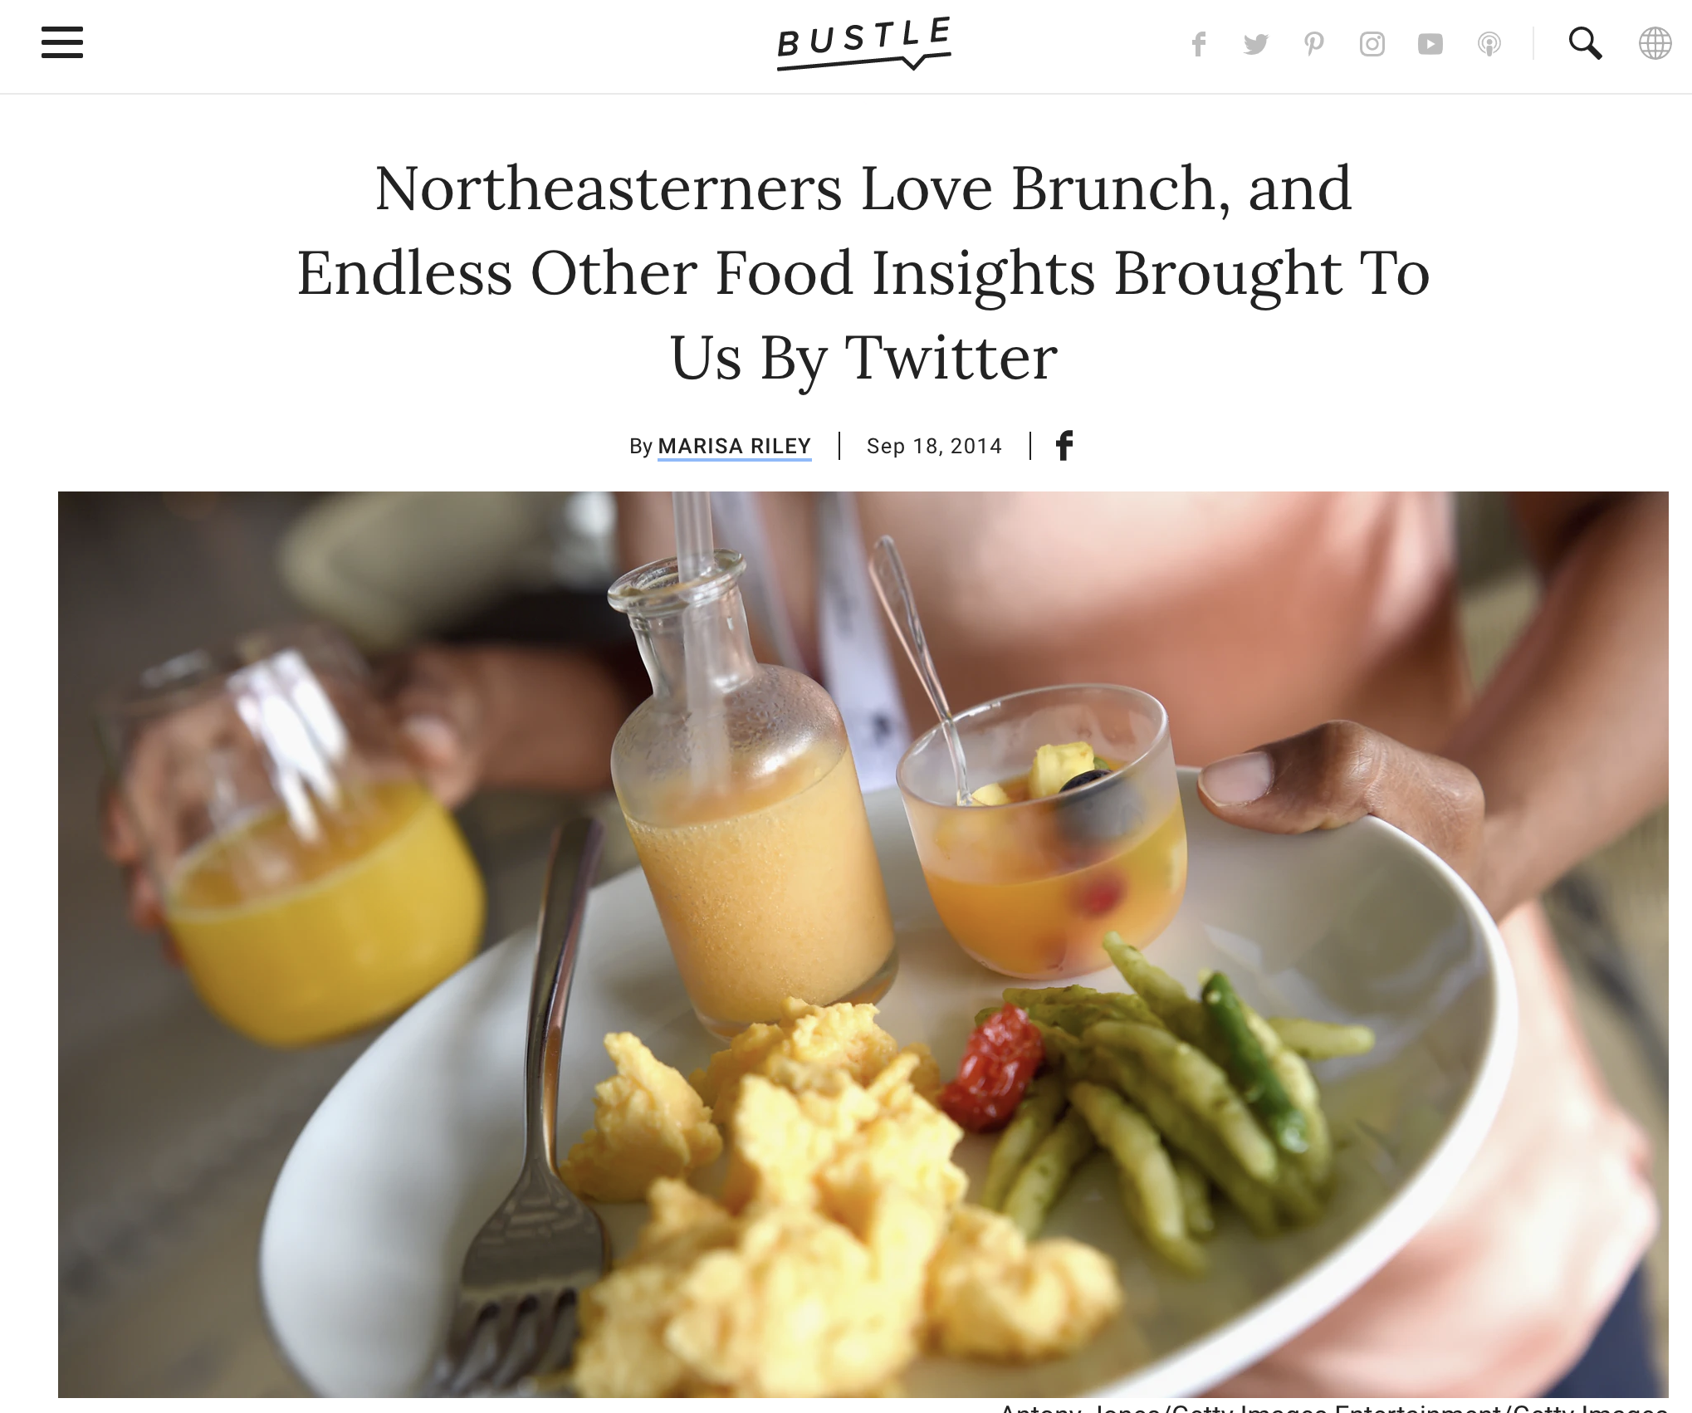
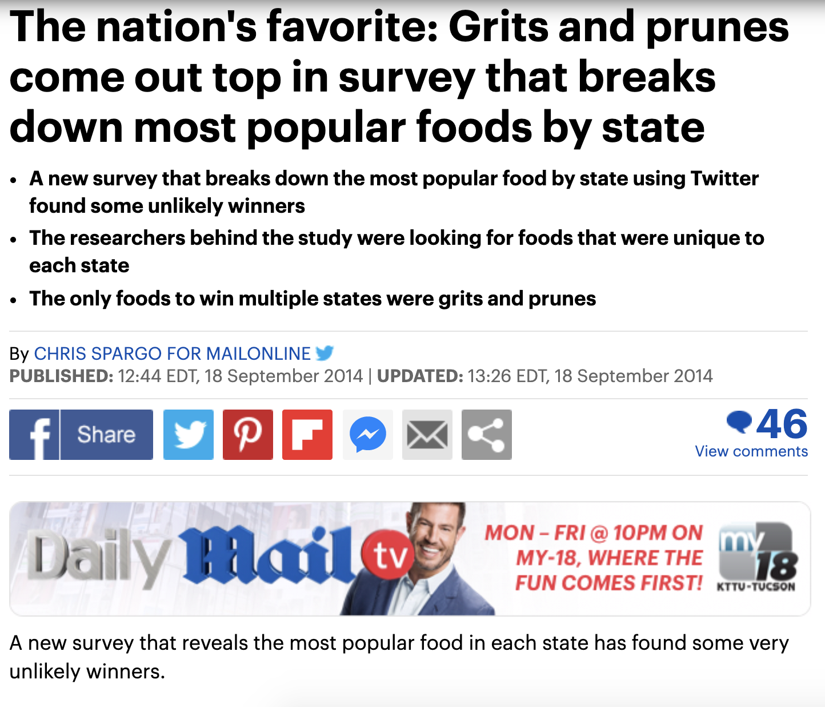
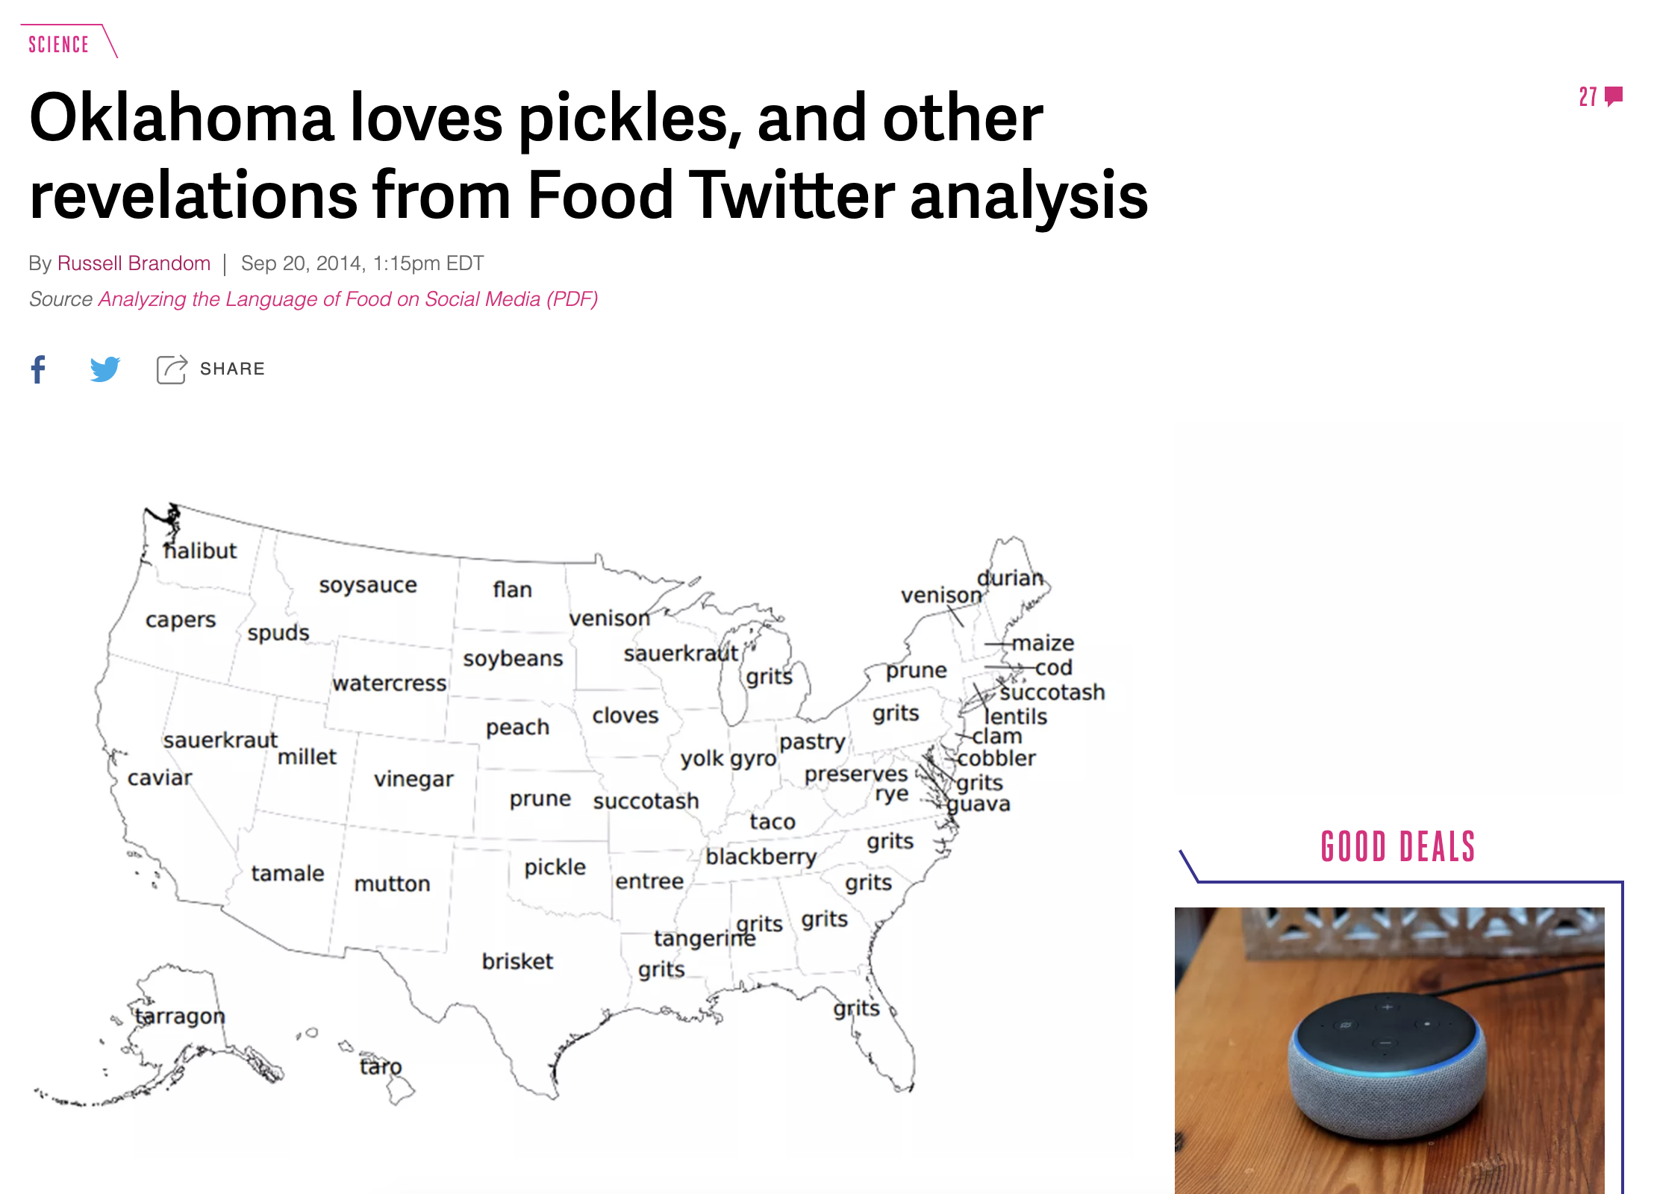
Press
Notes:
Daily Mail, Washington Post, Fox News, The Verge, Slate
People resonate with food!

Slide 8
Goals of this work
Revisit (Fried et al., 2014) with a lot more data (7 times larger dataset)
Improved results by 4 – 18%
Predicted additional state-level indicators such as income, poverty, and education levels
Investigate the overlap between socioeconomic factors and the language of food
The language of food is distinct from these factors
Analyze language trends over time
It is not great
Visualize and inspect the data
Discovered semantic relations between foods and various categories

Slide 9
methods

Slide 10
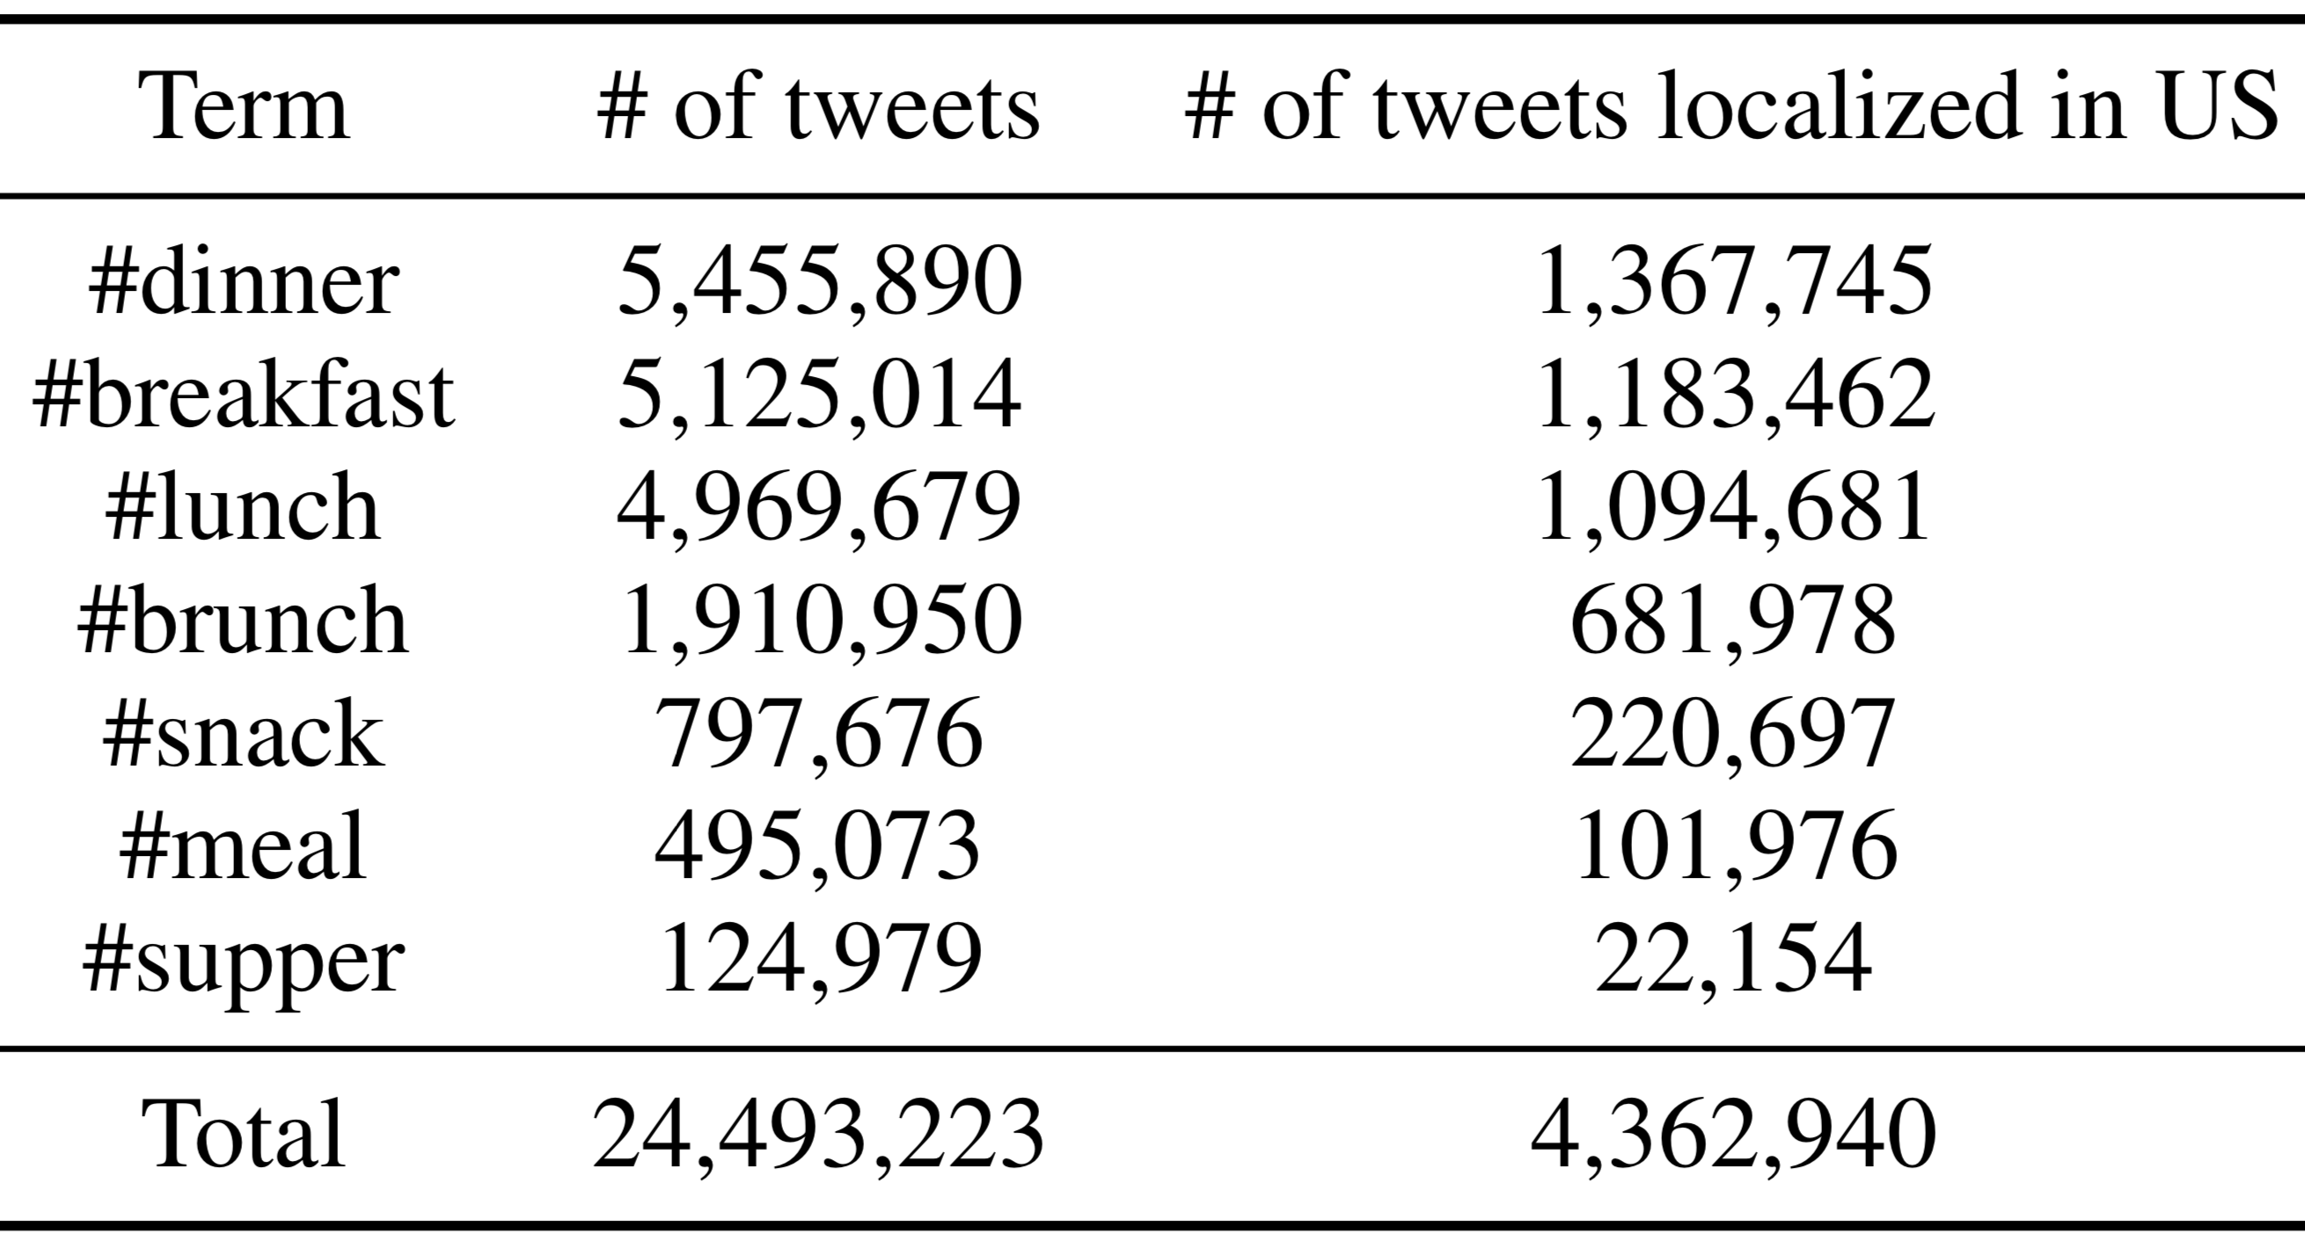
Data collection
Collected 24.5M tweets (4.3M localized to US) between 10/2013 and 8/2018
Localization used both self-reported user location in meta data and geo tagging

Slide 11
State-level prediction tasks Dependent variables
Task 1: Type 2 diabetes mellitus (T2DM) rate prediction
Percentage of individuals in a state who have been diagnosed with T2DM
Data from the Kaiser Commission on Medicaid and Uninsured (KCMU)’s analysis of the Center for Disease Control’s Behavioral Risk Factor Surveillance System (BRFSS) 2017 Survey
Task 2: Income rate prediction
Household median income in a state
Data from the United States Census Bureau (USCB)’s analysis of the American Community Survey (ACS)’s Income and Poverty in the United States: 2017

Slide 12
State-level prediction tasks Dependent variables
Task 3: Poverty rate prediction
Percentage of people in a state under the poverty threshold
Data from USCB’s analysis of the ACS’s Income and Poverty in the United States: 2017
Task 4: Education rate prediction
Higher education attainment rate (HEAR)
Data from the Center of American Progress (CAP)
All dependent variables converted to binary variables by comparing them with the corresponding national median
E.g.: the National median T2DM rate is 10.8%. West Virginia assigned the label 1 (high) because it has a rate of 15.2%

Slide 13
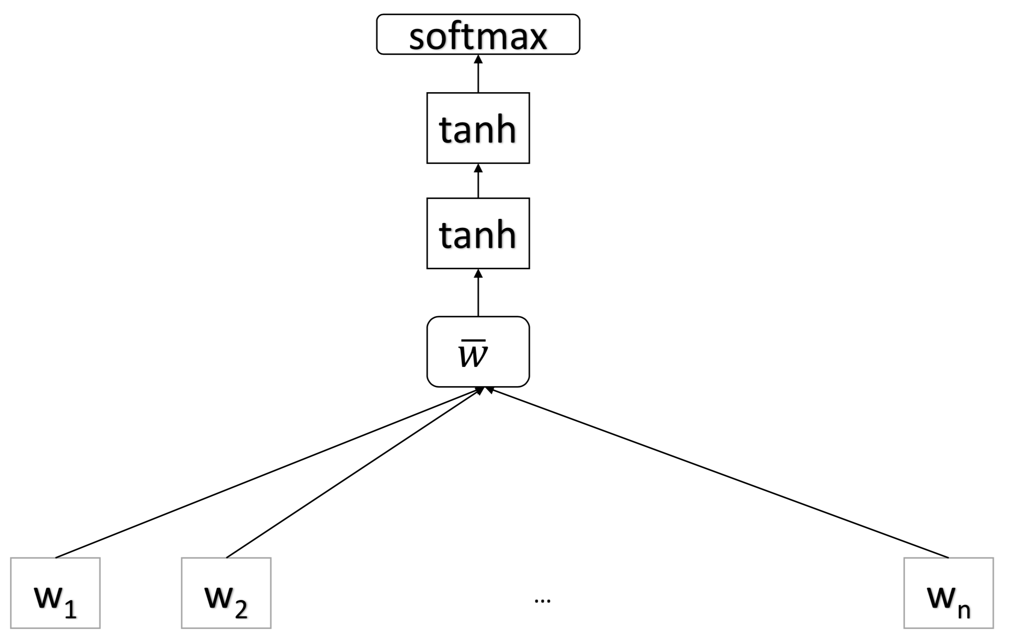
Classifiers
Deep averaging network
(Iyyer et al., 2015)
Linear support vector machines (SVM)
Random forests (RF)
All classifiers evaluated using LOOCV on the 50 + 1 states
Embeddings computed over 24M food tweets
Notes:
50 states + Washington DC
DAN: We hypothesize that the reason behind this low performance is the small number of data points (51), which is insufficient to train a neural network.

Slide 14
Features derived from food language
Bag of words
All words
A closed set of 800 words associated with food
Hashtags
Topics
200 topics created using LDA
The topic with highest probability assigned to each tweet
Feature value = number of tweets containing it

Slide 15
Features from socioeconomic factors (for T2DM prediction only)
Correlation between socioeconomic factors and US T2DM rate
The correlation with each state’s T2DM rate was added as a distinct feature (multiplied by a constant)

Slide 16
results

Slide 17
T2DM prediction using the SVM classifier
All words
Hashtags
Food words
Food words + LDA
Food words + Hashtags + LDA

Slide 18
T2DM prediction using the SVM classifier
More data is better: we consistently outperform Fried et al., by up to 12%
Simpler features are Ok: 800 food words obtain nearly the same performance as all words
All words
Hashtags
Food words
Food words + LDA
Food words + Hashtags + LDA

Slide 19
T2DM prediction using the SVM classifier
Again, more data is better: our classifier benefits more from feature combinations
All words
Hashtags
Food words
Food words + LDA
Food words + Hashtags + LDA

Slide 20
Learning curve for T2DM prediction
Considerable improvements from more data, regardless of features used

Slide 21
T2DM learning curve in reverse chronological order
Older tweets not relevant for T2DM prediction
Notes:
Suggests that people change their eating behavior over a period spanning multiple years, and
Older data not relevant for predicting recent health.

Slide 22
Predicting other socioeconomic factors from the language of food
Poverty
Income
Education
Best single feature group Best feature combination

Slide 23
Predicting other socioeconomic factors from the language of food
Poverty
Income
Education
Best single feature group Best feature combination

Slide 24
Predicting other socioeconomic factors from the language of food
Feature combinations improve performance by up to 4%
We can predict these factors from the language of food alone, with accuracies between 66 and 84%
Poverty
Income
Education
Best single feature group Best feature combination

Slide 25
Using socioeconomic factors as features for T2DM prediction
All words + LDA
Food words + LDA
Hashtags + LDA
Food words + Hashtags + LDA
Language-only features Language + a socioeconomic factor

Slide 26
Using socioeconomic factors as features for T2DM prediction
All words + LDA
Food words + LDA
Hashtags + LDA
Food words + Hashtags + LDA
Language-only features Language + a socioeconomic factor

Slide 27
Using socioeconomic factors as features for T2DM prediction
All words + LDA
Food words + LDA
Hashtags + LDA
Food words + Hashtags + LDA
Language-only features Language + a socioeconomic factor

Slide 28
Using socioeconomic factors as features for T2DM prediction
All words + LDA
Food words + LDA
Hashtags + LDA
Food words + Hashtags + LDA
Language-only features Language + a socioeconomic factor

Slide 29
Using socioeconomic factors as features for T2DM prediction
Education and income do not help in the SVM, but they do help a bit in the RF classifier (see paper).
All words + LDA
Food words + LDA
Hashtags + LDA
Food words + Hashtags + LDA
Language-only features Language + a socioeconomic factor

Slide 30
Using socioeconomic factors as features for T2DM prediction
Poverty consistently helps prediction accuracy.
Using poverty alone yields 58% T2DM accuracy.
All words + LDA
Food words + LDA
Hashtags + LDA
Food words + Hashtags + LDA
Language-only features Language + a socioeconomic factor

Slide 31
What we learned so far (1/3)
Observation #1 (a): multiple state-level characteristics can be estimated fairly accurately from the language of food alone!
Observation #1 (b): the language of food provides distinct signal from other state-level features such as poverty

Slide 32
Food (language) trends
Annotated the 800-word food lexicon into healthy/unhealthy/neutral foods using recommendations from medical sites
Healthy | Neutral | Unhealthy
apple | cereal | batter
avocado | chicken | cake
beetroot | corn | candy
… | …
Kappa agreement between any two annotators ranged between 0.39 to 0.72

Slide 33
Food (language) trends
Used four partitions of the tweet dataset, each containing a complete year’s set of tweets (from 2014 to 2017)
Computed the PMI between each food word category (t) and year (y):

Slide 34
Food (language) trends
Slight increase in mentions of unhealthy and neutral foods
Decrease in mentions of healthy foods

Slide 35
What we learned so far (2/3)
Observation #2: are we experiencing a continued decline in dietary patterns in the US?

Slide 36
Visualizing relations between food language and various semantic categories
Generated embeddings from all tweets collected to date using word2vec (Mikolov et al., 2013)
Projected them in 2D using the semantic axes tool (Heimerl and Gleicher, 2018)
Each axis defined by two words (or two sets of words)

Slide 37
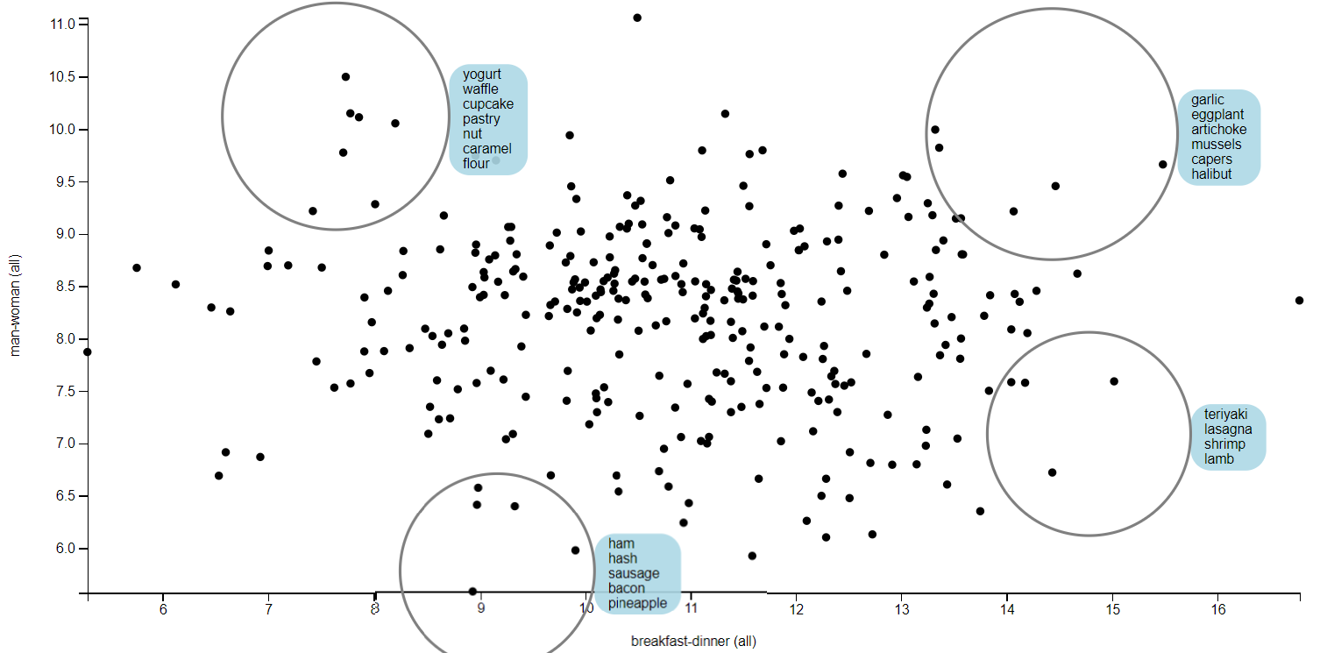
Visualizing relations between food language and various semantic categories
man – woman
Women tend to be more health-conscious than men
Men really like meat
Men really like meat
breakfast – dinner

Slide 38
Visualizing relations between food language and various semantic categories
Women prefer more gourmet foods
woman + vegetarian diet | mint, saffron, fennel, squash, soup, tomato, eggplant
man + vegetarian diet | beet, onion, coconut, spinach, kale, carrot
woman + low-carb diet | hazelnut, nut, cupcake, pastry, grain, caramel, wheat
man + low-carb diet | cereal, spaghetti, buns, hamburger, pepperoni, crunch
man vs. woman, vegetarian vs. low-carb diets
Men prefer more hearty foods

Slide 39
What we learned so far (3/3)
Observation #3: visualization helps discover hidden trends in dietary patterns

Slide 40
Contributions of this work
Predicted state-level characteristics from the language of food, with 7 times more data than Fried et al. (2014)
Improved results by 4 – 18%
Predicted additional state-level indicators such as income, poverty, and education levels
Investigated the overlap between socioeconomic factors and the language of food
The language of food is distinct from these factors
Analyzed language trends over time
There is a downward trend in the usage of healthy food words
Visualized the data
Discovered semantic relations between foods and various categories

Slide 41
Future work
Used this data and models to improve the prediction of health risk for individuals
Task that is plagued by sparsity
Use community information as a form of prior?

Slide 42
Thank you!
Mihai: msurdeanu@email.arizona.edu
Software: http://t4f.cs.arizona.edu/s/scatter.html

Slide 43
Acknowledgments
Mihai Surdeanu declares a financial interest in lum.ai. This interest has been properly disclosed to the University of Arizona Institutional Review Committee and is managed in accordance with its conflict of interest policies.

