Slide 1
Detecting Diabetes Risk from Social Media Activity
Dane Bell, Egoitz Laparra, Aditya Kousik, Terron Ishihara, Mihai Surdeanu, and Stephen Kobourov
LOUHI 2018

Slide 2
Motivation
30.3M diabetes cases in the US in 2015, of whom 7.2M were undiagnosed
Diabetes caused over 79K US deaths in 2015
Diabetes caused $245B in economic costs in 2012

Slide 3
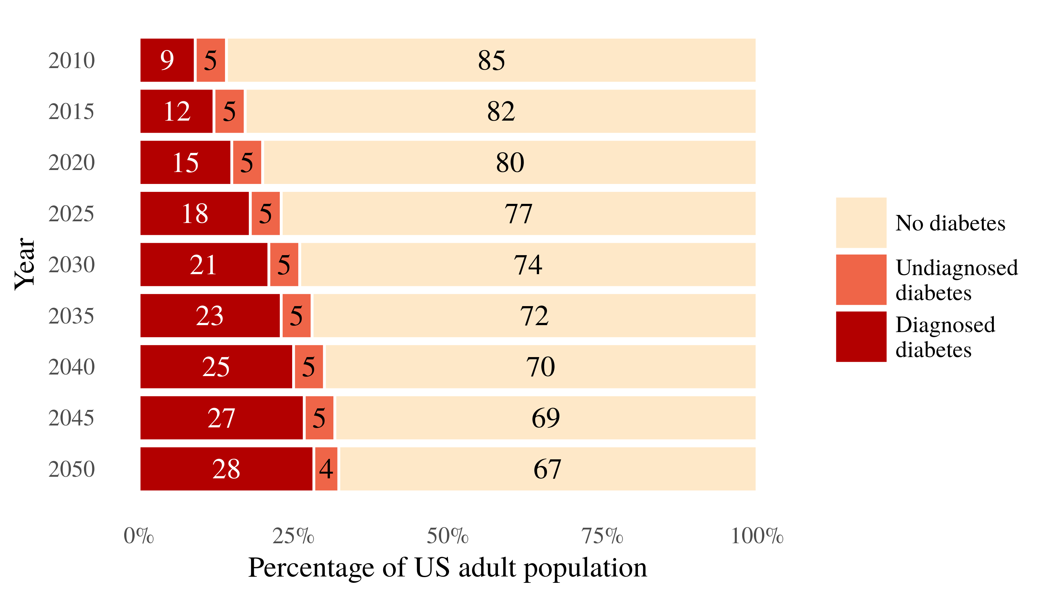
Projected US diabetes prevalence
Boyle et al. (2010)

Slide 4
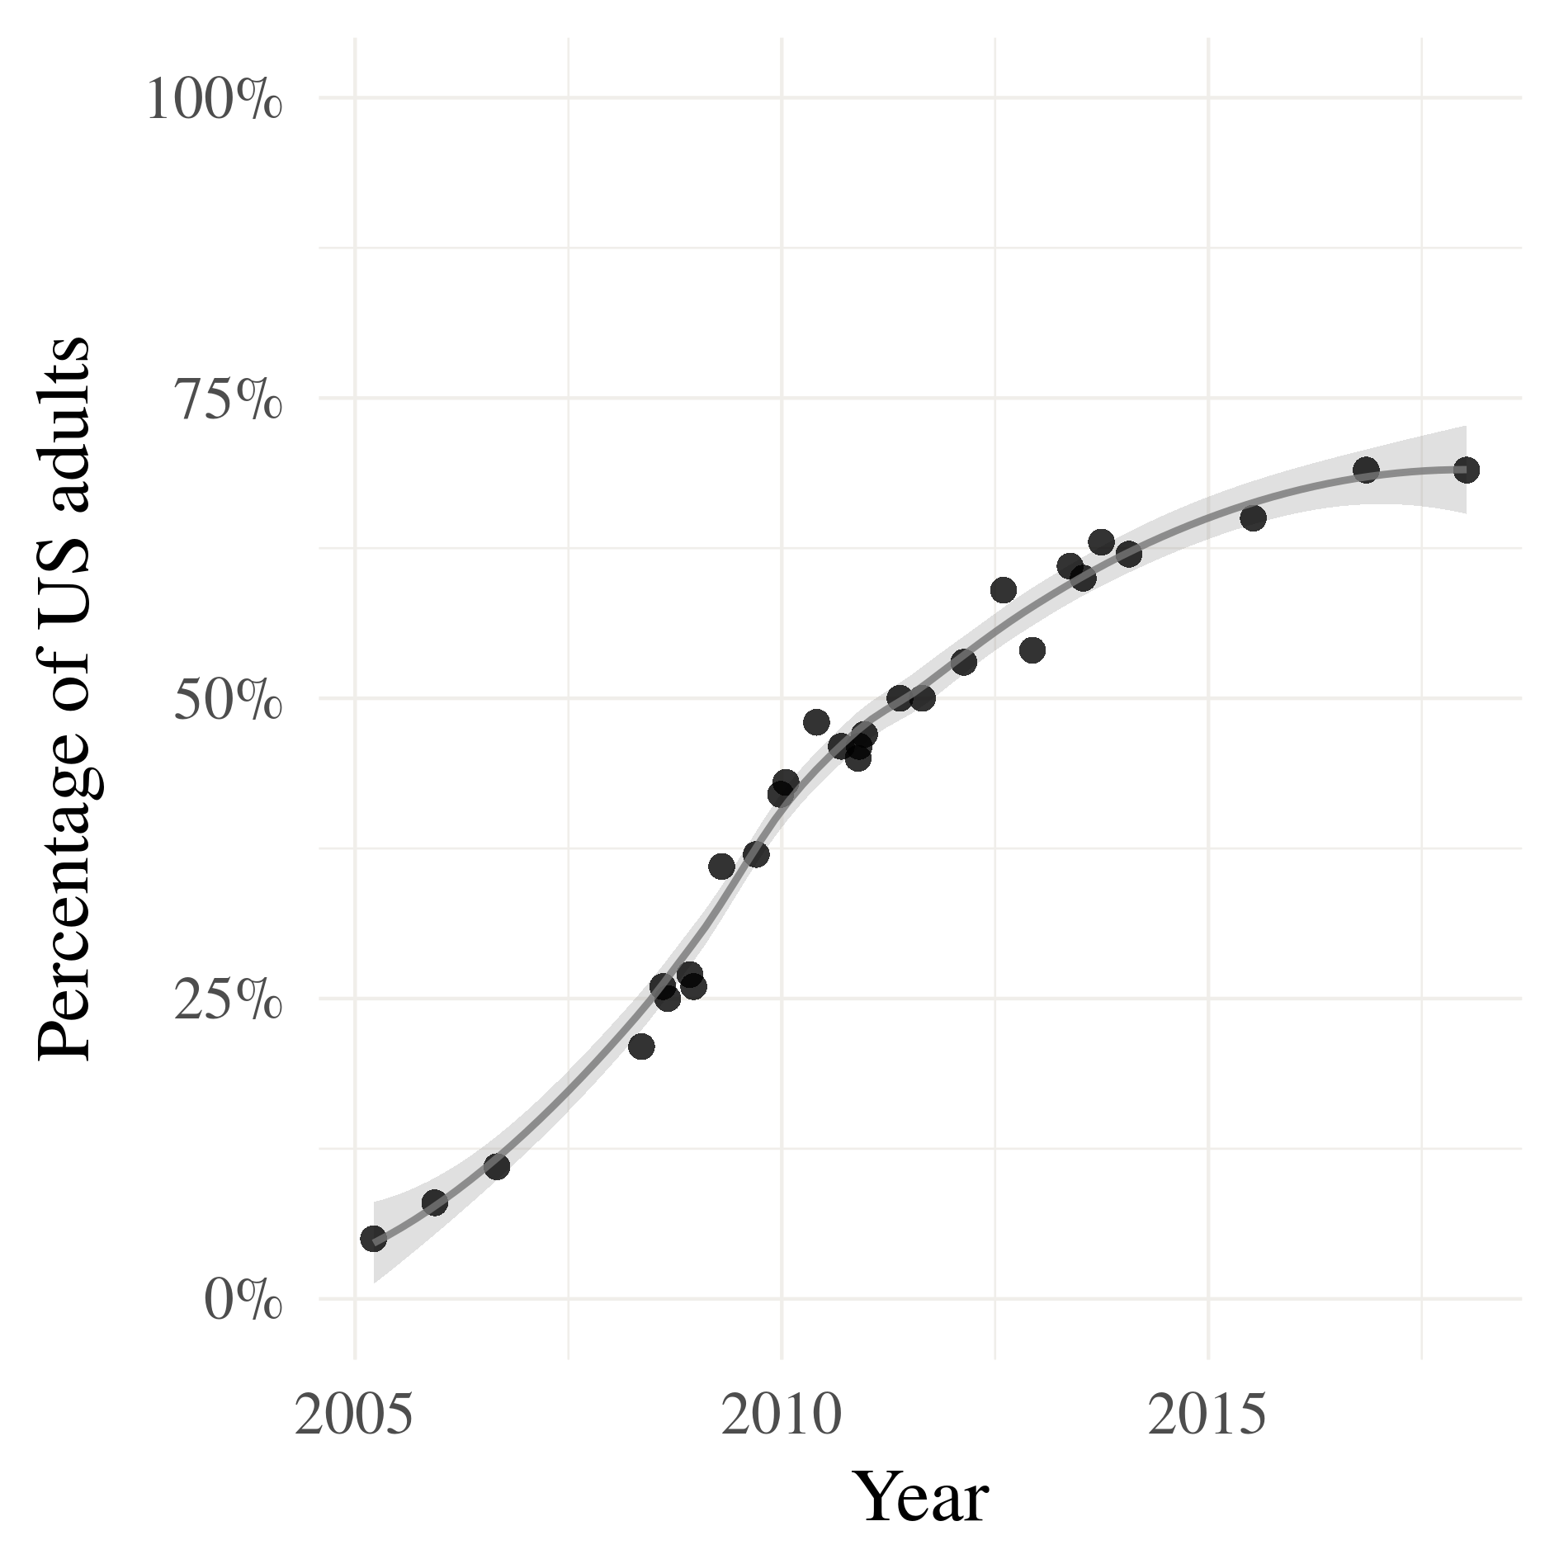
Goal
But Type 2 Diabetes Mellitus (T2DM), the most common type of diabetes, is preventable in many cases through life style adjustments
Let’s detect it early, using social media activity!
US adults using social media
Pew Research Center (2018)

Slide 5
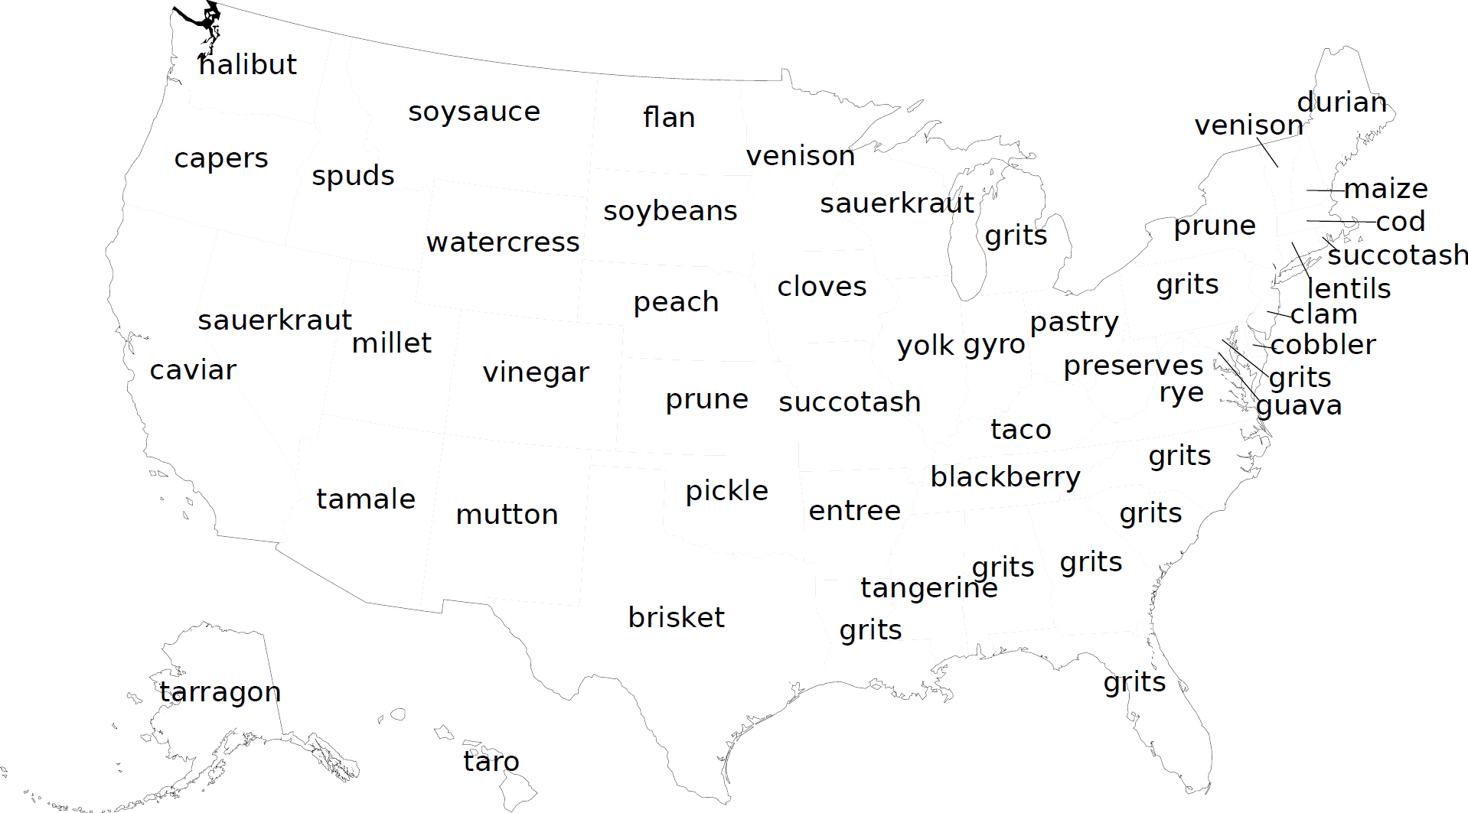
Where we started (Fried et al., 2014)

Slide 6
State-level prediction of risk (Fried et al., 2014)
Unfortunately, none of these results transferred to individuals…

Slide 7
Contributions of this work
New dataset: social media (tweets) + T2DM risk value on individuals
Novel deep learning approach to model risk
Captures recency of posts
Models gender information with domain adaptation
Shows that bag-of-words approaches better than RNNs

Slide 8
Data
Online quiz of T2DM risk (Bang et al., 2009)
Age, physical activity level, etc.
Produces a risk score between 0 and 9
3,612 people tool the quiz
736 supplied a Twitter handle
604 had a valid handle + public tweets
Small dataset!
Binary classification task
At-risk: score >= 5
Less-risk: score < 5

Slide 9
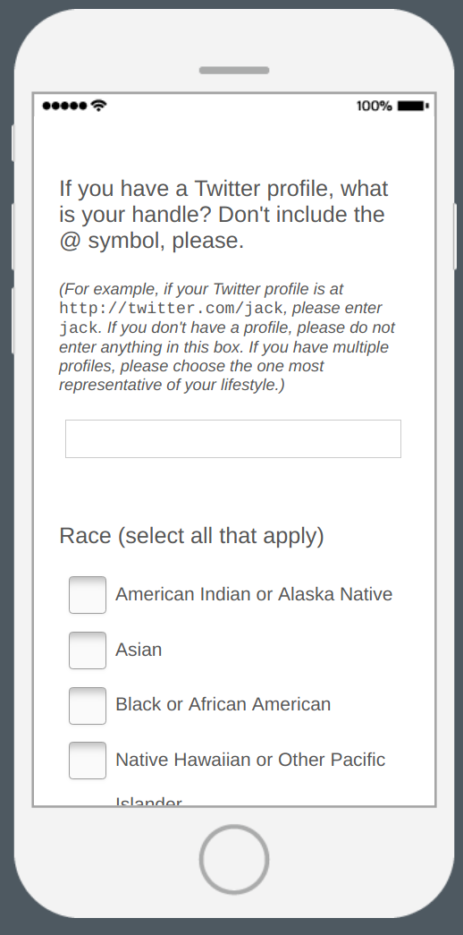
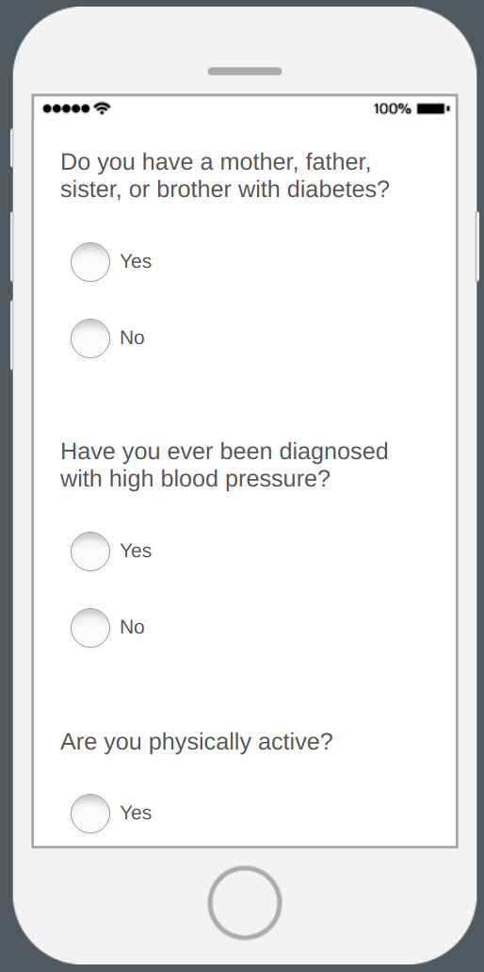
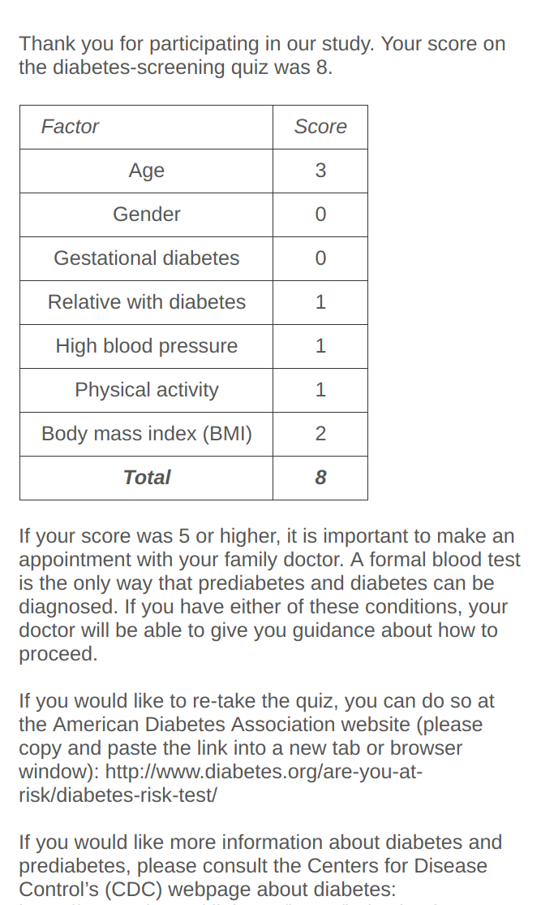
Quiz
9
Notes:
736 of 3612 respondents supplied a handle
604 were valid accounts
1.18 M tweets
20.3 M tokens

Slide 10
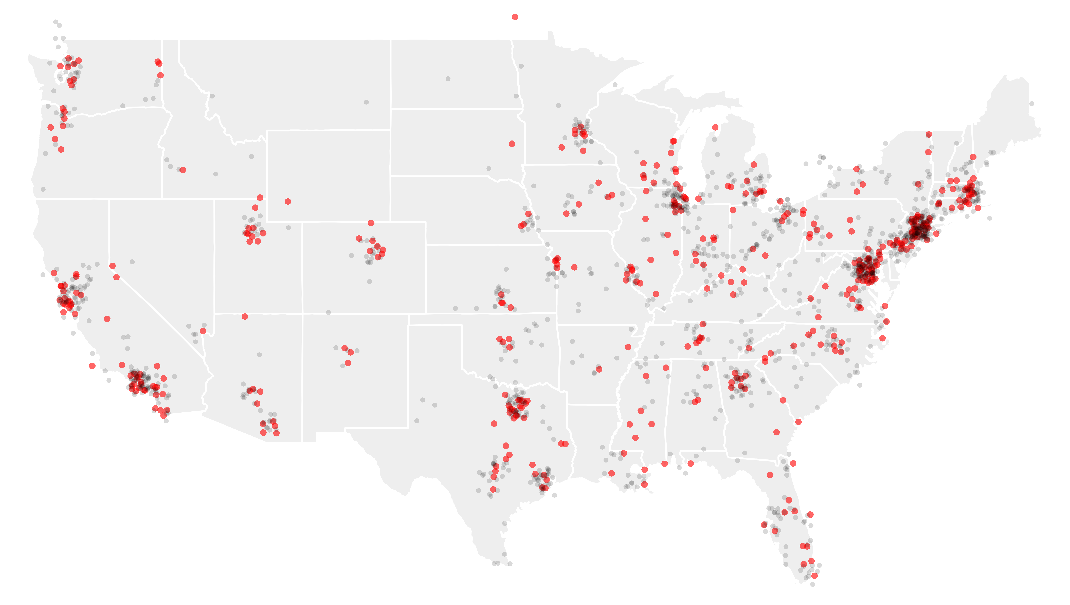
Participant distribution
10
Notes:
736 of 3612 respondents supplied a handle
604 were valid accounts
1.18 M tweets
20.3 M tokens

Slide 11
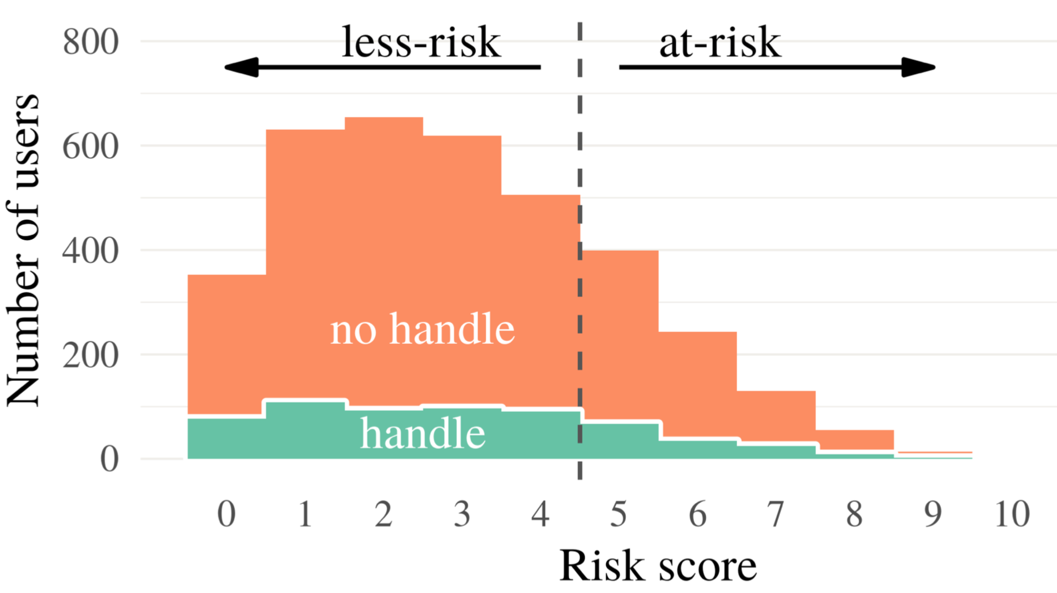
Label distribution

Slide 12
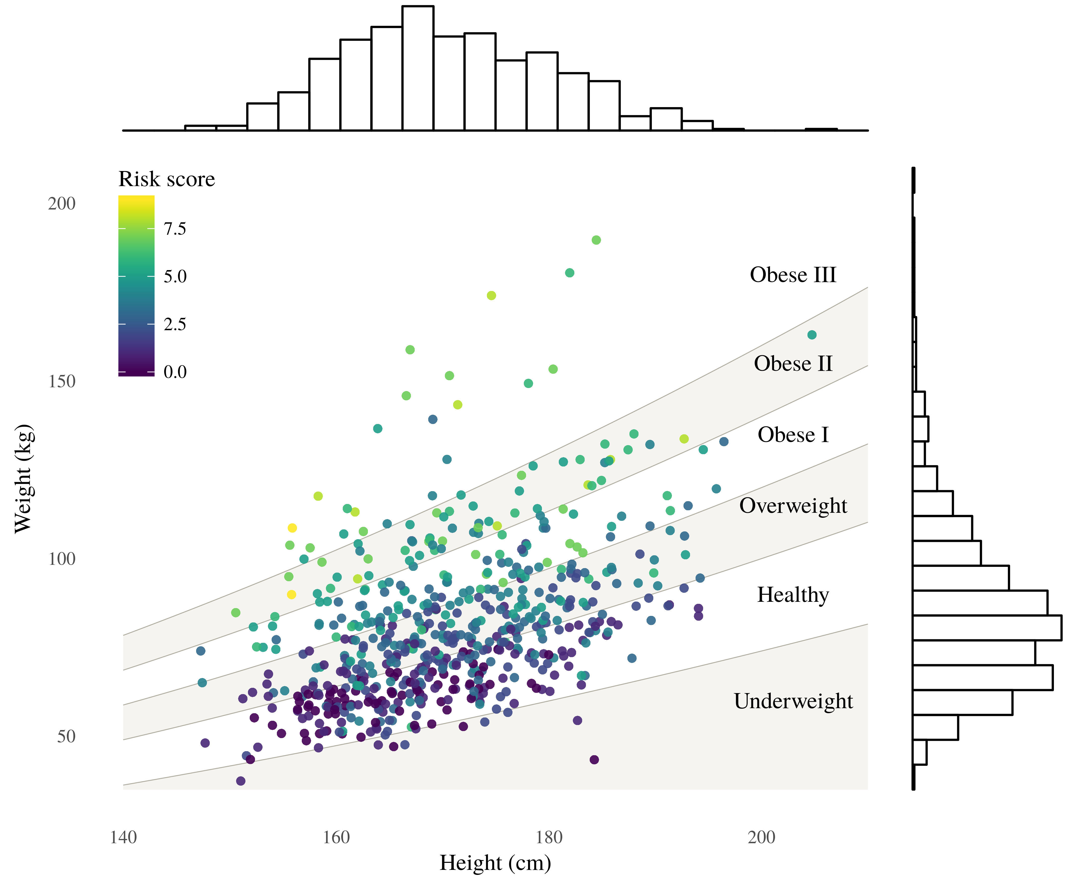
Notes:
An illustration of the relationship between height, weight, BMI, and risk score for respondents who pro- vided a valid Twitter handle. The BMI categories (underweight, healthy, overweight, etc.) are assigned according to boundaries set by the World Health Organization.

Slide 13
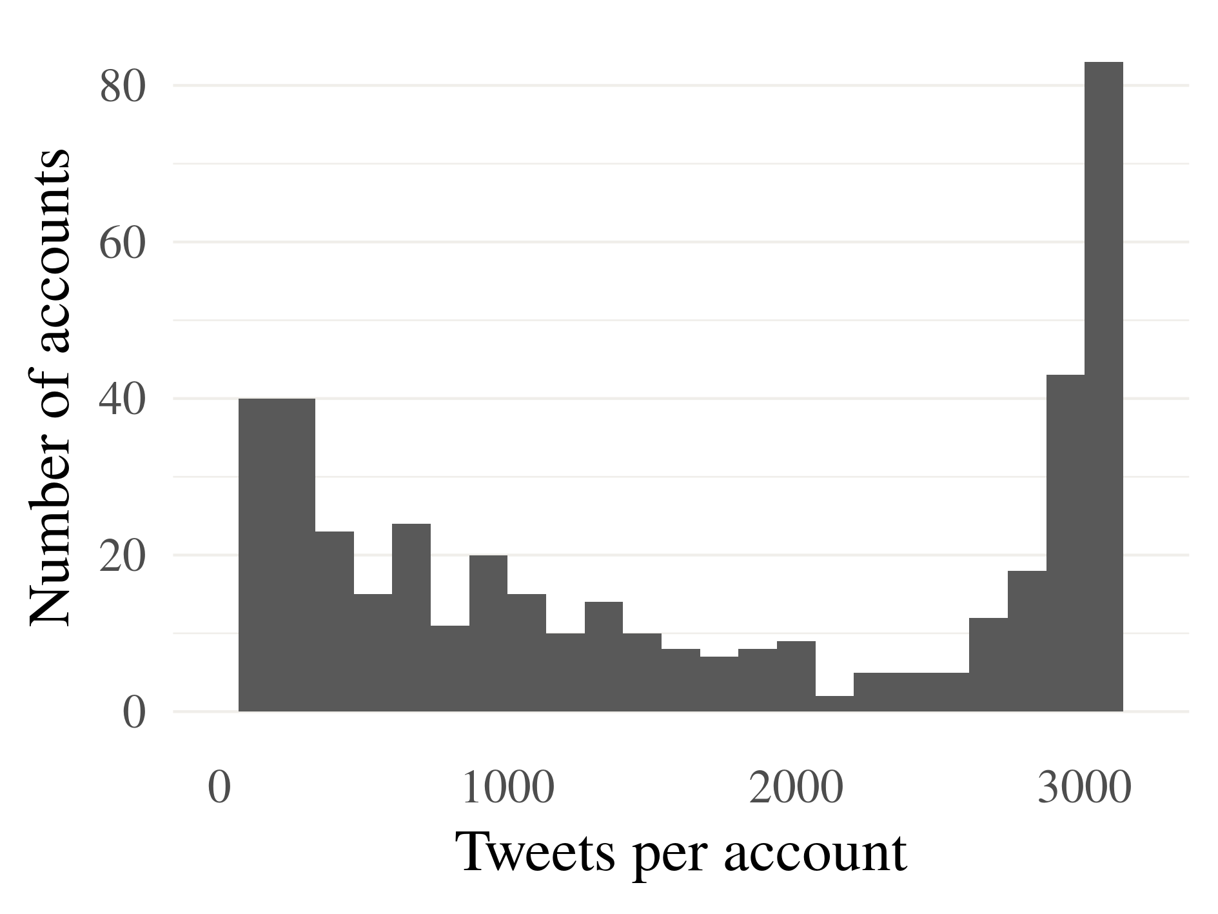
Account sizes in number of tweets
13
Notes:
736 of 3612 respondents supplied a handle
604 were valid accounts
1.18 M tweets
20.3 M tokens

Slide 14
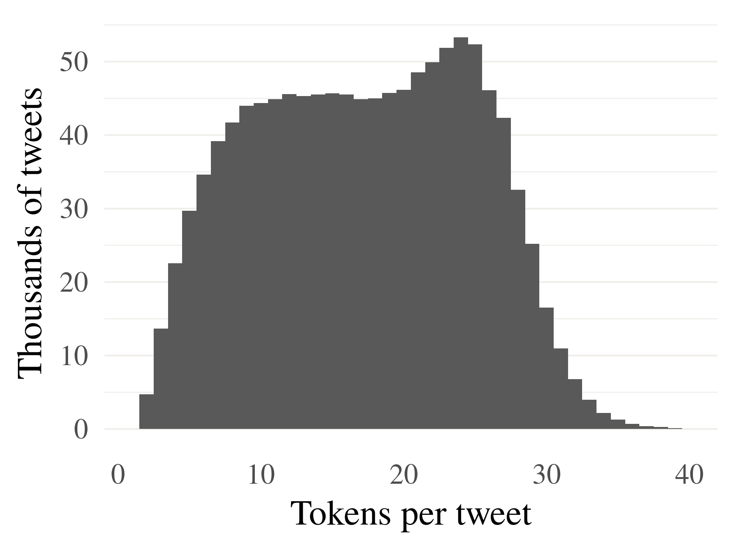
Tweet sizes in number of tokens
14
Notes:
736 of 3612 respondents supplied a handle
604 were valid accounts
1.18 M tweets
20.3 M tokens

Slide 15
Resources
Custom dictionaries of words and hashtags
Food, exercise, and restaurant names
Approximately 800
Automatically-expanded food dictionary
Trained word2vec over 12.3M food-related tweets

Slide 16
Activity words
Chains
BMI
10k
5k
abseil
abseiled
abseiling
abseils
aerobic
aerobics
aikido
airsoft
archer
…
#épée
#7eleven
#applebees
#arbys
#bajafresh
#baskinrobbins
#bigboy
#bobevans
#bojangles
#bonefishgrill
#bostonmarket
#buffalowildwings
…
zaxbys
#weightgain
#caloriecount
#overweight
#thick
#bellyfat
#curvy
#obese
#plussize
#fatguyproblems
#fatgirlproblems
...
#effyourbodystandards
16

Slide 17
Food words
New words
acorn
alfalfa
almond
almonds
anchovy
anise
appetite
appetizer
apple
apricot
artichoke
…
zucchini
#breakfastburrito
#brunching
#chinesefood
#chirashi
#clamchowder
#coffeecake
#crockpot
#eatmorefish
#eggporn
#fishfriday
#kitchenista
…
wonton
17

Slide 18
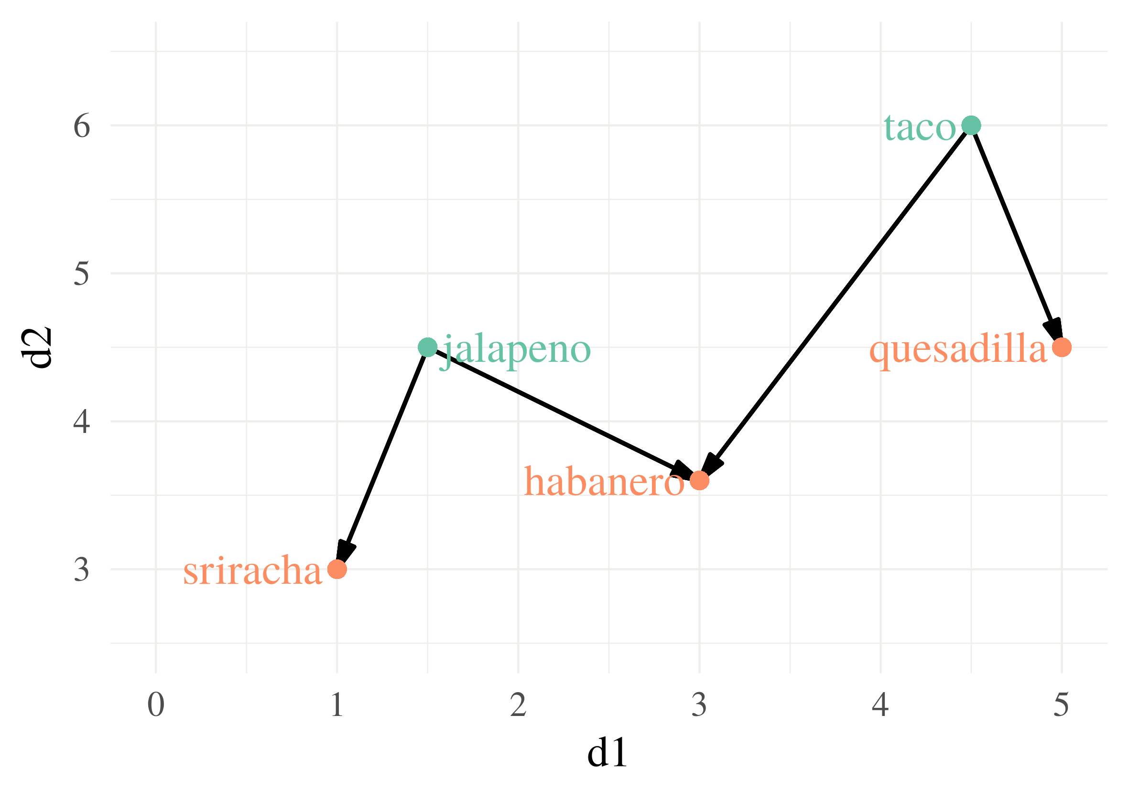
18
Notes:
We searched for the nearest neighbors of existing food words.
Candidates close to multiple food words got a bonus

Slide 19
Expanded dictionaries
2.8K words and hashtags
These dictionaries were used to filter the words in the tweets!

Slide 20
Resources: gender identification
Gender classifier
SVM classifier trained on 1,000 Twitter accounts hand-annotated with gender information (man or woman only)
75.79 F1 score on the T2DM dataset
Human annotators averaged 71% accuracy on an equivalent task (Nguyen et al., 2014)

Slide 21
i got mashed potatoes in my bag (gag)
the better question is when am i NOT thinking about kanye
<@MENTION> date me , both of u
<NUMBER> person's trash is another person's highly aesthetic trash
MINIONS R ON THE WAY AHHHHHHHHHHHH #Oscars
W
Toy Story's on .... Hurray !!
Who can tell us what's wrong with this picture ? <URL>
#Anthem over / under is <NUMBER> . Waaaay over .
Giants released ahmad bradshaw
This is not the movie you're looking for #Hansolo
M
21

Slide 22
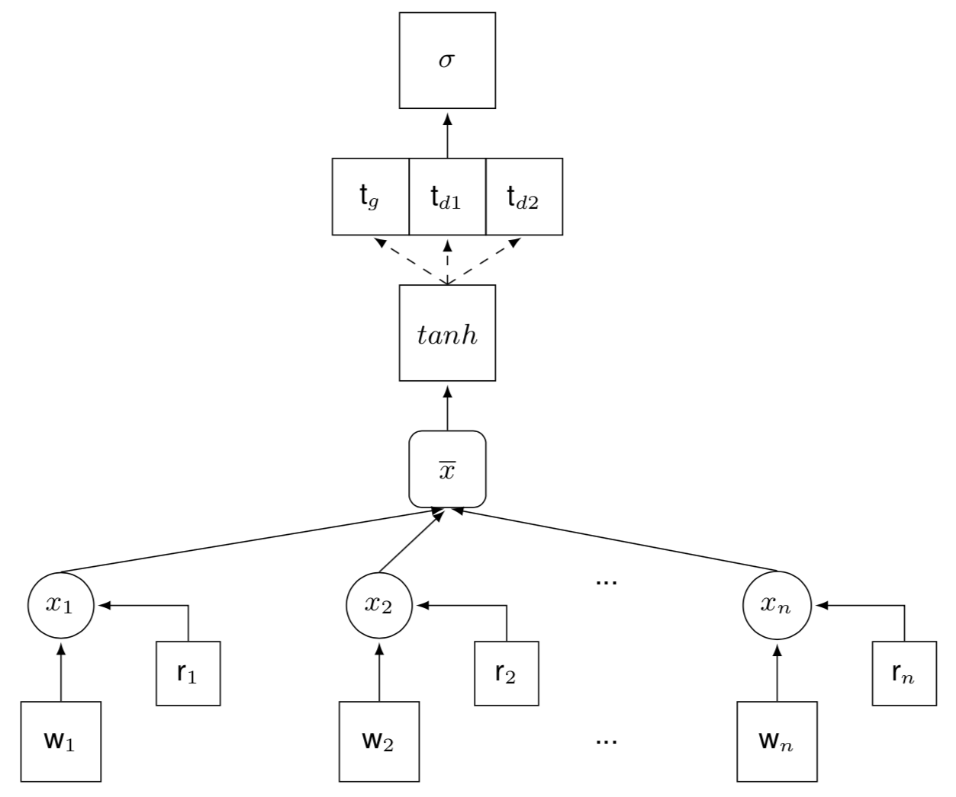
NN architecture

Slide 23
NN architecture
More recent words receive a higher weight:
x_{i} = w_{i} r_{i}

Slide 24
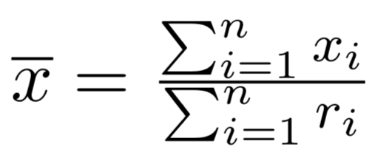
NN architecture
Bag-of-words approach:

Slide 25
NN architecture
Neural domain adaptation!
Each domain i, initializes t_{g} and t_{di} and sets the other domain’s vector to 0
Generic, cross-domain vector
Domain-specific vectors:
d1 = female, d2 = male

Slide 26
Baselines
All at risk
SVM
Features from the same filtered words provided to the NN
Gender adaptation using the approach of Daume III (2007)
Convolutional neural network (CNN)
Use a CNN instead of the BOW average in the proposed approach

Slide 27
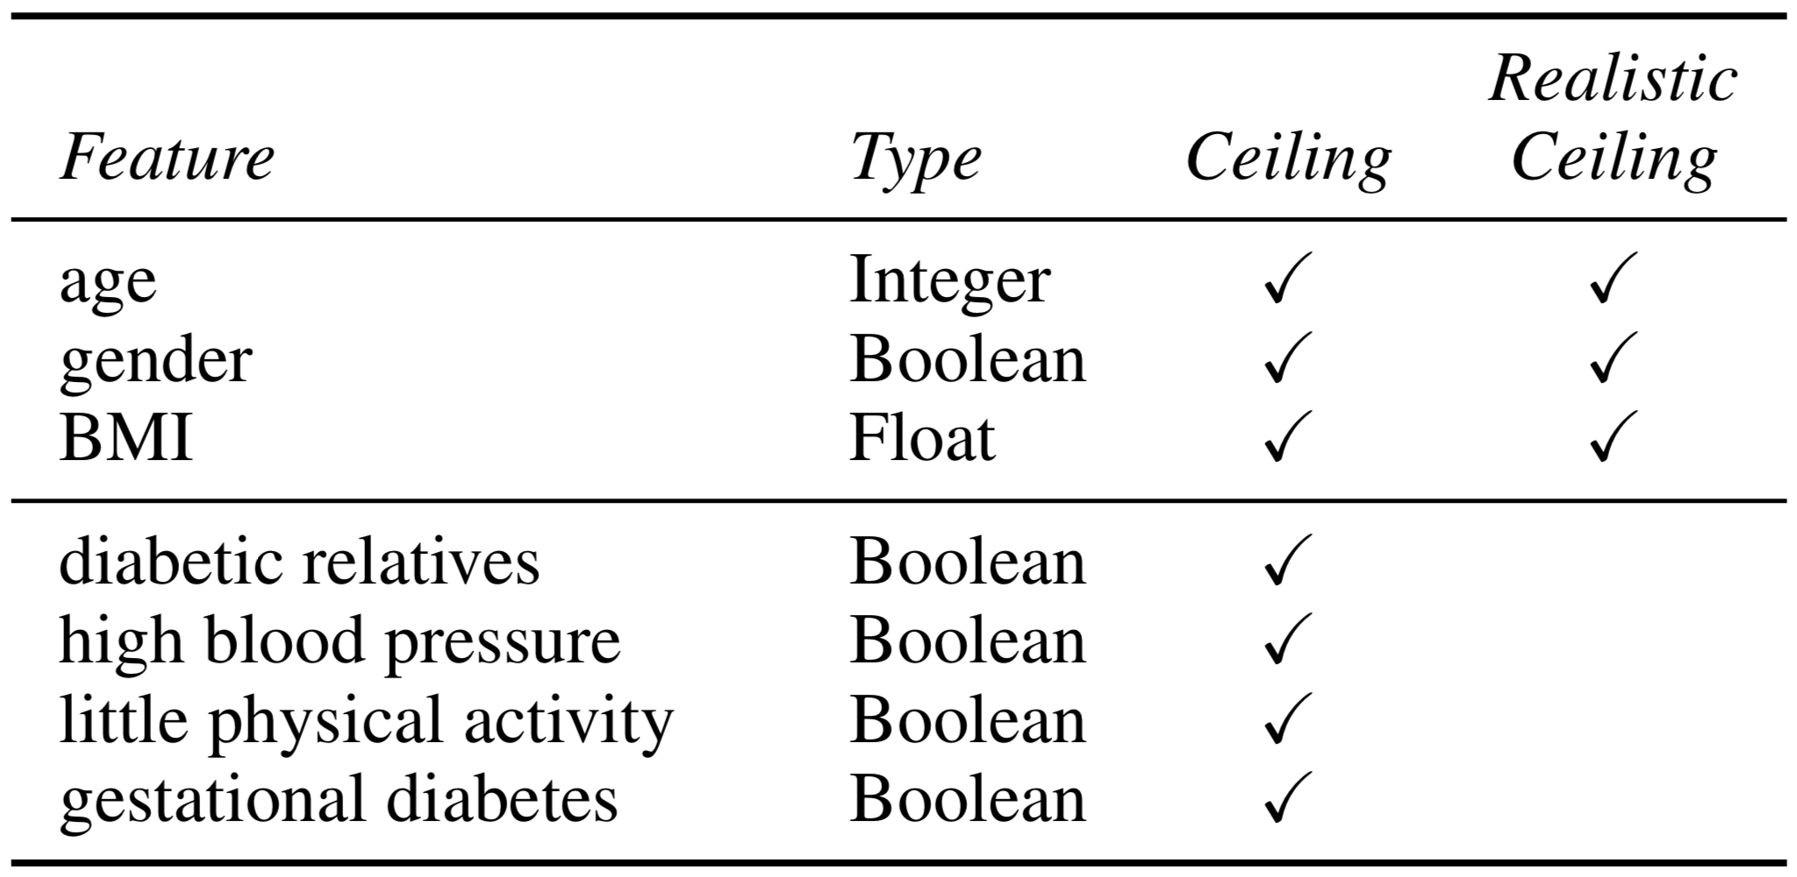
Ceiling models

Slide 28
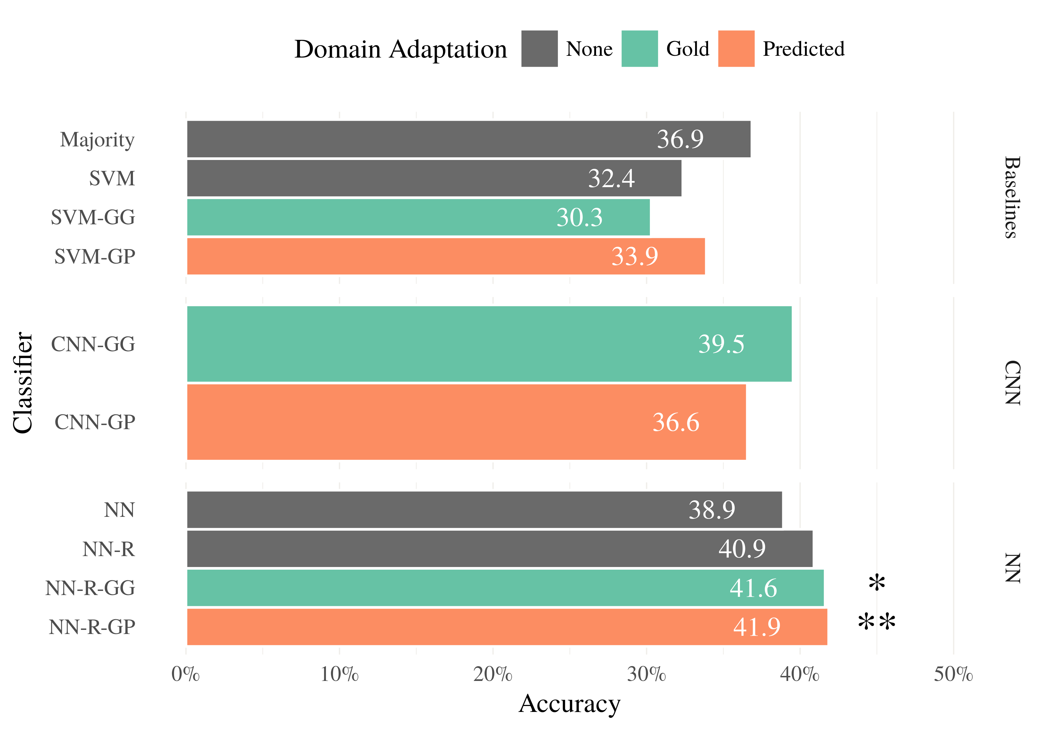
Results
F1 score
28

Slide 29
Results
Hard task: only CNN with gold gender outperforms the all-at-risk baseline!
F1 score
29
Notes:
Hard task: only CNN with GG outperforms all-at-risk!

Slide 30
Results
Bag-of-words better than CNN…
F1 score
30

Slide 31
Results
Recency matters
F1 score
31

Slide 32
Results
Gender matters
F1 score
32

Slide 33
Results
Hard task!
Realistic ceiling: 62.7 F1
F1 score
33

Slide 34
Model introspection
Word weights computed using
Layerwise Relevance Propagation

Slide 35
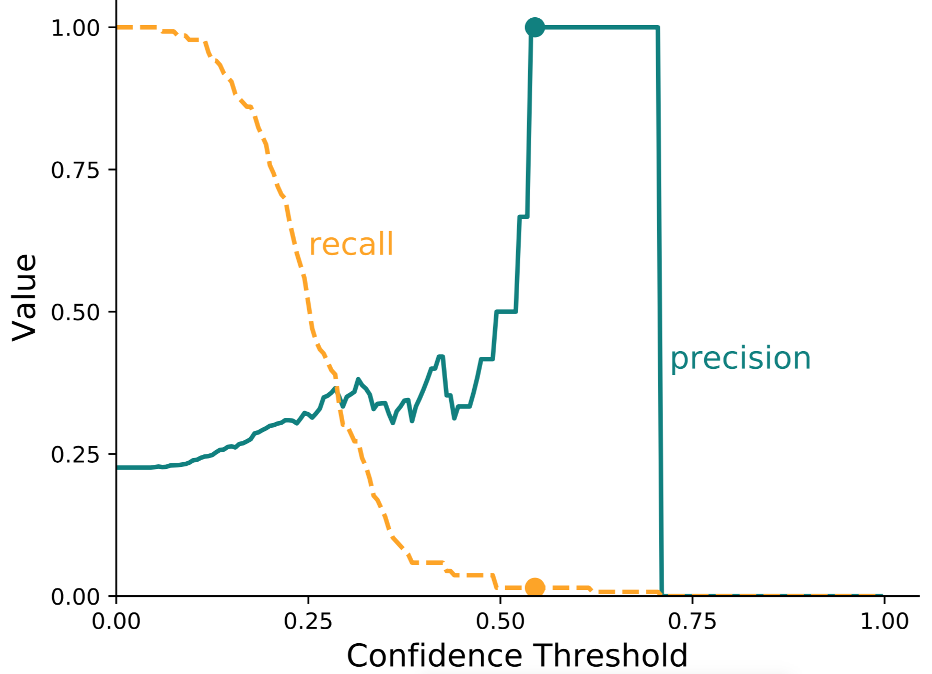
Real-world deployment using a high-precision model
Precision = 100%
Recall = 1.47%

Slide 36
Real-world deployment using a high-precision model
62M undiagnosed prediabetic individuals in the US
Let’s assume 15% Twitter adoption rate
Lower than the average 25%
Thus, there are 9.2M undiagnosed prediabetics who use Twitter
The 1.47% recall indicates that our approach would find ~140,000 of these prediabetics!

Slide 37
Contributions of this work
New dataset: social media (tweets) + T2DM risk value on individuals
Novel deep learning approach to model risk
Captures recency of posts
Models gender information with domain adaptation
Shows that bag-of-words approaches better than RNNs
NLP for good!

Slide 38
Thank you!
Mihai: msurdeanu@email.arizona.edu
Dane: dane.bell@gmail.com

Slide 39
appendix

Slide 40
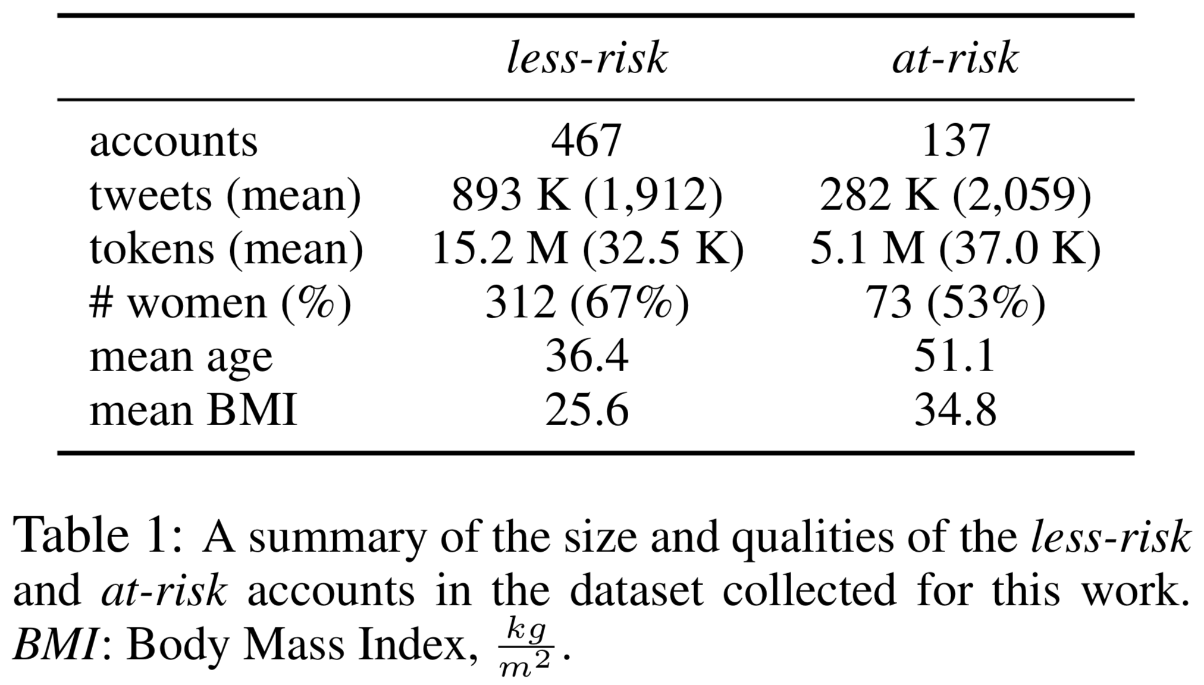
Data

Slide 41
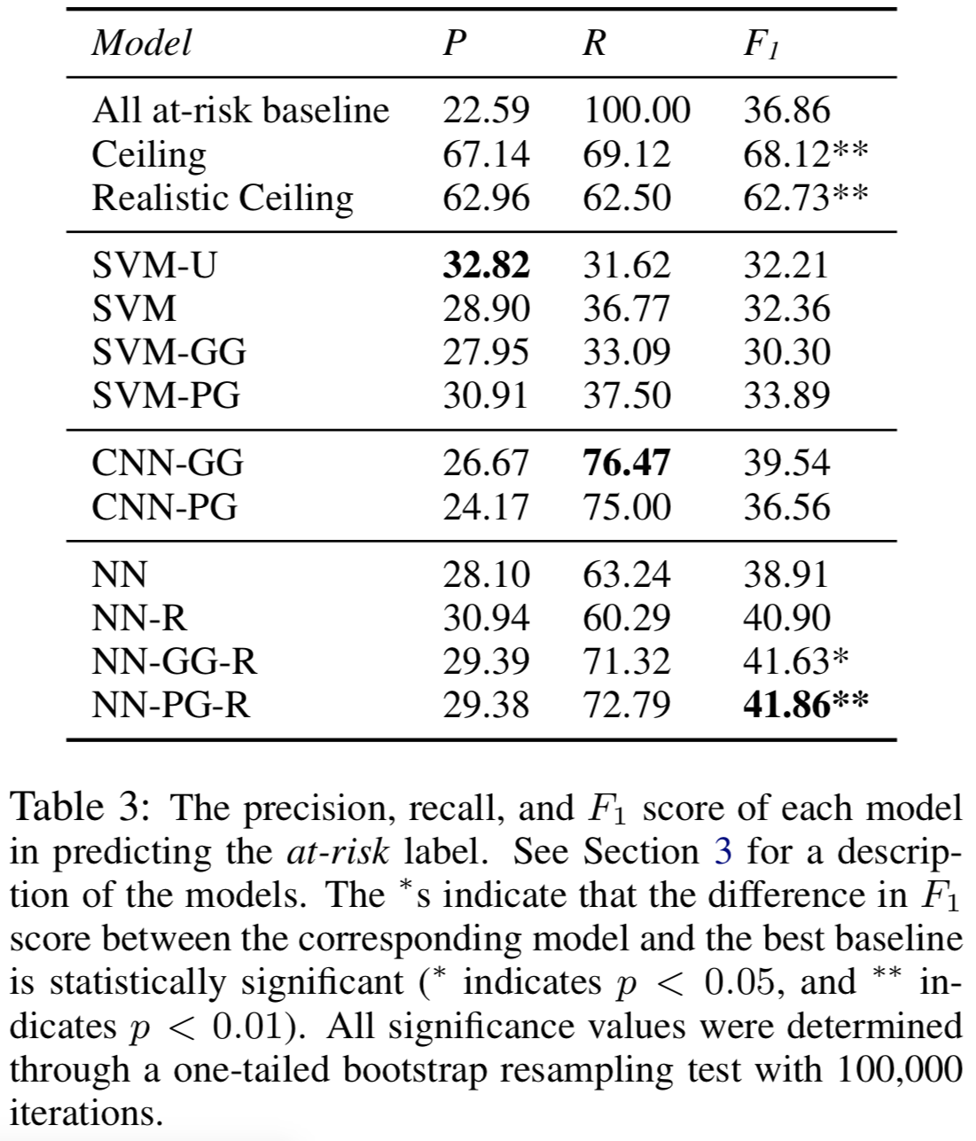
Results

Slide 42
Results
Baselines do not outperform All at-risk

Slide 43
Results
“The unreasonable effectiveness of bag-of-words approaches”

Slide 44
Results
Gender and recency information help!

Slide 45
Results
Very hard task!

